Slide 1
Clearing The Air Zero Emission Vehicle Draft Regional Action Plan (for Medium- and Heavy-duty Fleets)
Joseph Jakuta, Branch Chief, Air Quality Planning
March 15, 2022

Slide 2
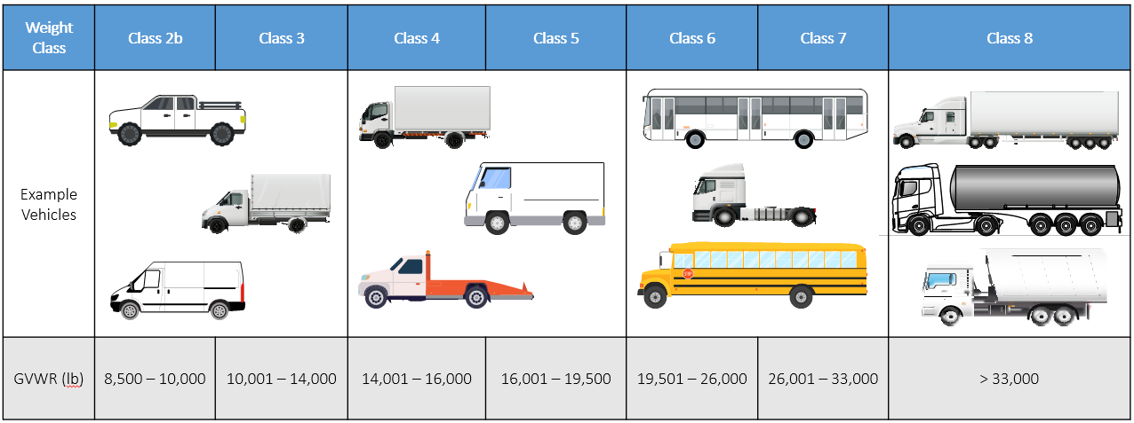
What is an MHD?
Types of Vehicles that are Medium or Heavy Duty

Slide 3
Emissions of MHDs in the District

Slide 4
MHD ZEV MOU
Medium-Heavy Duty Zero Emission Vehicle Memorandum of Understanding (MHD ZEV MOU)
Currently signed by the District, 15 states, and Quebec
Agrees to, among other things:
View the full MOU: https://www.nescaum.org/documents/mhdv-zev-mou_12-14-2021.pdf
Fostering a self-sustaining market for zero emission MHD ZEVs
Developing an action plan
Focusing on disadvantaged communities
Having measurable targets
Approaching public fleets and fueling stations
Coordinating between states
Collaborating with key stakeholders

Slide 5
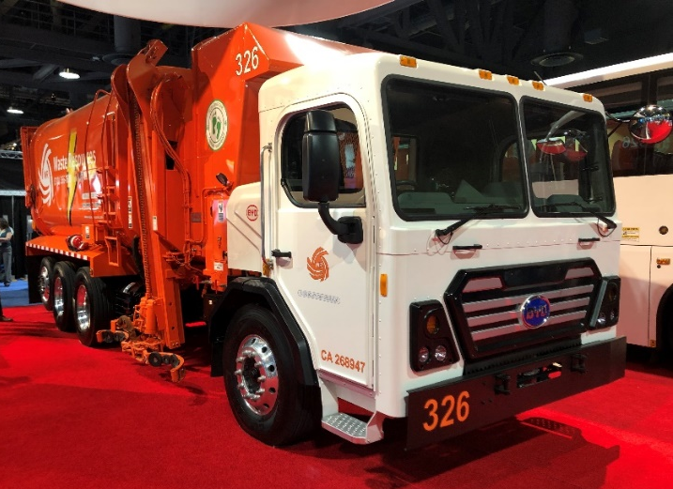
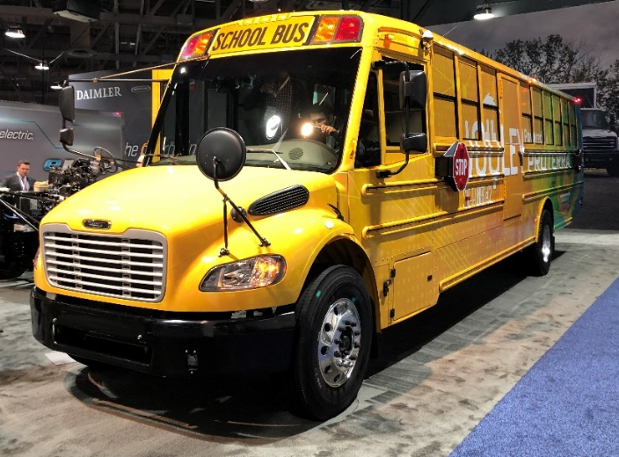
MHD ZEV Action Plan
Draft action plan was released on March 9, 2022
Draft Action Plan Available Here: https://www.nescaum.org/documents/mhd-zev-action-plan-public-draft-03-10-2022.pdf
Action Plan process managed by the Northeast States for Coordinated Air Use Management (NESCAUM)

Slide 6
MHD ZEV Stakeholder Process
Truck and Bus Manufacturers
Labor Advocates
Trucking Industry and Technology Experts
Public & Private Sector Fleet Representatives
Commercial Financing Experts
Utilities
Environmental Advocates
Community Advocates
Charging/Fueling Providers

Slide 7
MHD ZEV Equity Considerations
Just and Equitable Process
Have a robust framework for community engagement and implement it
Rely on numerous relevant data points to identify overburdened communities
Build knowledge and capacity within communities to advocate for zero-emission technology and effectively influence clean transportation policy
Establish or utilize existing equity advisory bodies to ensure the integration of equity considerations in clean transportation policymaking processes
Just and Equitable Outcomes
Prioritize and operationalize equity in all aspects of policymaking
Prioritize delivery of direct benefits to frontline and overburdened communities
Consider the goals and strategies outlined in climate justice planning documents developed by the environmental justice community

Slide 8
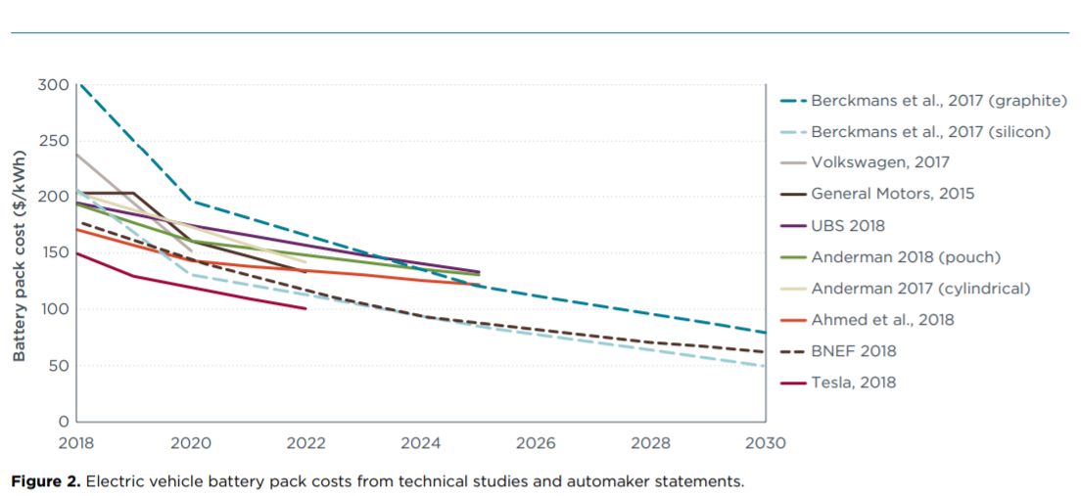
MHD ZEV Technology
Transit Buses
Delivery Vehicles
School Buses
Long-haul Trucks
Vehicle Types by Current Technology
Short-haul Drayage
Battery Prices are Declining and Expected to Continue
Update on EV Costs in the United States Through 2030 (ICCT Apr. 2019)

Slide 9
MHD ZEV Challenges
Higher Upfront Costs of Zero-Emission MHD Vehicles
Barriers for Small Fleets
The Need for Fleet Outreach and Education Programs
Critical Need to Deploy Charging Infrastructure
Production Issues
Electricity Rates
Lack of Financing Options
Different Charging Standards
Lithium-ion Battery Production and Recycling
Photo by Washington State DOT: https://flic.kr/p/6kWwBZ

Slide 10
MHD ZEV Recommendations
Sales and Fleet Purchase Requirements
Zero-Emission Vehicle and Infrastructure Purchase Incentives
Work With and Regulate Utilities
Mobilize Private Capital to Finance Fleet Conversions
Conduct Outreach and Education
Ensure Economic Equity for Workers
Conduct Community Air Monitoring
Plan for Public Charging and Hydrogen Fueling Infrastructure
Continue Multi-State Research and Policy Evaluation

Slide 11
MHD ZEV Action Plan Schedule
Date | Action
March 8, 2022 | Draft Action Plan Public Release
April 21, 2022 | End of Public Comment
May 6, 2022 | States Review Draft with Public Comment
May 20, 2022 | Final State Review Period
May 30, 2022 | Action Plan Released
Please submit all comments directly to NESCAUM at:
https://www.nescaum.org/files/mhd-zev-input.php

Slide 12
Comments/Questions
Joseph Jakuta – joseph.jakuta@dc.gov

