Slide 1
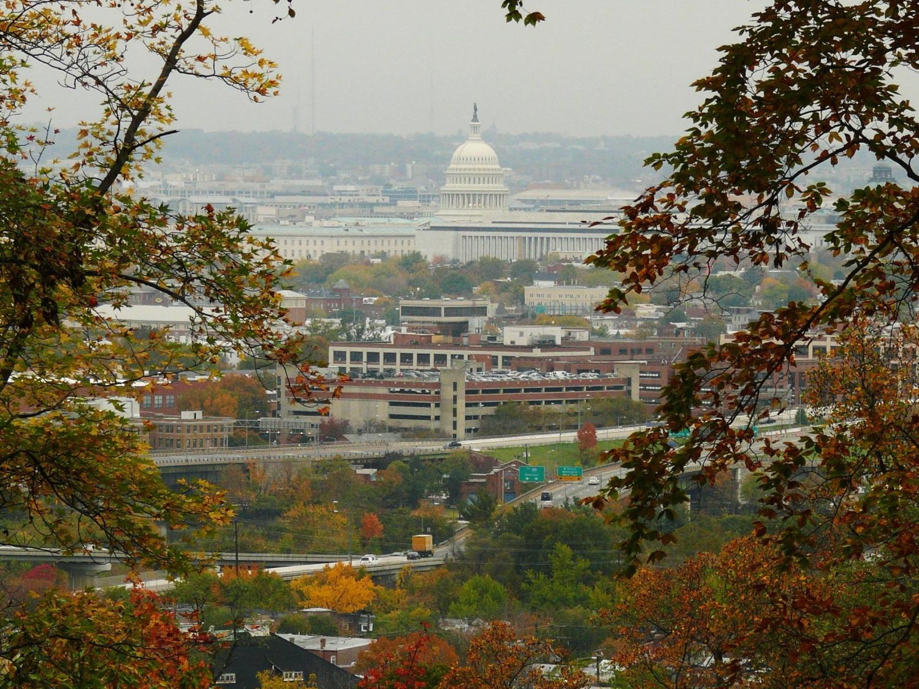
Updating the District’s Wildlife Action Plan in 2015
Fisheries & Wildlife Division
Department of Energy & Environment
Government of the District of Columbia

Slide 2
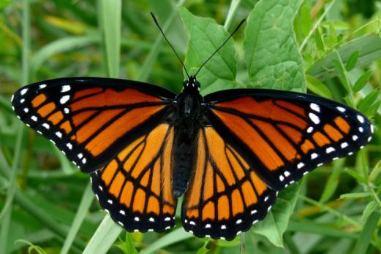
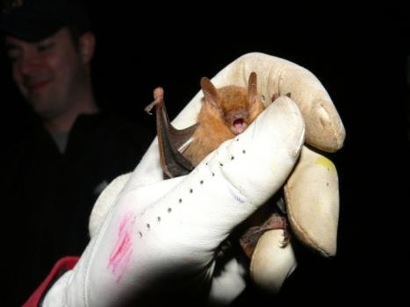
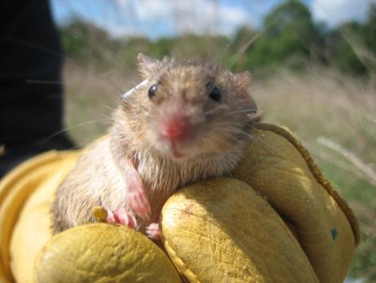
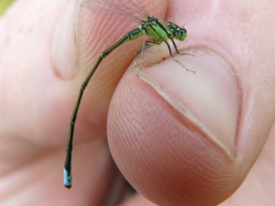
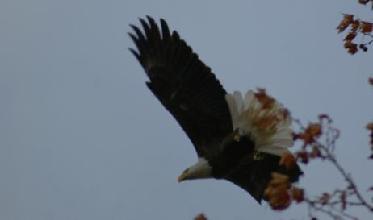
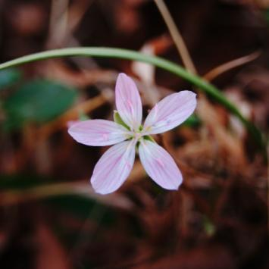
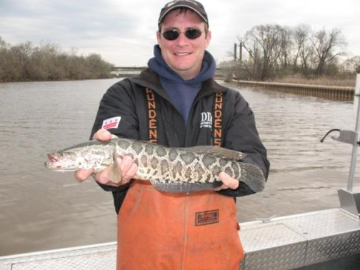
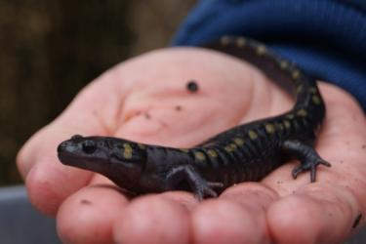
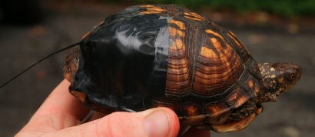
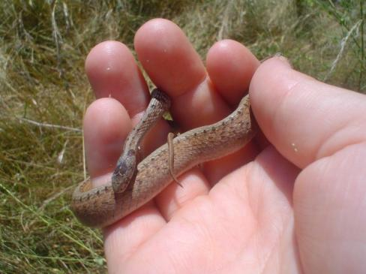
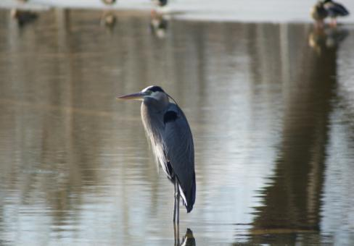
Examples of current monitoring projects and animals found in the District
Notes:
Operate under wildlife action plan
Designates “Species of Conservation Need”
Lists important wildlife habitat
Delineates threats to wildlife and their habitats
Specifies actions take to minimized threats.
Required to receive federal funding for non-game wildlife

Slide 3
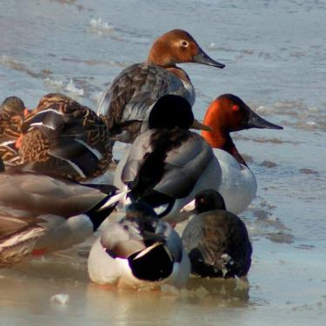
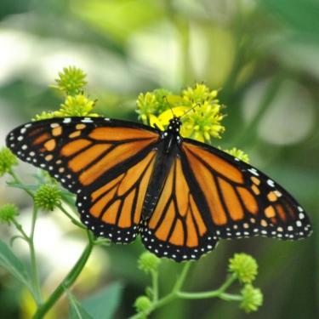
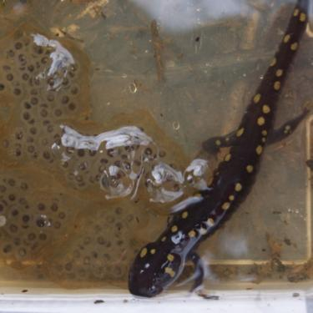
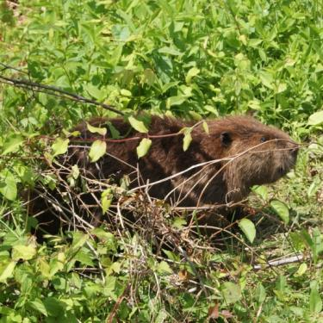
Main Elements of the Wildlife Action Plan
A list of rare or declining animal species
The location and condition of habitats
Threats to wildlife and their habitats
Conservation actions
Effectiveness monitoring
Government and stakeholder input
Public outreach and input
Notes:
Distribution and abundance of rare/declining animal species
Location and condition of habitats
Threats to wildlife and their habitats
Conservation actions (with prioritization)
Monitoring the effectiveness of actions
Periodic plan review
Stakeholder input
Public input

Slide 4
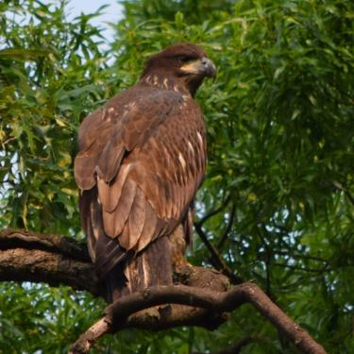
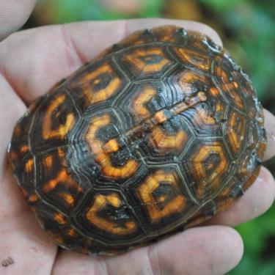
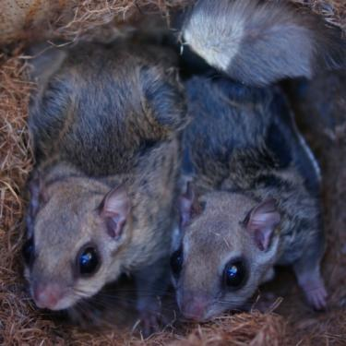
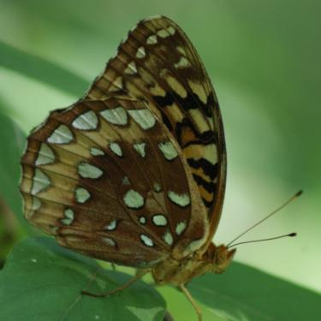
Rare Animal Species
“Species of Greatest Conservation Need” (SGCN)
Threatened by numerous issues
Face unique threats -> urban area
Most land-based habitat is protected as National Park
Long record of natural history in DC

Slide 5
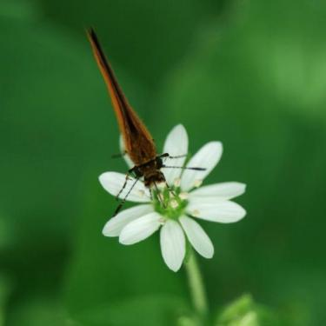
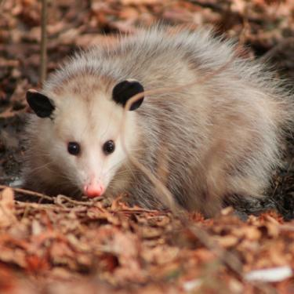
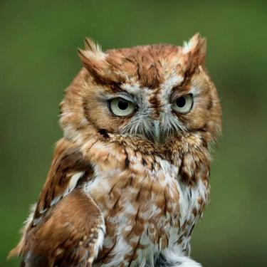
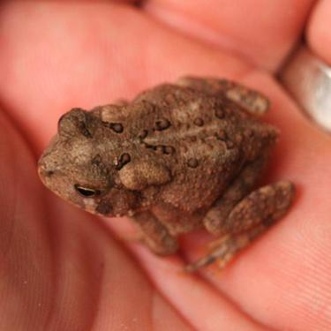
Rare Animal Species – Listing as SGCN
203 SGCN
Based on recent data
Quantitative analysis
Populations, life history, ecological variables
Distribution and trend in the District
Habitat specialization
External impacts (e.g. emerging diseases)
Added whole groups (bees, crayfish, snails)
Notes:
SWAP 2005
147 SGCN
Based on expert opinion and historical data
Quantitaive ranking process
Population variarbles (national and local) size – Estimated number of adults throughout North America
Population trend – Overall trend throughout the taxon’s range over the last two decades
Range size – The area over which a species is distributed when most restricted
Distribution trend – Percent change (since European settlement) in the range occupied by the taxon
Population concentration –Degree to which populations congregate at specific locations
Reproductive potential for recovery – Ability of a species to recover from serious population declines
Ecological specialization – Degree to which the species is dependent upon environmental factors
Action Variables for the District
Distribution in the District
Population trend in the District
District population limits
Ongoing management activities in the District
Supplemental Variables
Population trend and/or Percent of Occupied Area (POA) of taxon in the District
Last documented
Range size/concentration throughout the District/POA
Impacted by known emerging disease
Habitat specialization within the District

Slide 6
SGCN 2005 versus SGCN 2015
Taxa | SGCN 2005 | SGCN 2015 | Removed | Added
Birds | 35 | 58 | 4 | 27
Mammals | 11 | 21 | 2 | 12
Reptiles | 23 | 17 | 6 | 0
Amphibians | 16 | 18 | 2 | 4
Fish | 12 | 12 | 4 | 4
Dragonflies & Damselflies | 9 | 26 | 2 | 19
Butterflies | 13 | 10 | 6 | 3
Bees | 0 | 4 | N/A | 4
Mollusks | 9 | 13 | 0 | 4
Crustaceans | 19 | 22 | 6 | 9
Sponges | 0 | 2 | N/A | 2
Total | 147 | 203 | 32 | 89
Notes:
Reasons for removal:
Species is secure based on recent data
Species has been extirpated long-term
No records of species ever existing in the District
Reasons for addition:
Recent local or regional data suggests declining populations
New data is available for species was not assessed in 2005
New taxa are being added

Slide 7
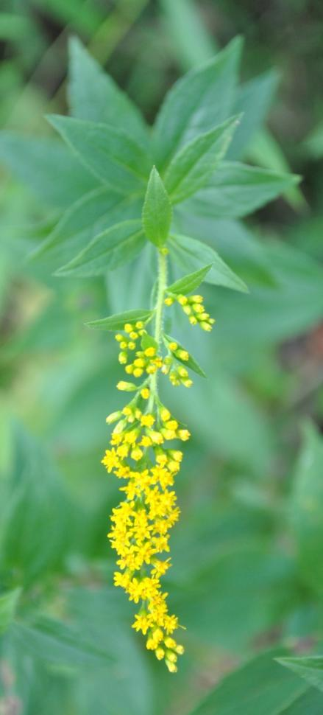
Rare Animal Species – Prioritization
Tier 1: Direct Management
Habitat can be improved with management or other conservation efforts
High probability of successful improvement of habitat and species population
Tier 2: Inventory
Recent observations exist, but the species is rarely recorded in formal surveys
Lower probability of successful improvement of habitat and species population
Tier 3: Historical Species
Reliable historical documentation, but there were no recent observations in the District
Notes:
Tier 1: Direct Management
Species observed in more than one location and/or in a variety of habitats
Habitat can be improved with management or other conservation efforts
Conservation efforts are economically feasible
High probability of successful improvement of habitat and species population
Tier 2: Inventory
Recent observations exist, but the species is rarely recorded in formal surveys
Habitat may be improved with management or other conservation efforts
Conservation efforts are not as economically feasible
Lower probability of successful improvement of habitat and species population
Tier 3: Historical Species
Reliable historical documentation, but there were no recent observations in the District
Habitat requirements may be lacking or nonexistent
Minimal probability of observation; species are listed mainly due to a case of incidental observation so that conservation actions can be applied if observed

Slide 8
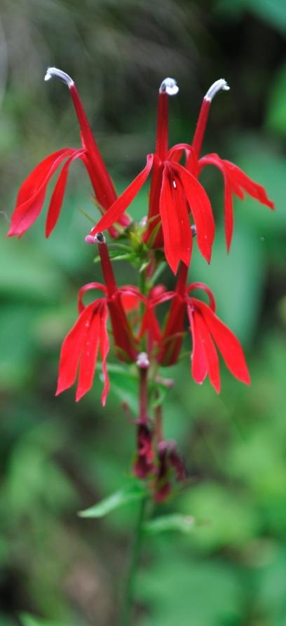
Habitats – Categorization
Vegetative habitats
forests, wetlands, grasslands and shrublands
Aquatic habitats
rivers, streams, ponds, vernal pools, springs
Developed areas
commercial, residential, ball fields, golf courses
Notes:
Classified and mapped habitats using data from DDOE, DCGIS, NPS

Slide 9
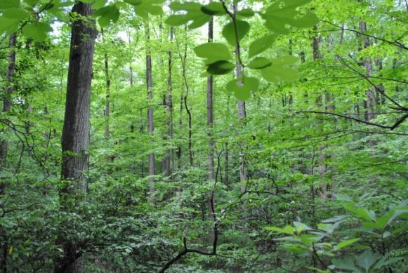
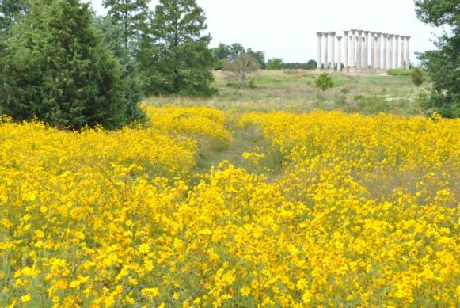
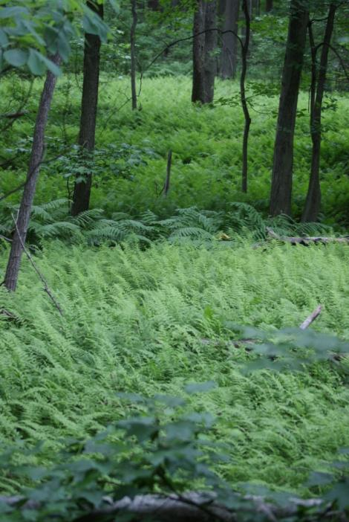
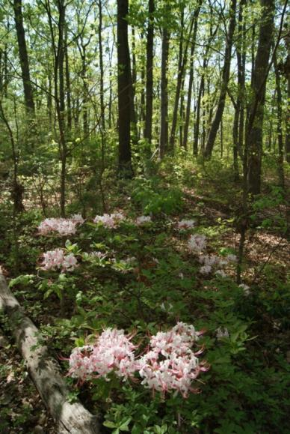
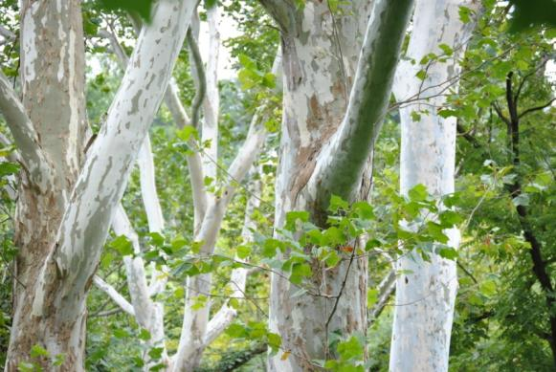
Ft. DuPont Park; Mesic Hardwood Forest
National Arboretum; Meadow
Potomac River Floodplain Forest
Ft. Chaplin Park; Oak-Pine Forest
Oxon Run Park; Hardwood Swamp
Notes:
Vegetative habitats

Slide 10
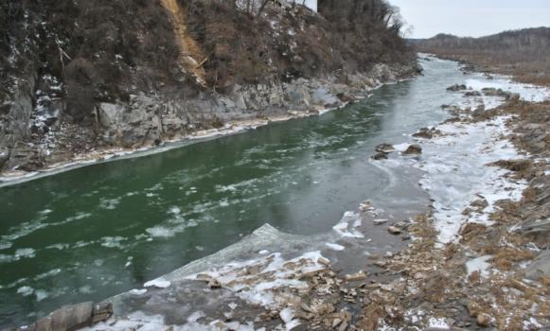
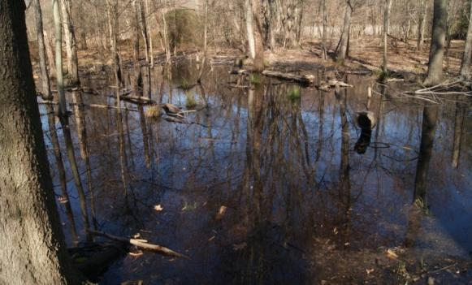
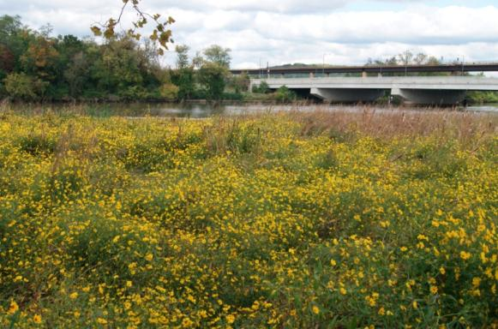
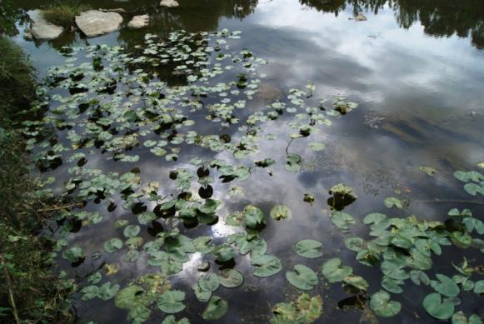
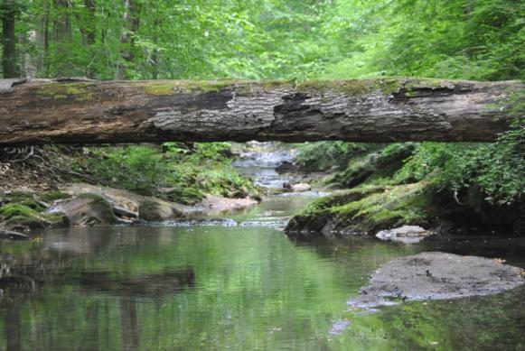
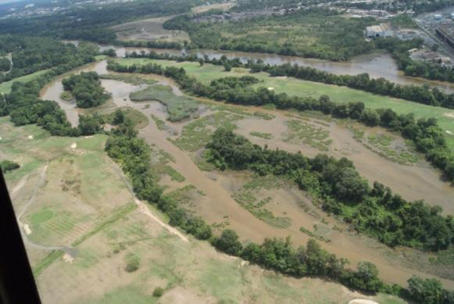
Potomac River
Vernal Pool
Freshwater Tidal Wetland
Freshwater Pond
Stream
Tidal Mudflats
Notes:
Aquatic habitats

Slide 11
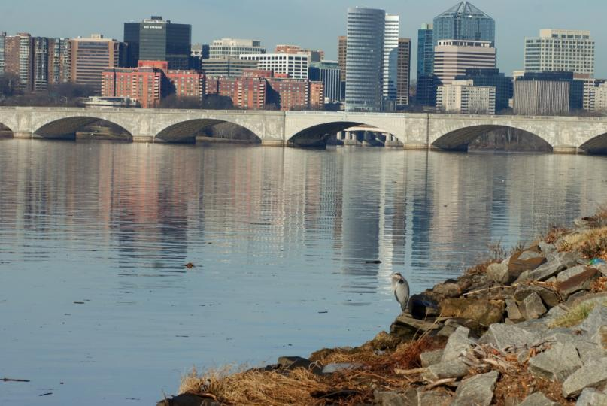
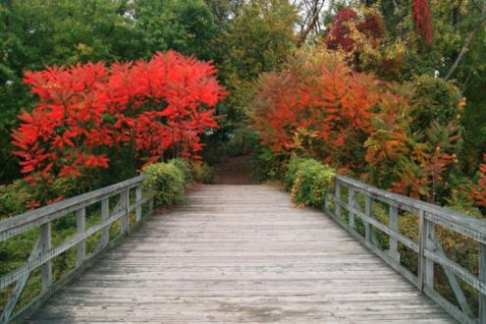
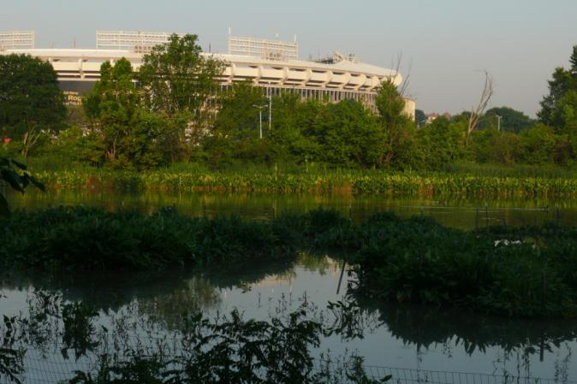
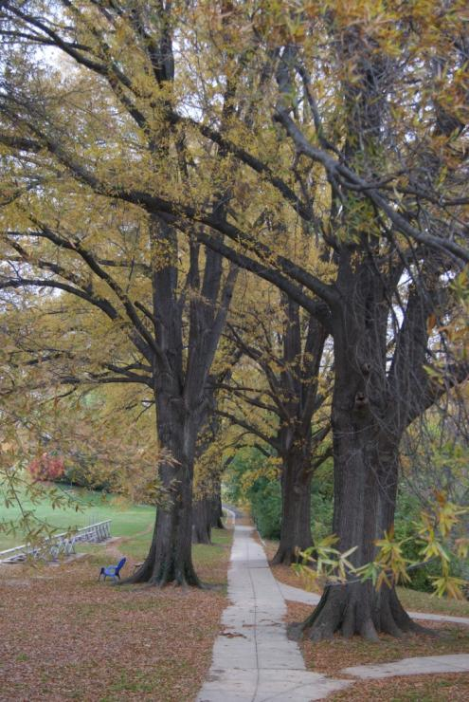
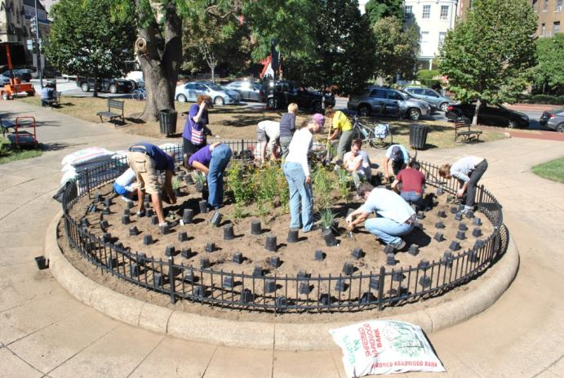
Habitats in developed areas
Notes:
Developed habitats

Slide 12
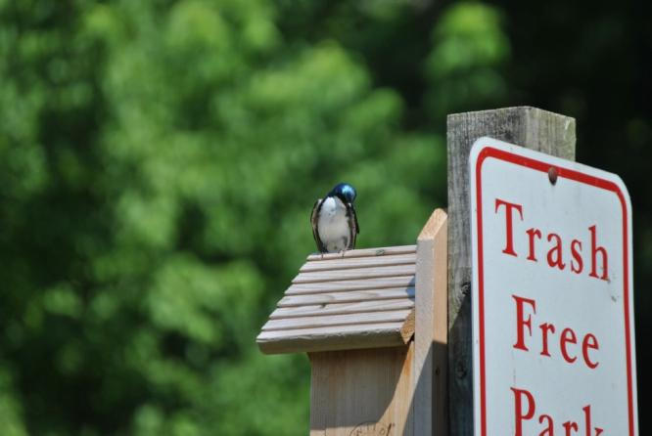
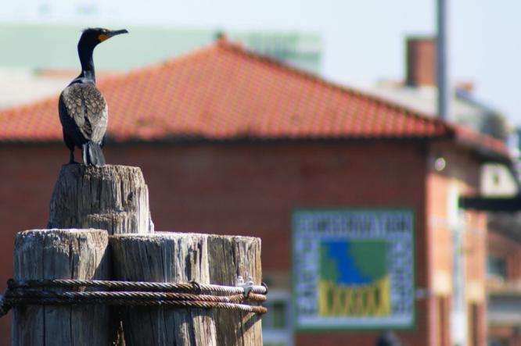
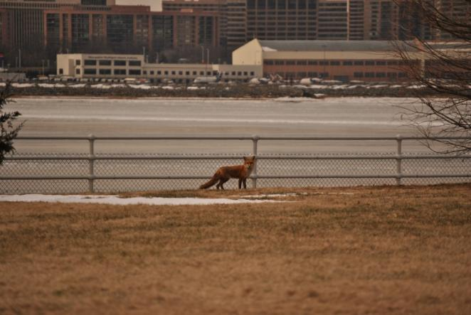
Wildlife using built structures in developed areas
Notes:
Developed habitats

Slide 13
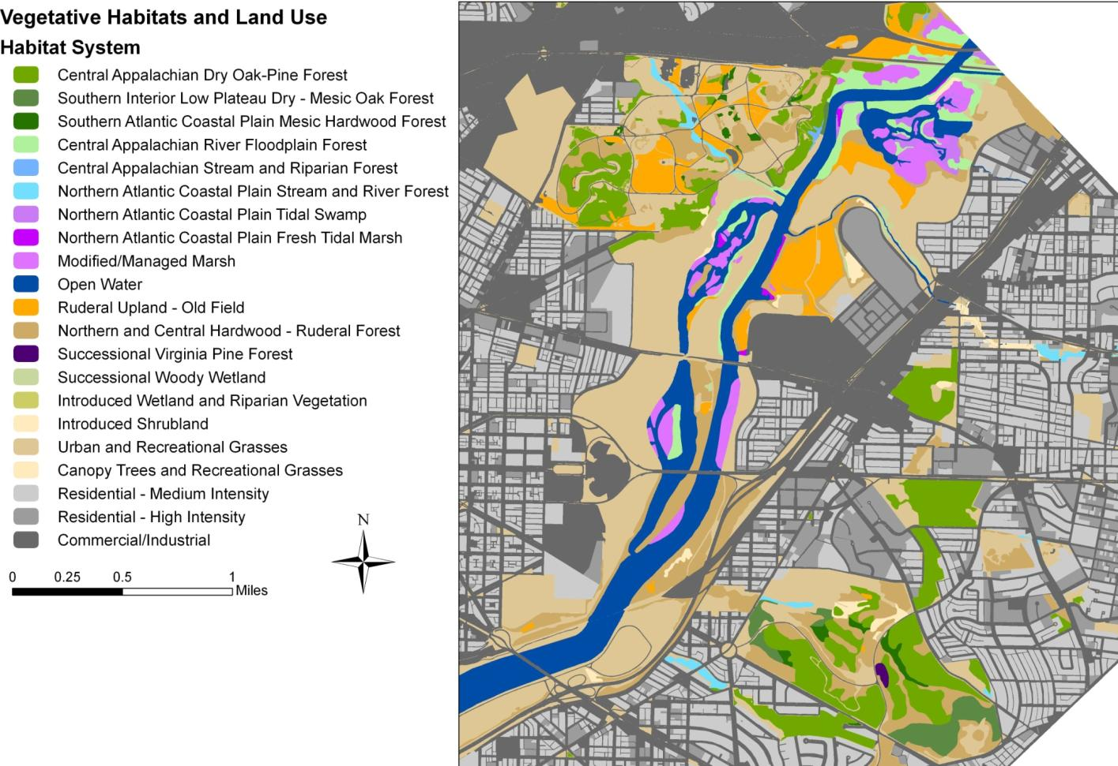
Vegetative Habitats of the Upper Anacostia River

Slide 14
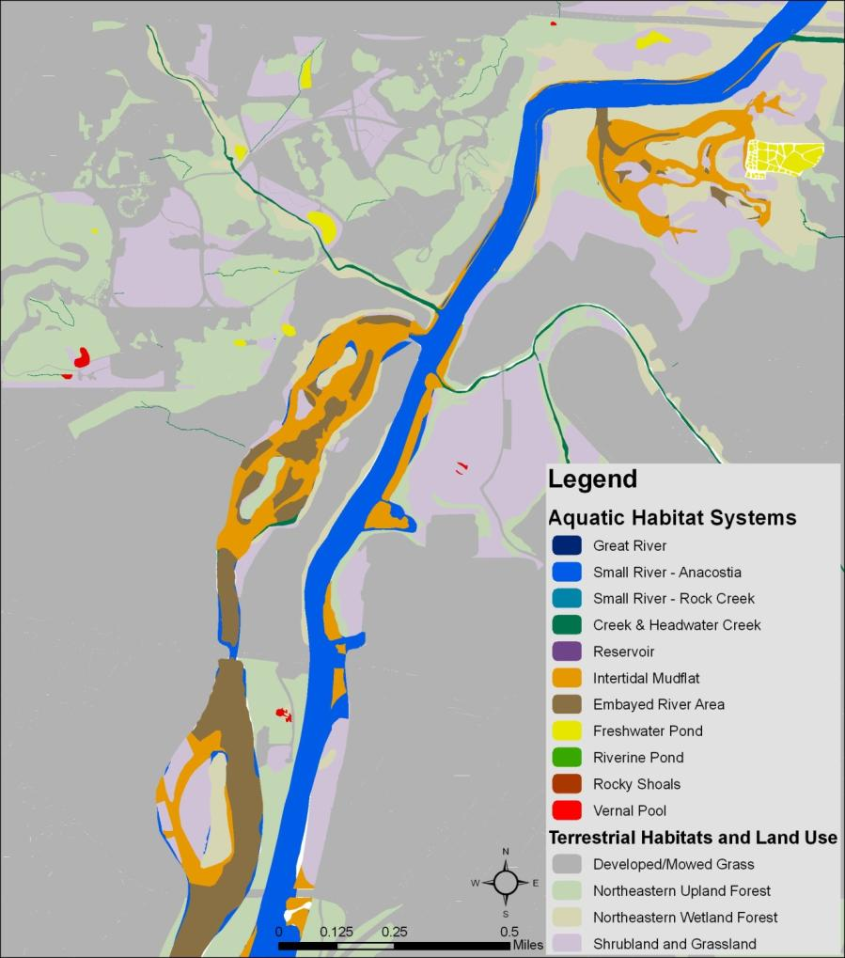
Aquatic Habitats of the Upper Anacostia River

Slide 15
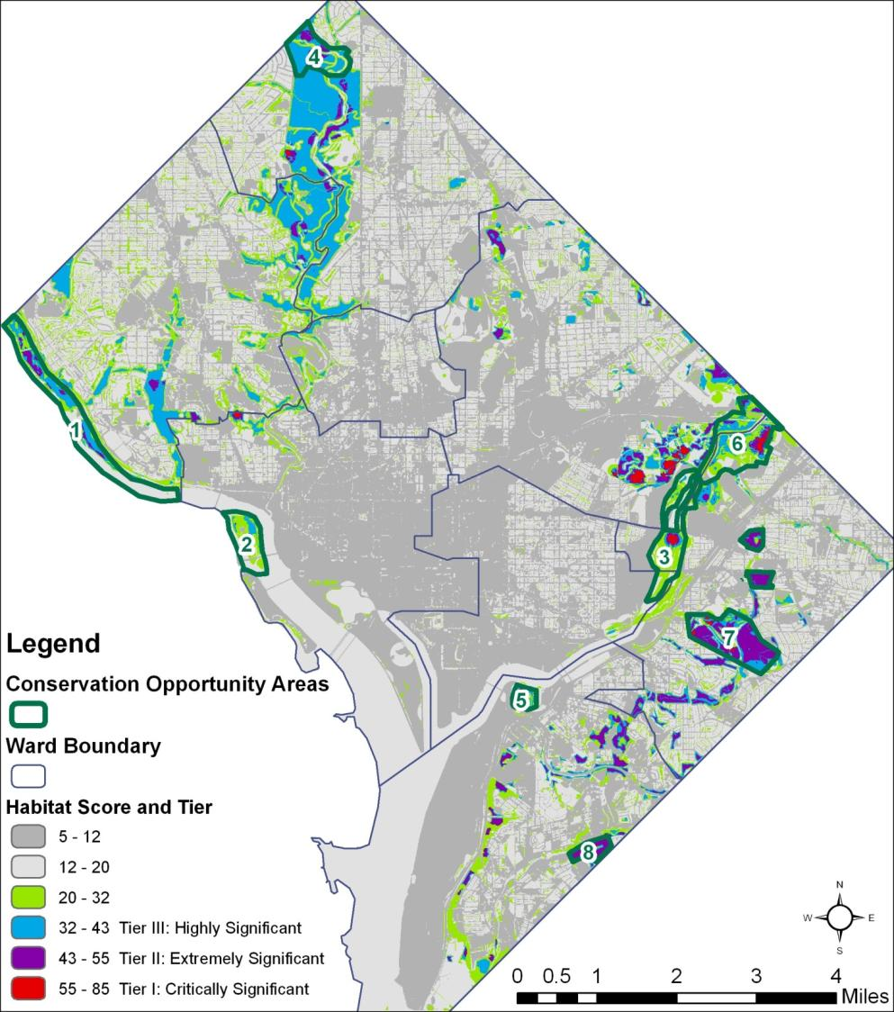
Habitat Condition
Analysis
Used 6 data layers in a GIS
Species richness
Abundance normalized by effort
Core habitat/impacts of invasive plants
Soil type/quality
Deer browse index
Tree canopy cover
Notes:
Species richness
Species abundance
Core habitat/impacts of invasive plants
Soil type
Deer browse index
Tree canopy cover

Slide 16
IUCN Hierarchy of Conservation Threats 2015
IUCN Level 1 | IUCN Level 2 | IUCN Level 3
Residential and Commercial Development | Housing and Urban Areas | Any type of development
 | Commercial and Industrial Areas
 | Tourism and Recreational Areas
Transportation and Service Corridors | Roads and Railroads | Road and railroad contruction
 | Utility and Service Lines | Utility line
Biological Resource Use | Hunting and Collecting Terrestrial Animals | Intentional Use
 |  | Unintentional effects
 | Fishing and Harvesting of Aquatic Resources | Intentional Use (subsistence/small scale)
 |  | Intentional Use (large scale)
Human Intrusions and Disturbance | Recreational Activities | Direct impacts of human use of habitats
 | Work and Other Activities
Natural Systems Modifications | Dams and Water Management/Use | Abstraction of Surface Water (domestic use)
 |  | Small dams, fish passage blockages
 | Other Ecosystem Modifications | Fire, mowing or other alteration
Invasive and Other Problematic Species, Genes and Diseases | Invasive Non-native/Alien Species/Diseases | Named or Unspecified Species
 | Problematic Native Species/Diseases
 | Problematic Species/Diseases of Unknown Origin
 | Viral/Prion-induced Diseases | Named or Unspecified Disease
Pollution | Domestic and Urban Waste Water | Sewage, Runoff
 | Industrial and Military Effluents | Oil Spills
 | Agricultural and Forestry Effluents | Herbicides and Pesticides
 | Garbage and Solid Waste | type, source, specific pollutants of concern
 | Excess Energy | Light, Heat, and Noise Pollution
Climate Change and Severe Weather | Habitat Shifting or Alteration | Variety of specific threats
 | Droughts
 | Temperature Extremes
 | Storms and Flooding
 | Sea Level Rise

Slide 17
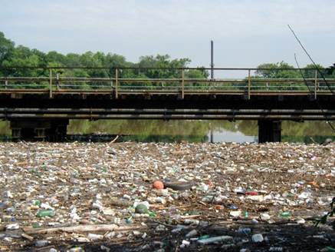
Prioritization of Threats to Vegetative and Aquatic Habitats
The Top Six Threats
Invasive species
Urban wastewater
Nutrification/ sedimentation
Problematic native species
Ecosystem modifications
Recreational activities/development of recreational areas
Notes:
The District has identified twenty-two Level II threats (Salafsky et al, 2008) that are affecting critical habitats or will likely impact habitats in the near future.
1. Invasive species (plants, insects, pathogens, and fish);
2. Urban wastewater;
3. Nutrification/sedimentation;
4. Problematic native species;
5. Ecosystem modifications (aquatic habitats); and
6. Recreational activities/development of recreational areas (vegetative habitats).

Slide 18
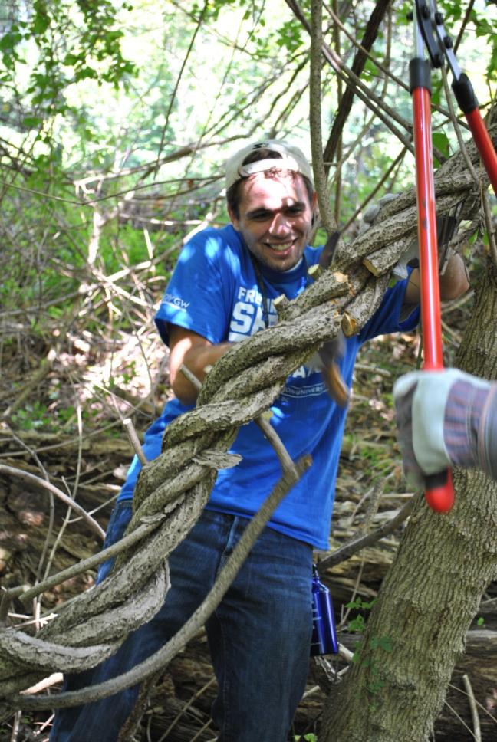
Overarching Actions - Habitats
These address the top threats:
1. Invasive species management
2. Urban wastewater/CSO abatement
3. Stream restoration; stormwater management infrastructure
4. Deer and goose management; forest and wetland restoration
5. Restore hydrology to vernal pools and bogs; restore fish passage; restore channelized streams
6. Include wildlife impacts in trails planning; close unofficial trails; enforce leash laws
Notes:
Overarching Actions – Habitats
Invasive species management
2. Urban wastewater/CSO abatement
3. Stream restoration; stormwater management infrastructure
4. Deer and goose management; forest and wetland restoration
5. Restore hydrology to vernal pools and bogs; restore fish passage; restore channelized streams
6. Include wildlife impacts in trails planning; close unofficial trails; enforce leash laws
Non-habitat based actions
Invasive predators
Diseases and Pathogens
Light Pollution
Noise Pollution
Endocrine Disruption
Collisions with Glass and Buildings

Slide 19
Focal Conservation Actions
Broad-scale conservation actions that can apply to many habitat types or that may be extensions of or additions to other actions.
Meadow Restoration
Tidal Wetland Restoration
Native Plant Propagation
Vernal Pool Creation
Artificial Nesting Structures and Opportunities
Citizen Science Programs
Wildlife Corridors
Notes:
Focal Conservation Actions are broad-scale conservation actions that can apply to many habitat types or that may be extensions of or additions to other actions.

Slide 20
Tidal Wetland Restoration
Blue circles indicate potential sites in locations where wetlands may have existed historically

Slide 21
Meadow Restoration
Potential locations where meadows can be created in areas that are currently mowed grass.

Slide 22
Native Plant Propagation
Native Plant Propagation
Artificial Nesting Structures
Artificial Nesting Structures

Slide 23
Please read the entire Wildlife Action Plan 2015 at doee.dc.gov/swap
Send comments to swap.comments@dc.gov
All of the photographs in this document are pictures of animals observed in the District of Columbia. These photos were taken by Fish & Wildlife Biologists while conducing inventory and monitoring projects throughout the District.

