Slide 1
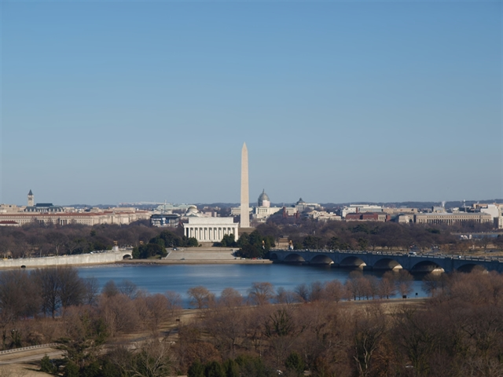
AIR QUALITY REQUIREMENTS 101
Air, Energy, and Waste
101 for Engineers and
Contractors

Slide 2
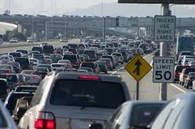
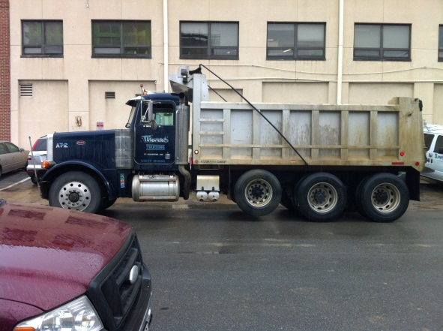
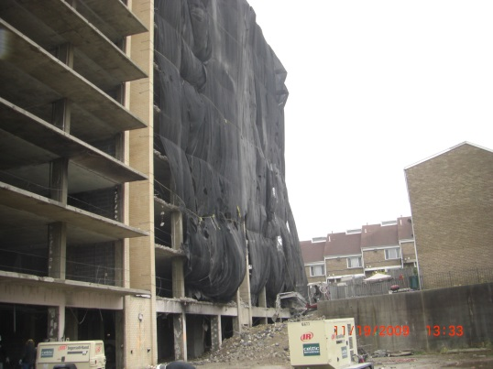
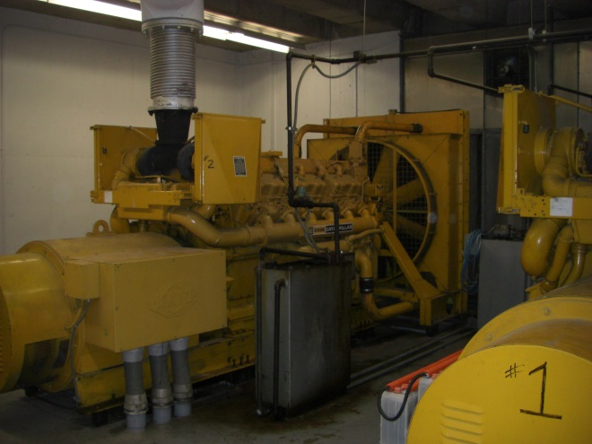
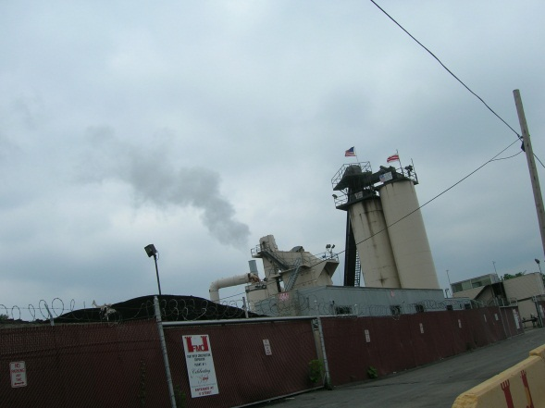
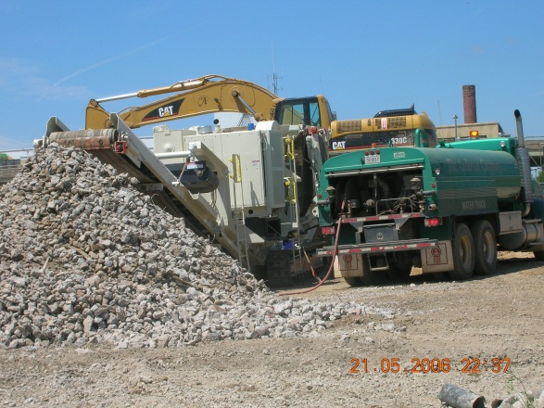
Common Sources of Air Pollution in the District

Slide 3
Air Quality Permitting – Basic Requirement
If you plan to install equipment that would emit air pollution, you need to apply for and obtain an air quality permit before you begin construction/installation of the equipment.
Examples:
Boilers (>5MMBTU/hr heat input)
Cogeneration Equipment
Generators
Paint Booths
Anything else that will emit air pollution

Slide 4
Who applies?
Permits are issued to owners or operators of equipment who must subsequently maintain a permit to operate.
Frequently the owners or operators ask construction companies, equipment suppliers/installers, developers, etc. to do the legwork for getting a permit as part of their construction duties.
The owner or operator needs to sign the permit application.

Slide 5
What kind of permit do I need?
Source Category Permits (aka general permits) – fastest and easiest, but for limited categories of permits.
Standard Chapter 2 Permits
Nonattainment New Source Review (NSR)
Minor New Source Review (MNSR)
Title V (major source)
See http://doee.dc.gov/service/apply-air-pollutant-permit

Slide 6
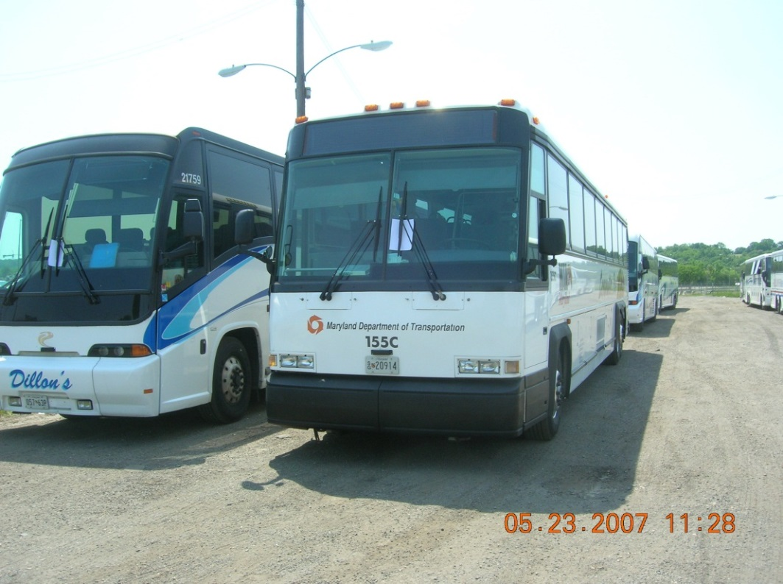
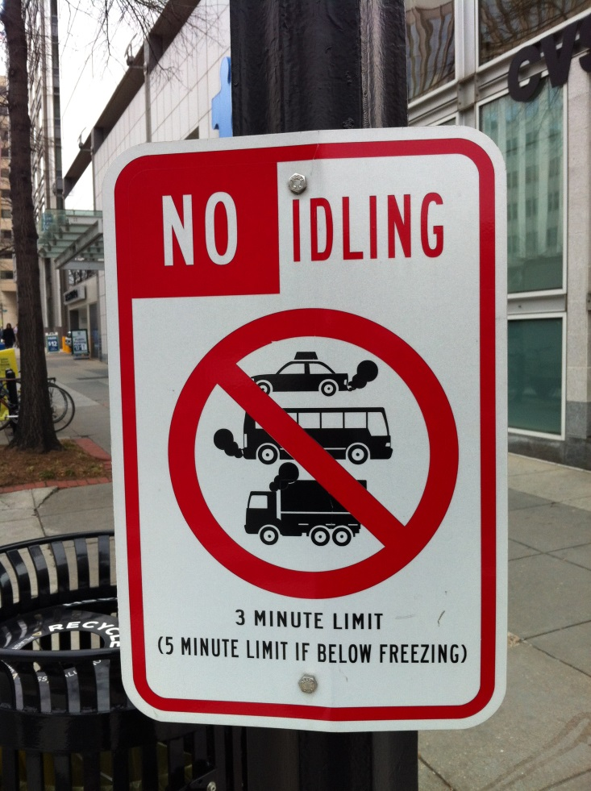
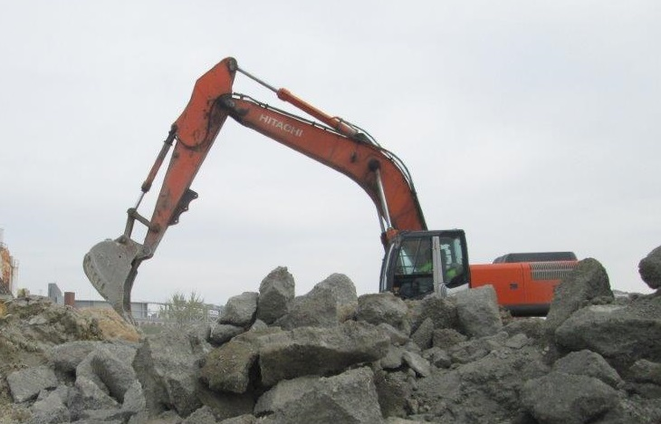
Engine Idling Program

Slide 7
Onroad Engine Idling
Idling of onroad gasoline or diesel-powered motor vehicles on public or private space for more than 3 minutes is prohibited while the vehicle is parked, stopped, or standing, including for the purpose of operating air conditioning or heating equipment
Exceptions:
Non-commercial private passenger vehicles.
Idling to operate power take-off equipment such as dumping beds, cement mixers, refrigeration systems, content delivery, winches, or shredders.
Idling up to 5 minutes when the temperature is at or below freezing (32ºF).
Private use, not for compensation.

Slide 8
Nonroad Engine Idling
Idling of Nonroad diesel-powered engines for more than 3 minutes is prohibited.
Exceptions:
Idling for up to 15 minutes when queueing (i.e. intermittently moving forward to perform work).
Idling for safety, servicing, inspection, or emergency purposes.
Idling up to 5 minutes to operate heating equipment when the temperature is at or below freezing (32ºF).

Slide 9
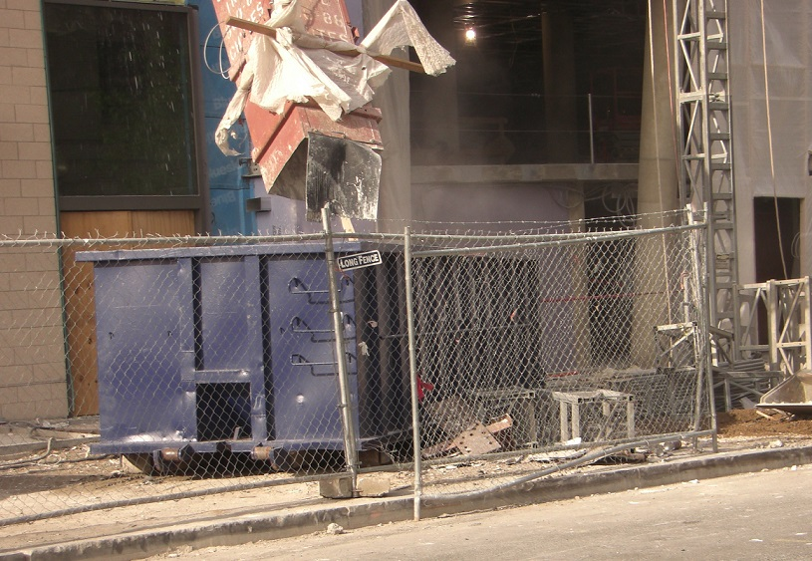
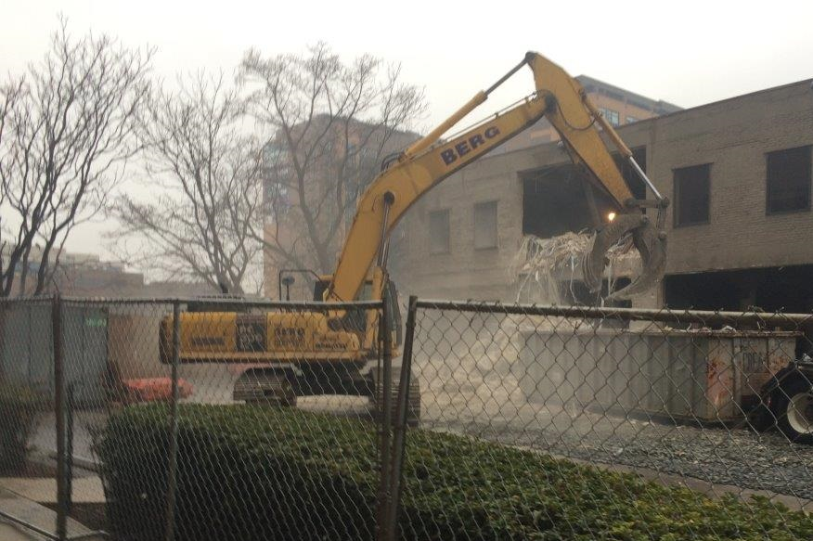
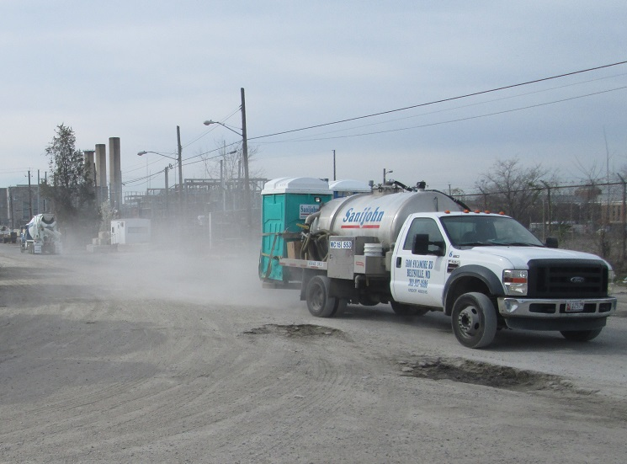
Fugitive Dust

Slide 10
Fugitive Dust
Reasonable precautions shall be taken to minimize the emission of any fugitive dust into the outdoor atmosphere.
The emission of fugitive dust from the following is prohibited:
Any material handling, screening, crushing, grinding, conveying, mixing, or other industrial-type operation or process;
Heater-planers in repairing asphaltic concrete pavements;
Portable tar-melters, unless close-fitting lids, in good repair, for the tar-pots are available and are used;
The ventilation of any tunnelling operation; or
The cleaning of exposed surfaces through the use of compressed gases.

Slide 11
Odor
An emission into the atmosphere of odorous or other air pollutants from any source in any quantity and of any characteristic, and duration which is, or is likely to be injurious to the public health or welfare, or which interferes with the reasonable enjoyment of life and property is prohibited.

Slide 12
Contact Information
Stephen S. Ours, P.E.
Chief, Permitting Branch
Air Quality Division
Department of Energy and Environment
(202) 535-1747
stephen.ours@dc.gov

Slide 13
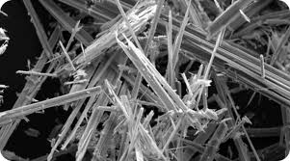
DEPARTMENT OF ENERGY AND ENVIRONMENT
AIR QUALITY DIVISION
COMPLIANCE & ENFORCEMENT
ASBESTOS ABATEMENT PROGRAM
- CECILY BEALL, ASSOCIATE DIRECTOR, AIR QUALITY DIVISION
- MANUEL OLIVA, CHIEF OF COMPLIANCE & ENFORCEMENT
- RALPH KNATT, ENVIRONMENTAL PROTECTION SPECIALIST
- JOANNA VIVANCO, ENVIRONMENTAL PROTECTION SPECIALIST
- KEITH KEEMER, ENVIRONMENTAL PROTECTION SPECIALIST
- JUANITA THOMPSON, COMPLIANCE PROGRAM SPECIALIST

Slide 14
Asbestos Regulations
DOEE - Title 20 DCMR § 800 (Control of Asbestos)
EPA - Title 40 CFR § 61.145 part 61- Subpart M-National Emission Standards For Hazardous Air Pollutants (NESHAP)
OSHA - Title 29 CFR § 1910.134 (Respiratory Protection)
OSHA – Title 29 CFR § 1926.1101 (Asbestos in Construction)

Slide 15
Where is Asbestos Found?
Sprayed-on fire proofing & insulation in buildings
Insulation for pipes and boilers
Wall and ceiling insulation
Ceiling tiles
Floor tiles
Putties, caulks, and cements (e.g. cement pipes used to store and transport chemicals)
Plaster material (acoustical and decorative)
Mastic material (pipe, HVAC, sink)
Construction mastics (floor, tile, carpet, ceiling tile, etc.)

Slide 16
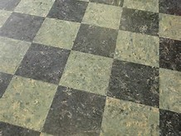
Asbestos Floor Tile

Slide 17
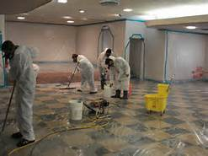
Preparing for Asbestos Abatement

Slide 18
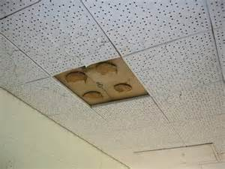
Asbestos Ceiling Tile & Glue Dots

Slide 19
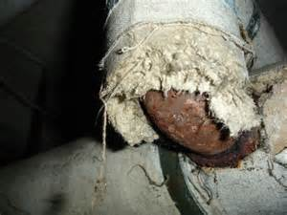
Damaged Asbestos Pipe Insulation

Slide 20
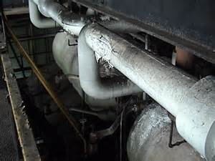
Asbestos Pipe Insulation

Slide 21
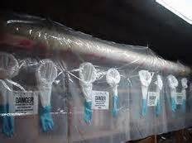
Glove-Bag Preparation

Slide 22
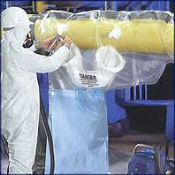
Glove-bag Removal

Slide 23
Spray-on Insulation – Structural Beam

Slide 24
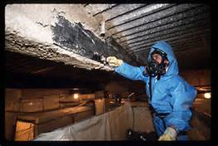
Removal of Spray-on Insulation

Slide 25
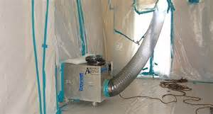
Negative Air Machine w/HEPA

Slide 26
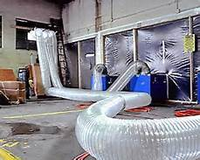
Negative Air Machines - NPE

Slide 27
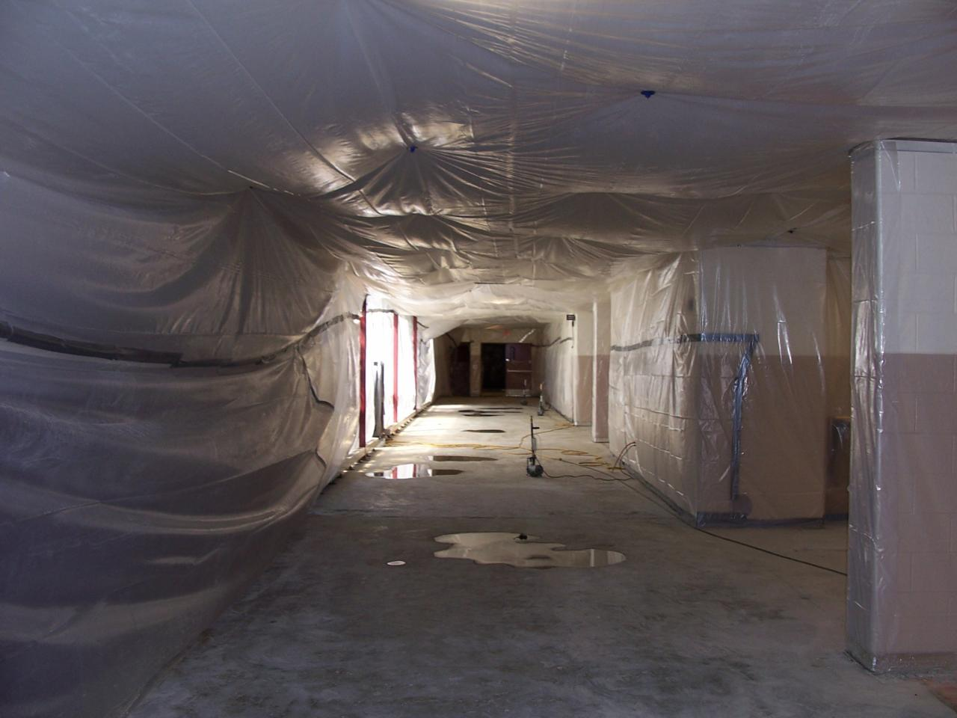
Regulated Area - Full Containment

Slide 28
3-Stage Decontamination Unit

Slide 29
Building/Facility Owner Responsibilities
Environmental (asbestos) survey: determine presence, location, and quantity of asbestos containing material (ACM).
Inform employers, employees, tenants, and others who may be impacted.
Have “suspect” material sampled and tested before starting any renovation or maintenance work.
Permit only certified individuals to perform work that may release asbestos fibers into the air.
Submit “Notification of Demolition and Renovation” to DOEE when projects involve 160 square feet, 260 linear feet or 35 cubic feet of ACM.

Slide 30
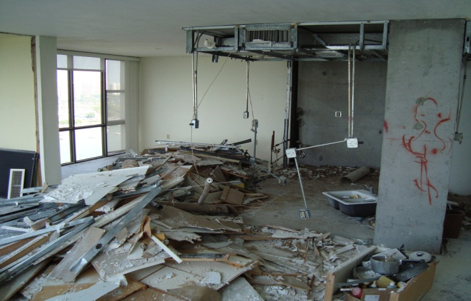
NATIONAL EMISSIONS STANDARD FOR HAZARDOUS AIR POLLUTANTS (NESHAP)
Notification (EPA)
Visible Emissions
What Defines A Facility
Facility Quantity Thresholds
Transport/Disposal

Slide 31
NOTIFICATION PROCESS
Completing the Notification Form (DC)
30 Day Notice to Tenants
Emergency Asbestos Abatement
Revisions
Variances
Determining which projects require a permit
Operations & Maintenance Plan

Slide 32
QUESTIONS?

Slide 33
CONTACT INFORMATION
DEPARTMENT OF ENERGY AND ENVIRONMENT
AIR QUALITY DIVISION
COMPLIANCE & ENFORCEMENT
ASBESTOS ABATEMENT PROGRAM
RALPH KNATT JOANNA VIVANCO JUANITA THOMPSON
ralph.knatt@dc.gov joanna.vivanco@dc.gov juanita.thompson2@dc.gov
202-535-2998 (OFFICE) 202-535-2998 (OFFICE)
202-481-3771 (FAX) 202-481-3771 (FAX)
202-309-5122 (CELL)
202-535-2263 (OFFICE)
202-481-3771 (FAX)

