Slide 1
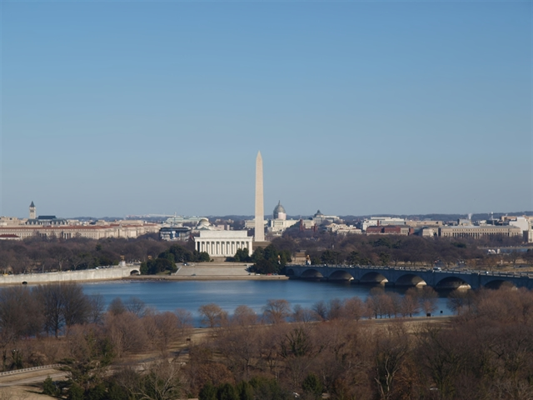
AIR QUALITY REQUIREMENTS 101
Air, Energy, and Waste
101 for Engineers and
Contractors

Slide 2
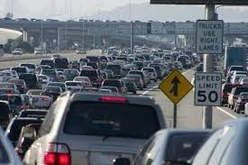
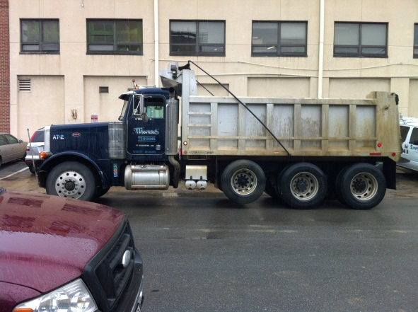
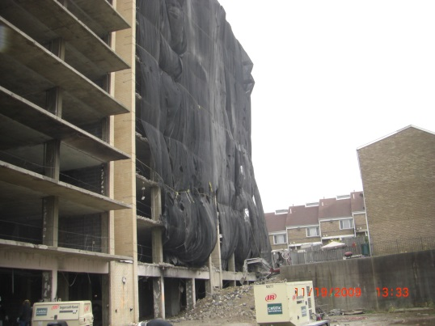
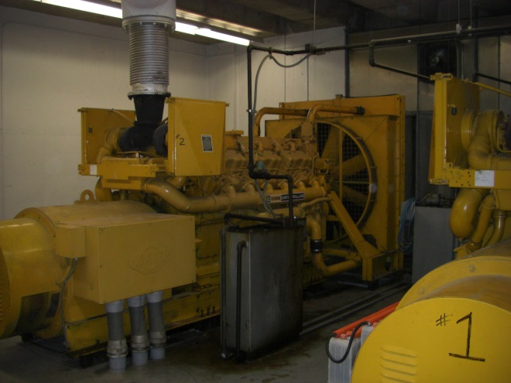
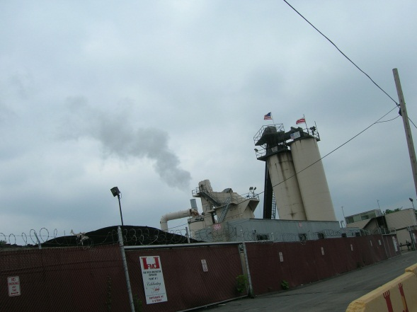
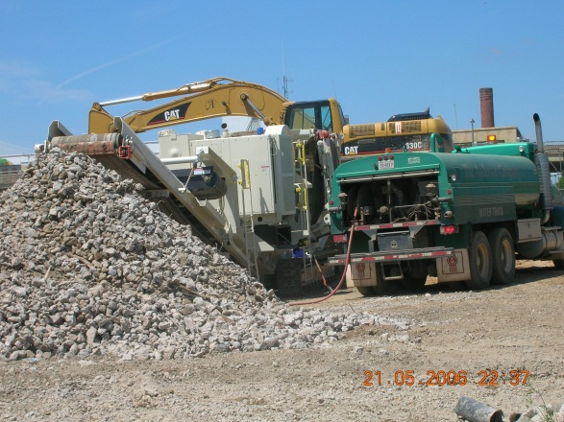
Common Sources of Air Pollution in the District

Slide 3
Air Quality Permitting – Basic Requirement
If you plan to install equipment that would emit air pollution, you need to apply for and obtain an air quality permit before you begin construction/installation of the equipment.
Examples:
Boilers (>5MMBTU/hr heat input)
Cogeneration Equipment
Generators
Paint Booths
Anything else that will emit air pollution

Slide 4
Who applies?
Permits are issued to owners or operators of equipment who must subsequently maintain a permit to operate.
Frequently the owners or operators ask construction companies, equipment suppliers/installers, developers, etc. to do the legwork for getting a permit as part of their construction duties.
The owner or operator needs to sign the permit application.

Slide 5
What kind of permit do I need?
Source Category Permits (aka general permits) – fastest and easiest, but for limited categories of permits.
Standard Chapter 2 Permits
Nonattainment New Source Review (NSR)
Minor New Source Review (MNSR)
Title V (major source)
See http://doee.dc.gov/service/apply-air-pollutant-permit

Slide 6
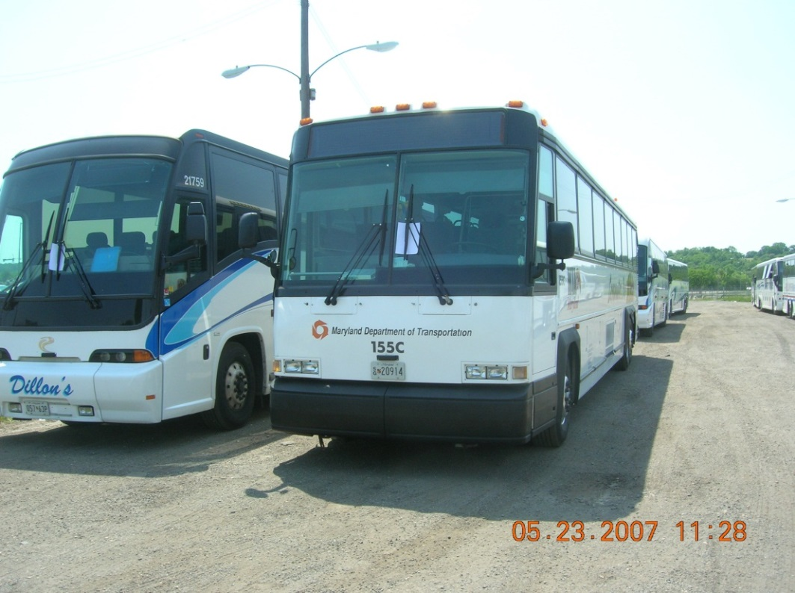
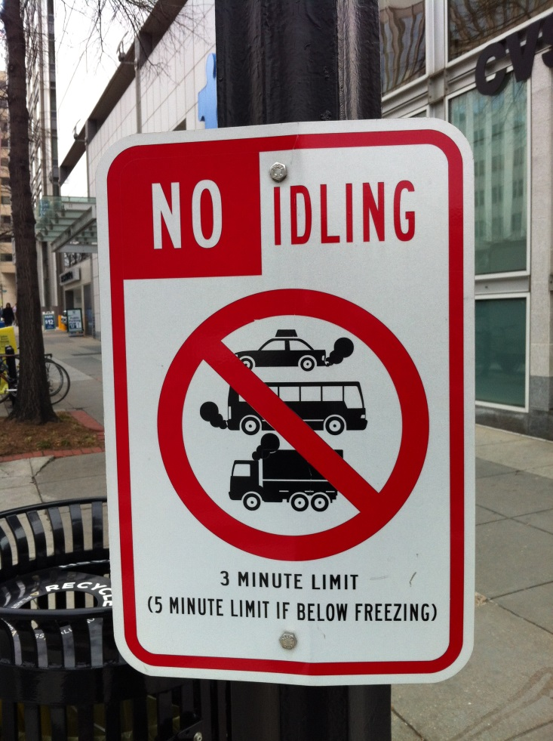
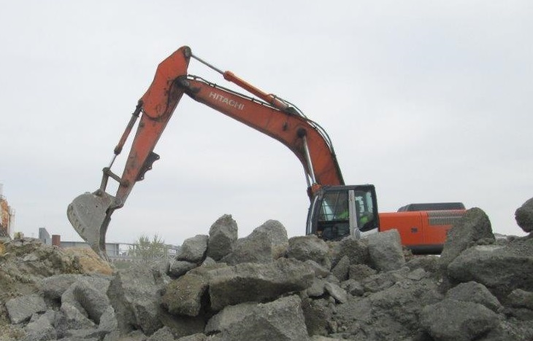
Engine Idling Program

Slide 7
Onroad Engine Idling
Idling of onroad gasoline or diesel-powered motor vehicles on public or private space for more than 3 minutes is prohibited while the vehicle is parked, stopped, or standing, including for the purpose of operating air conditioning or heating equipment
Exceptions:
Non-commercial private passenger vehicles.
Idling to operate power take-off equipment such as dumping beds, cement mixers, refrigeration systems, content delivery, winches, or shredders.
Idling up to 5 minutes when the temperature is at or below freezing (32ºF).
Private use, not for compensation.

Slide 8
Nonroad Engine Idling
Idling of Nonroad diesel-powered engines for more than 3 minutes is prohibited.
Exceptions:
Idling for up to 15 minutes when queueing (i.e. intermittently moving forward to perform work).
Idling for safety, servicing, inspection, or emergency purposes.
Idling up to 5 minutes to operate heating equipment when the temperature is at or below freezing (32ºF).

Slide 9
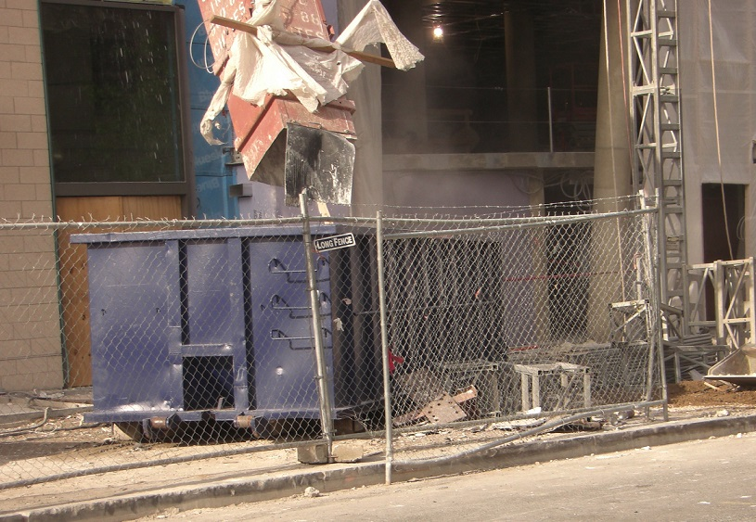
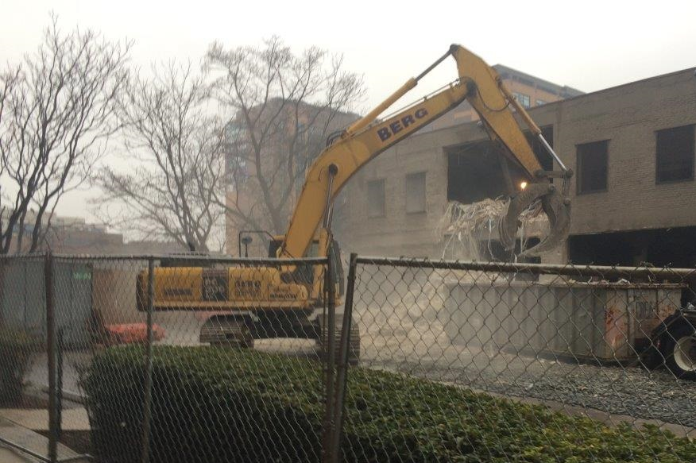
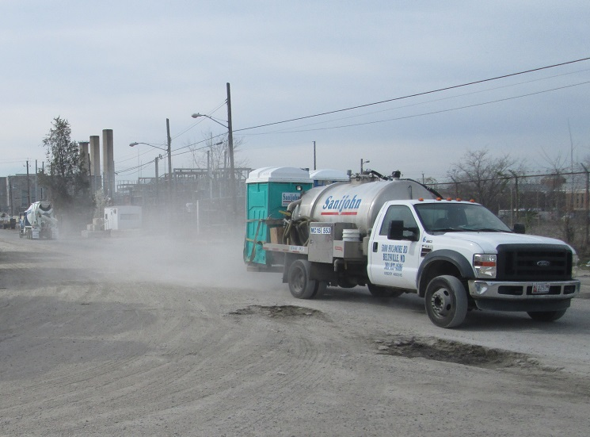
Fugitive Dust

Slide 10
Fugitive Dust
Reasonable precautions shall be taken to minimize the emission of any fugitive dust into the outdoor atmosphere.
The emission of fugitive dust from the following is prohibited:
Any material handling, screening, crushing, grinding, conveying, mixing, or other industrial-type operation or process;
Heater-planers in repairing asphaltic concrete pavements;
Portable tar-melters, unless close-fitting lids, in good repair, for the tar-pots are available and are used;
The ventilation of any tunnelling operation; or
The cleaning of exposed surfaces through the use of compressed gases.

Slide 11
Odor
An emission into the atmosphere of odorous or other air pollutants from any source in any quantity and of any characteristic, and duration which is, or is likely to be injurious to the public health or welfare, or which interferes with the reasonable enjoyment of life and property is prohibited.

Slide 12
Contact Information
Stephen S. Ours, P.E.
Chief, Permitting Branch
Air Quality Division
Department of Energy and Environment
(202) 535-1747
stephen.ours@dc.gov

