Slide 1
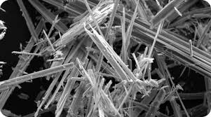
DEPARTMENT OF ENERGY AND ENVIRONMENT
AIR QUALITY DIVISION
COMPLIANCE & ENFORCEMENT
ASBESTOS ABATEMENT PROGRAM
- CECILY BEALL, ASSOCIATE DIRECTOR, AIR QUALITY DIVISION
- MANUEL OLIVA, CHIEF OF COMPLIANCE & ENFORCEMENT
- RALPH KNATT, ENVIRONMENTAL PROTECTION SPECIALIST
- JOANNA VIVANCO, ENVIRONMENTAL PROTECTION SPECIALIST
- KEITH KEEMER, ENVIRONMENTAL PROTECTION SPECIALIST
- JUANITA THOMPSON, COMPLIANCE PROGRAM SPECIALIST

Slide 2
Asbestos Regulations
DOEE - Title 20 DCMR § 800 (Control of Asbestos)
EPA - Title 40 CFR § 61.145 part 61- Subpart M-National Emission Standards For Hazardous Air Pollutants (NESHAP)
OSHA - Title 29 CFR § 1910.134 (Respiratory Protection)
OSHA – Title 29 CFR § 1926.1101 (Asbestos in Construction)

Slide 3
Where is Asbestos Found?
Sprayed-on fire proofing & insulation in buildings
Insulation for pipes and boilers
Wall and ceiling insulation
Ceiling tiles
Floor tiles
Putties, caulks, and cements (e.g. cement pipes used to store and transport chemicals)
Plaster material (acoustical and decorative)
Mastic material (pipe, HVAC, sink)
Construction mastics (floor, tile, carpet, ceiling tile, etc.)

Slide 4
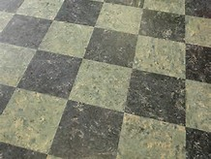
Asbestos Floor Tile

Slide 5
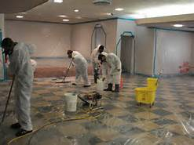
Preparing for Asbestos Abatement

Slide 6
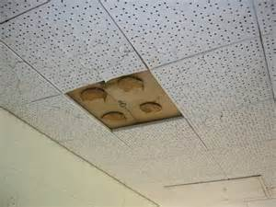
Asbestos Ceiling Tile & Glue Dots

Slide 7
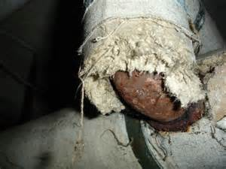
Damaged Asbestos Pipe Insulation

Slide 8
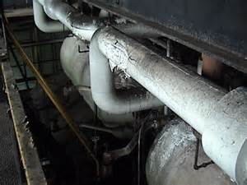
Asbestos Pipe Insulation

Slide 9
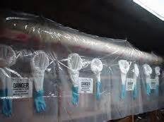
Glove-Bag Preparation

Slide 10
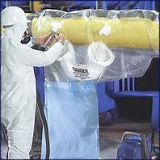
Glove-bag Removal

Slide 11
Spray-on Insulation – Structural Beam

Slide 12
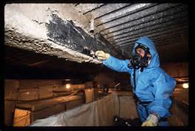
Removal of Spray-on Insulation

Slide 13
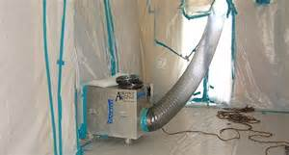
Negative Air Machine w/HEPA

Slide 14
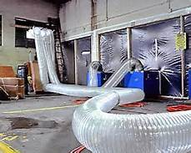
Negative Air Machines - NPE

Slide 15
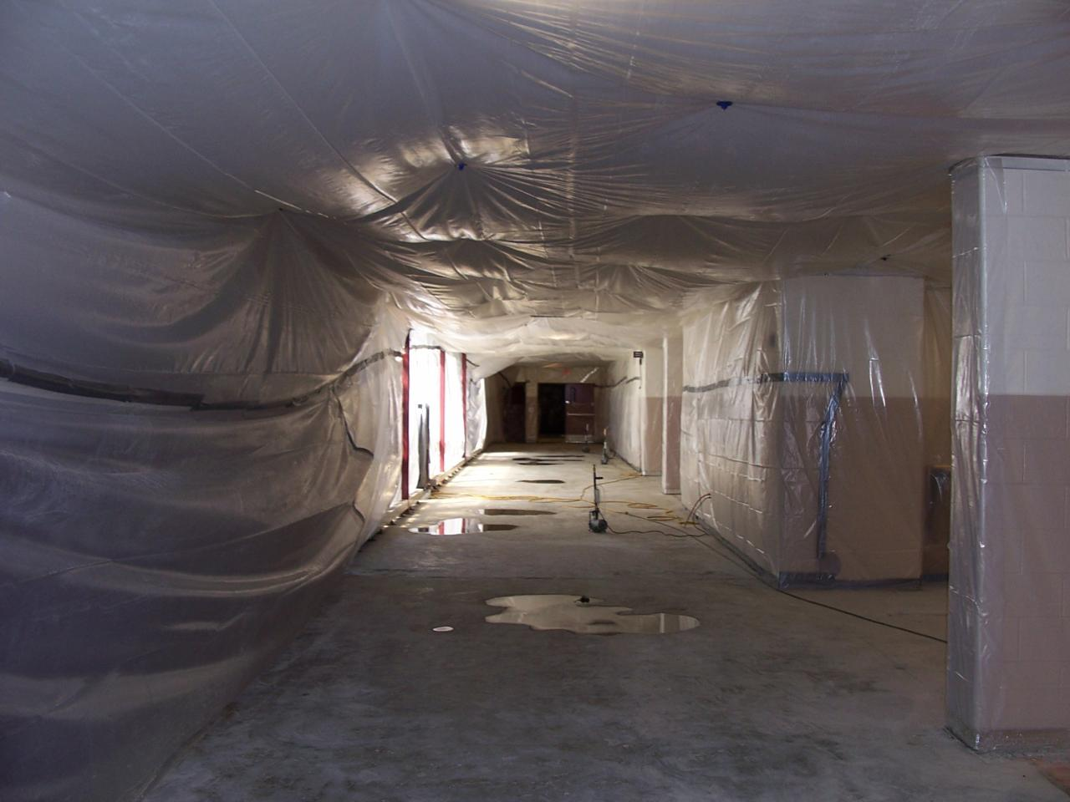
Regulated Area - Full Containment

Slide 16
3-Stage Decontamination Unit

Slide 17
Building/Facility Owner Responsibilities
Environmental (asbestos) survey: determine presence, location, and quantity of asbestos containing material (ACM).
Inform employers, employees, tenants, and others who may be impacted.
Have “suspect” material sampled and tested before starting any renovation or maintenance work.
Permit only certified individuals to perform work that may release asbestos fibers into the air.
Submit “Notification of Demolition and Renovation” to DOEE when projects involve 160 square feet, 260 linear feet or 35 cubic feet of ACM.

Slide 18
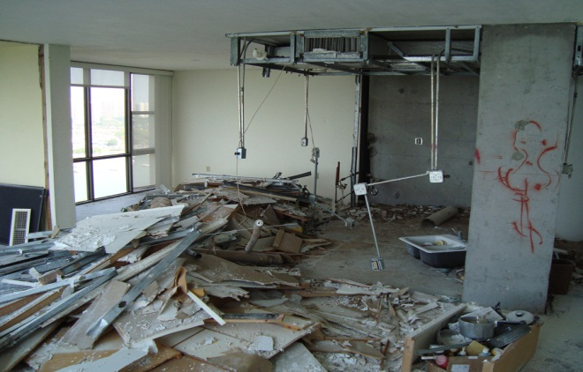
NATIONAL EMISSIONS STANDARD FOR HAZARDOUS AIR POLLUTANTS (NESHAP)
Notification (EPA)
Visible Emissions
What Defines A Facility
Facility Quantity Thresholds
Transport/Disposal

Slide 19
NOTIFICATION PROCESS
Completing the Notification Form (DC)
30 Day Notice to Tenants
Emergency Asbestos Abatement
Revisions
Variances
Determining which projects require a permit
Operations & Maintenance Plan

Slide 20
QUESTIONS?

Slide 21
CONTACT INFORMATION
DEPARTMENT OF ENERGY AND ENVIRONMENT
AIR QUALITY DIVISION
COMPLIANCE & ENFORCEMENT
ASBESTOS ABATEMENT PROGRAM
RALPH KNATT JOANNA VIVANCO JUANITA THOMPSON
ralph.knatt@dc.gov joanna.vivanco@dc.gov juanita.thompson2@dc.gov
202-535-2998 (OFFICE) 202-535-2998 (OFFICE)
202-481-3771 (FAX) 202-481-3771 (FAX)
202-309-5122 (CELL)
202-535-2263 (OFFICE)
202-481-3771 (FAX)

