Slide 1
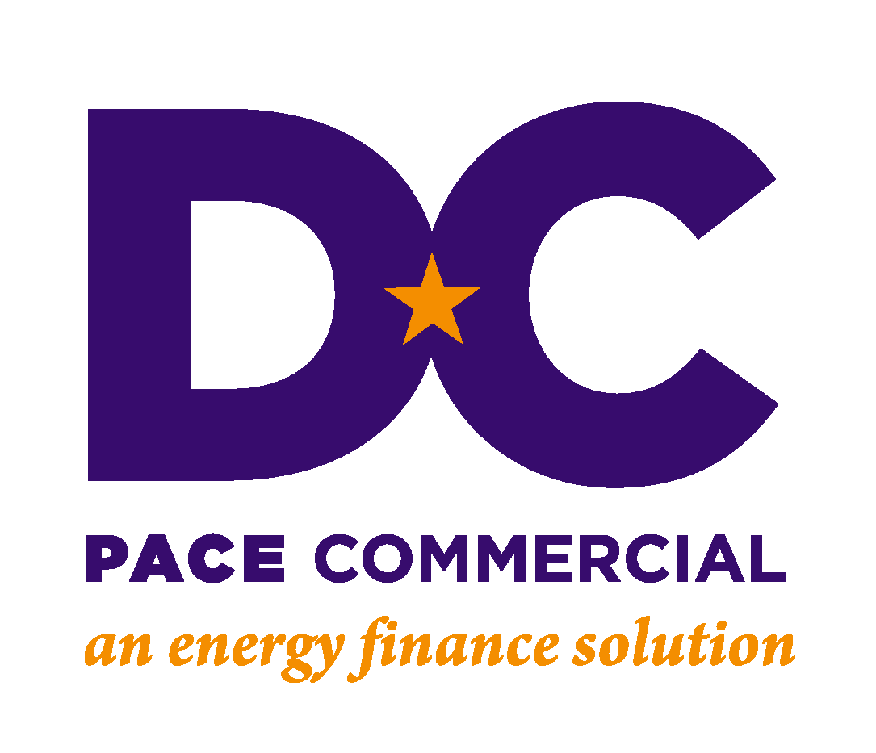
Financing energy, water,
and infrastructure upgrades

Slide 2
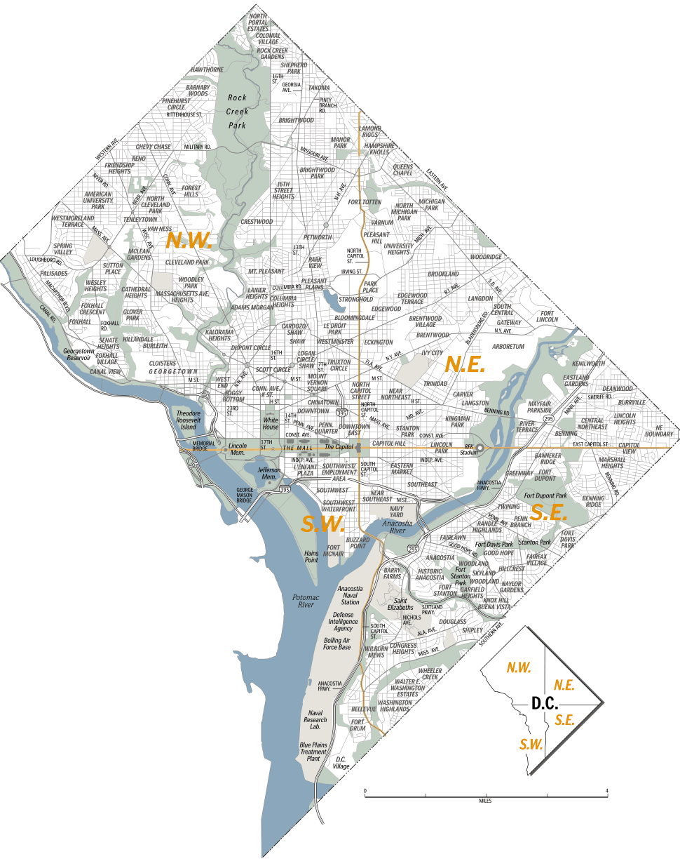
DC PACE: Program History
Statutory Authority: Established by the DC Council as part of the Energy Efficiency Financing Act of 2010, and Sustainable DC Act of 2012. DC PACE is backed by $250 million in bonding authority, available to all commercial, institutional and multi-family real estate within the District of Columbia.
Program Design
Sustainability Goals
Market-based, privately administered
Can accommodate multiple building types
For-profit & properties that don’t pay real estate tax
Increase energy reliability
Drive economic development and job creation
Reduce GHG emissions and environmental damage

Slide 3
DC PACE: Program Administration
Oversees DC PACE Program | Private-sector program administrator, on behalf of DOEE
Approves projects | Responsible for marketing and outreach
Initiates PACE Note | Conducts technical and financial underwriting
Responsible for bill collection and disbursement of proceeds | Arranges capital Confirms M&V

Slide 4
DC PACE: Financing for Building Upgrades
Property Assessed Clean Energy (PACE)
DC PACE is the District’s only clean energy and water financing program, offered through DOEE
PACE is a government financing policy that classifies energy and water-saving upgrades as a public benefit – like a sewer hook-up, road extension, etc.
100% of project costs are funded by private capital and repaid through a special assessment placed on the property
The owner repays the cost of the energy or water project over up to 20 years… making most projects cash flow positive from day one

Slide 5
DC PACE: Most Energy/Water Projects Qualify
DC PACE can finance any project that reduces energy or water usage and/or adds renewable energy generation. This can include lighting, mechanical equipment, building controls, windows, building envelope, solar panels, water conservation, green roofs, cisterns, stormwater retention, and associated soft costs like energy audits. PACE can also finance roof replacements and other related measures.
Building Requirements
Commercial, Industrial, Non-Profit, Multifamily
Does not work for residential, government
Both for profit and tax-exempt properties
Stand alone finance or part of larger capital stack

Slide 6
Why PACE? Removes Financing Barriers
Immediate Savings: Cash-flow positive on day one
Extends Capital Budget: Paid for in operating savings
Longer Term (20 Yr.): Reduces annual payments
Off Balance Sheet Finance: Tied to property not your credit
Independent Validation: Reduces technical risk for owner
Comprehensive Financing: Covers broader capital needs
No Money Out of Pocket: 100% financing including soft costs

Slide 7
How it Works: Project development process
Phase 1: Pre-Screen | Make sure that the property is eligible for PACE Determine how much financing the property can support
Phase 2: Project Development and Underwriting | Conduct financial underwriting Select capital provider Obtain mortgage lender consent Provide technical review
Phase 3: Approval and Closing | Complete financial closing Transfer funds Start construction!

Slide 8
How it works: The PACE transaction structure
PACE Capital Provider
PACE Note
DC PACE /
District of Columbia
Pass through payments
$$
$$
Up-front
capital
Property
Owner
PACE Assessment on title
$$
Semi-annual tax payments
$$
Project
Cost
Energy
savings
Energy Project /
Contractor
Notes:
Add 800 9th street

Slide 9
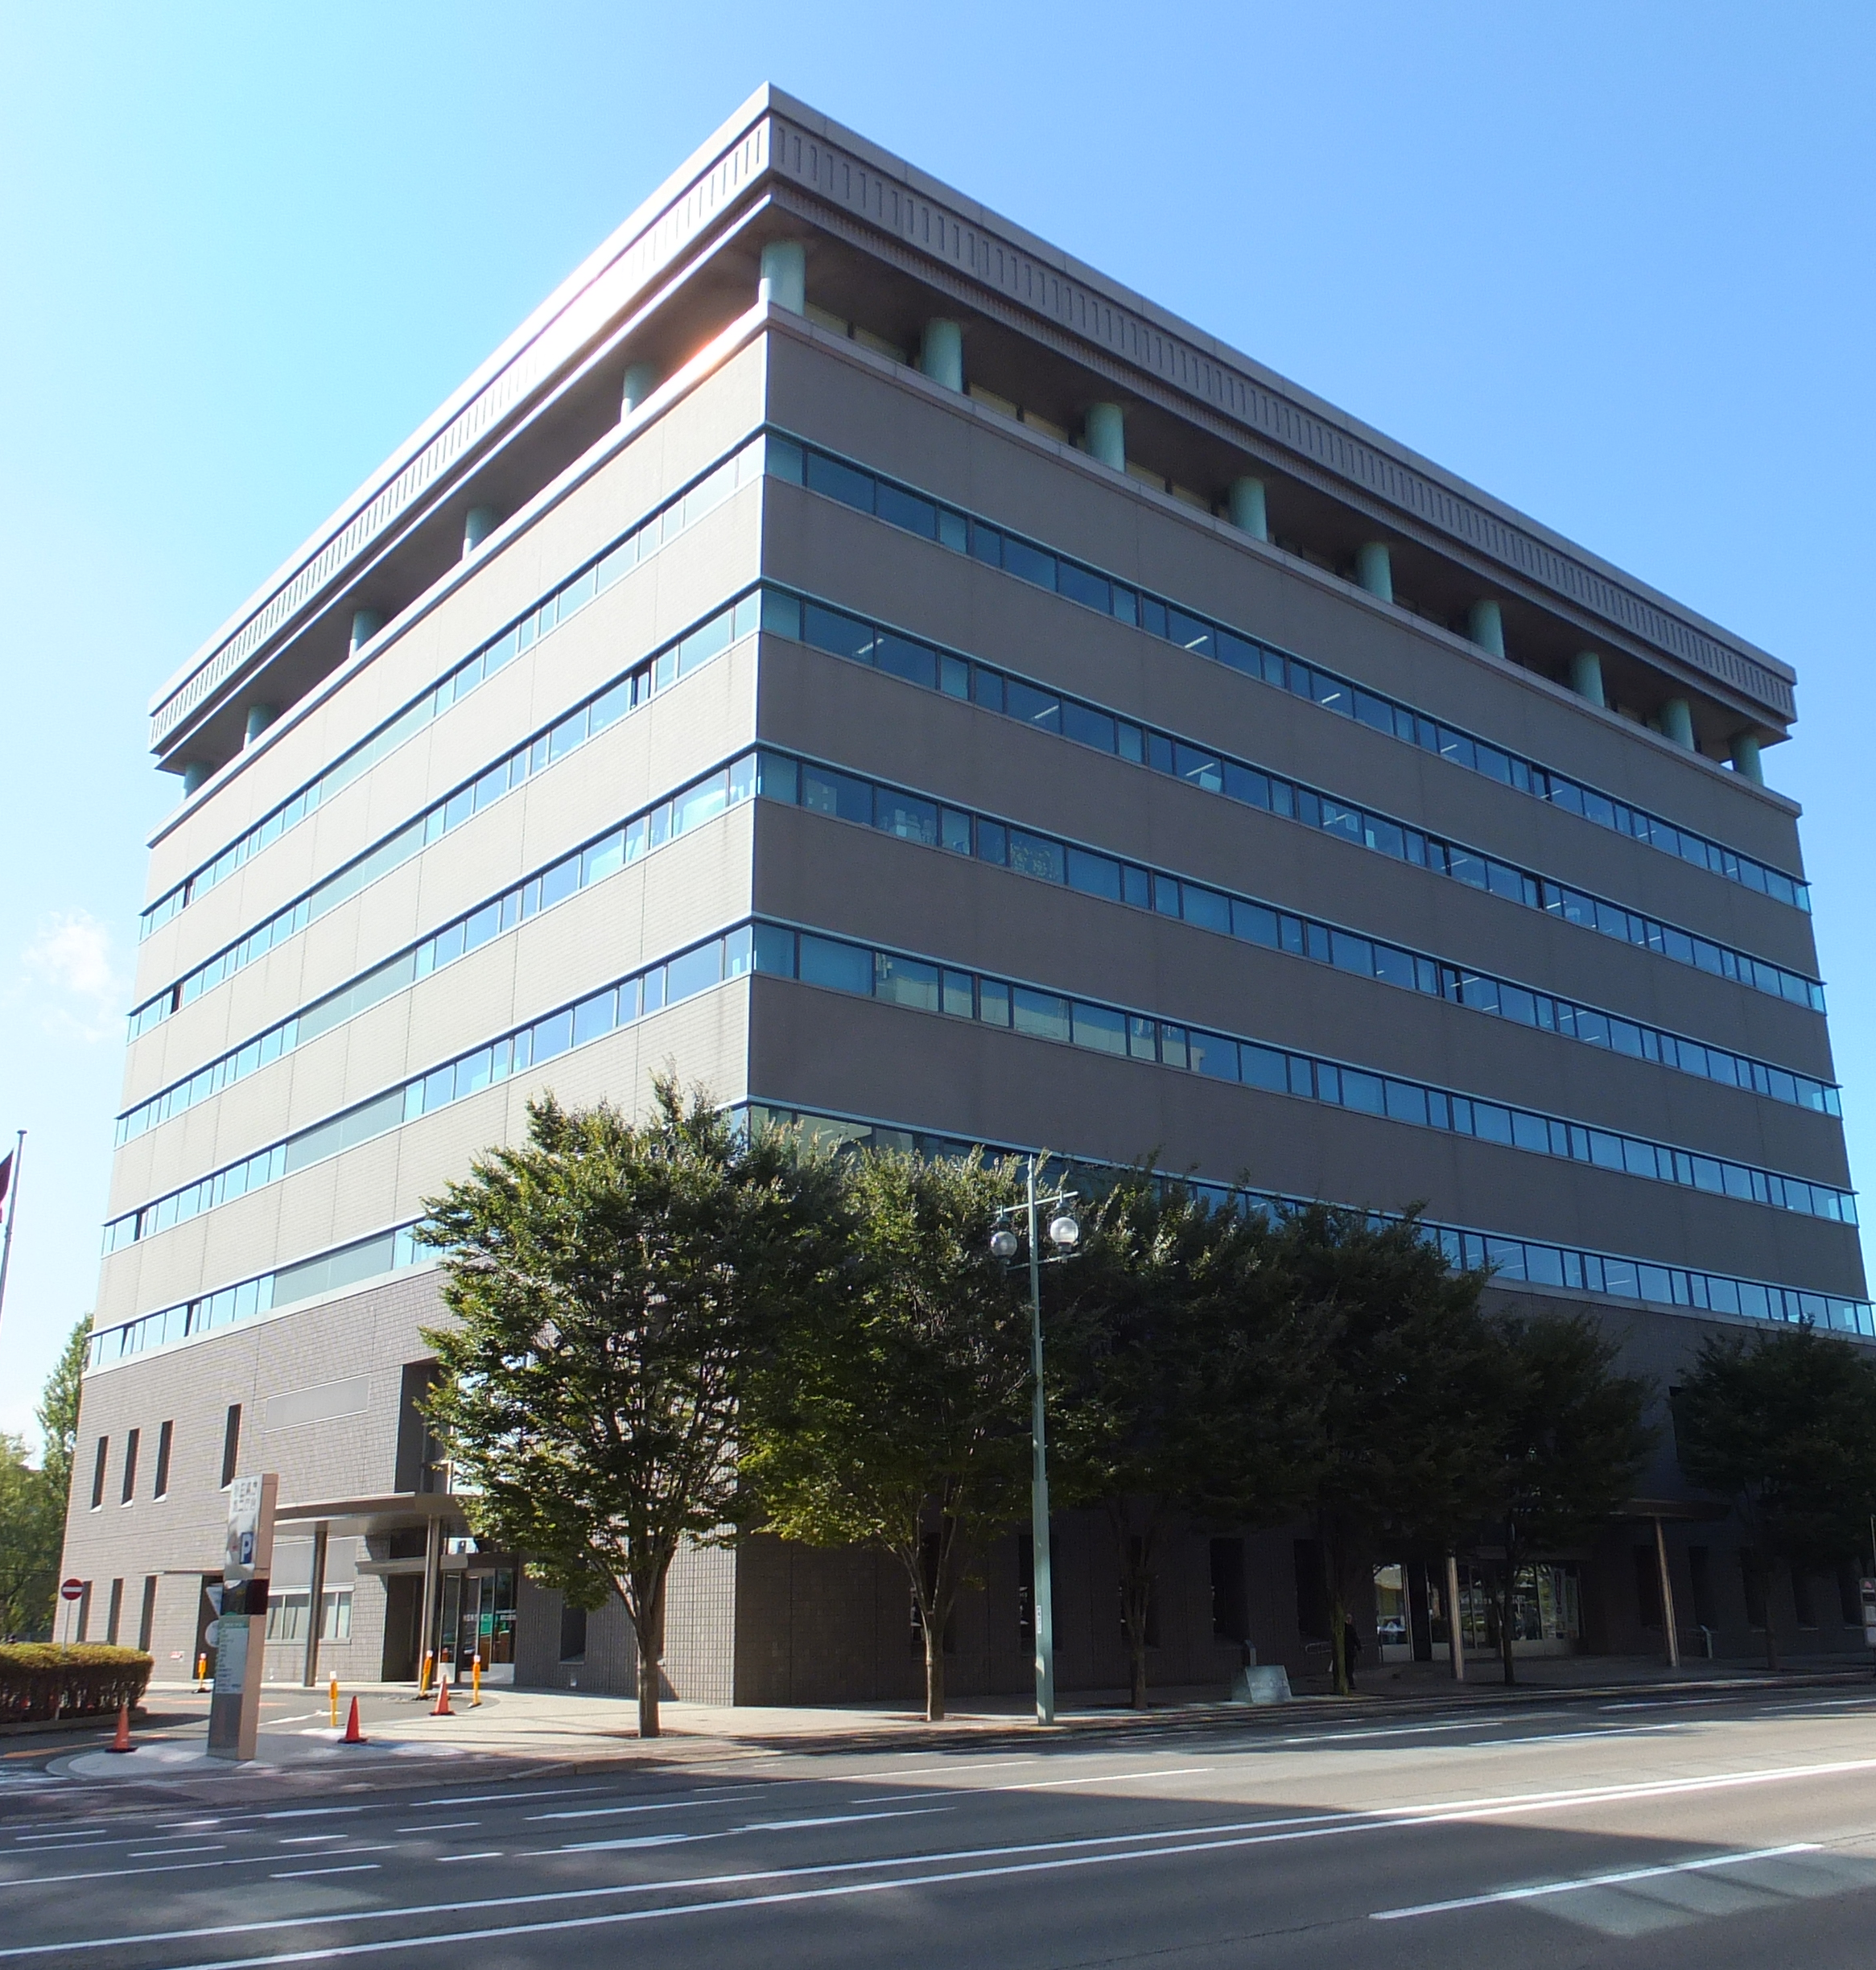
Case Study 1: Multi-measure EE Retrofit
Customer: Downtown office building with energy-conscious anchor tenant
High annual energy spend
Building constructed in 1980s, due for capital upgrades
Challenge: Finance large retrofit project without adding debt
Project: EE, water conservation measures, roof replacement
Note: Project financials have been simplified for illustrative purposes.

Slide 10
Case Study 1: Financial Eligibility & Structuring
ECMS | Capital Cost
Lighting | $150,000
Water conservation | $25,000
HVAC & controls | $775,000
Roof rehab | $550,000
Boiler replacement | $100,000
Total | $1,600,000
Annual Savings
Electricity | $157,000
Water | $10,000
Gas | $3,000
Total | $170,000
Note: Project financials have been simplified for illustrative purposes.
Annual payments = Up to $170,000
Desired term: 20 years (@ 6%)
PACE Eligibility: Up to $1,950,000
PACE Eligibility

Slide 11
Case Study 1: Cash Flows & Benefits
 | Self-Funded | PACE
Investment by Property Owner | $1,600,000 | $0.00
Annual Utility Savings | $170,000 | $170,000
Annual PACE Payment | $0.00 | $(140,000)
Net Benefit Year 1 | $(1,430,000) | $30,000
Annual Net Benefit Years 2-20 | $170,000 | $30,000
5-year NPV of Cash Flows (@ 8% discount rate) | $(802,000) | $126,000
20-year NPV of Cash Flows (@ 8% discount rate) | $188,000 | $310,000
5-year IRR | -18% | Infinite
20-year IRR | 9% | Infinite
PACE increases NOI by $30,000 annually, adding $620K to property value with no money out of pocket (@ 5% cap rate)
Note: Project financials have been simplified for illustrative purposes.

Slide 12
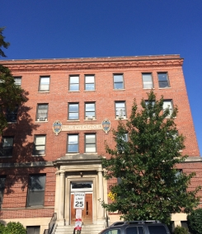
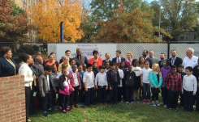
#2: HUD-Assisted Housing—Phyllis Wheatley YWCA
Project: Deep rehab of historic property offering transitional housing to homeless women
Challenges:
Install solar and highly efficient equipment
Pays back, without impacting capital budget
Approval from many public & private partners
Solution: PACE filled a gap in a complex multi-million $ project
Financed 30 kW rooftop solar
Efficient HVAC systems, heat recovery system, LED lighting, and low-flow water fixtures

Slide 13
#2: HUD-Assisted Housing—YWCA Project Benefits
PACE Financing: $635,0000 (15 Year Term)
Tax Equity: $65,000
Property Owner: Annual Benefit
Utility savings | $73,000
PACE Payments | $(66,000)
Net Cash Flow | $7,000
PACE finances solar PV and efficiency in one package
Net benefit $7,000 per year in cash flow
Made infrastructure improvements without raising rents
First use of PACE financing in a HUD-assisted mixed finance property
Integrated PACE with LIHTC, DHCD, DCHA & other structures
Equity Investor Benefits
SREC Revenue (pre-tax) | $72,000
ITC | $36,000
Depreciation | $35,500
Total Benefit | $143,500
Tax Equity | -$65,000
Net Benefit | $78,500
Project financials simplified for illustrative purposes.

Slide 14
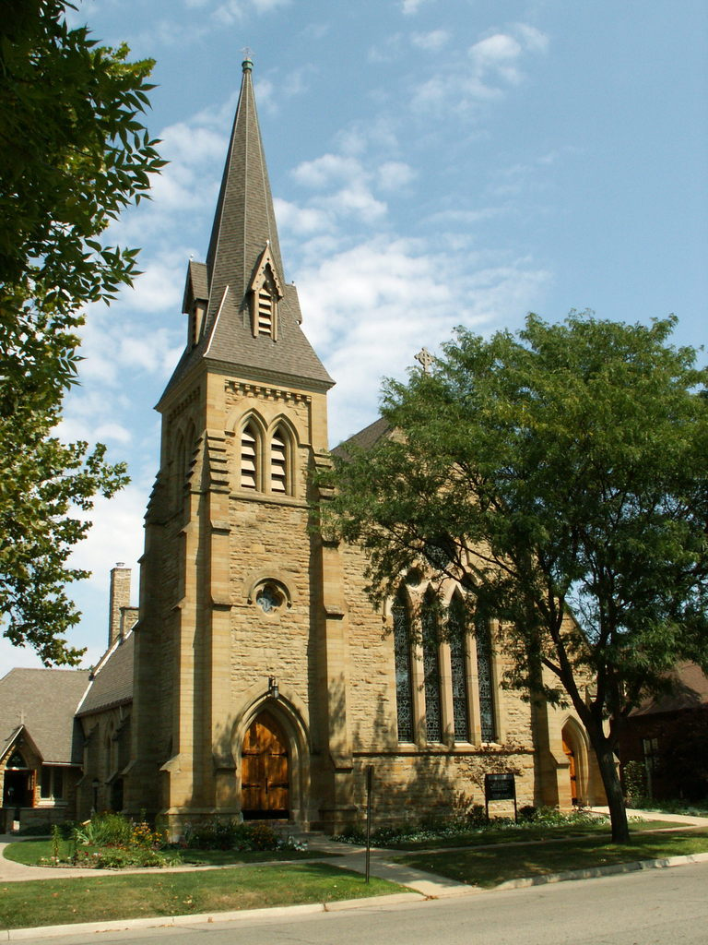
#3: House of Worship—Solar PPA + Efficiency
Project: Energy and infrastructure upgrades on four large properties for a prominent church
Challenges:
Monetize tax benefits from solar PV
Use savings to finance structural work
Retire traditional mortgage debt
Solution:
$3 million in building upgrades, including solar PACE-secured PPA for 300 kW system, partial roof replacements, HVAC upgrades, smart thermostats & controls, LED lighting, low-flow water fixtures

Slide 15
#3: House of Worship—PACE-Enhanced PPA for solar
PACE improves Solar PPA contracting…
PACE is a credit enhancement: Adds security for investors, reduces default risk, brings more economics into transaction.
PACE simplifies underwriting: PACE is tied to the asset not the credit of the borrower, simplifying underwriting.
PACE eliminates personal guarantees: PACE security removes the need for contractor or owner guarantees on debt.
Increases owner benefits: PACE can structure tax equity investment to maximize cash flows.

Slide 16
Questions?
To learn more about DC PACE financing opportunities, contact DOEE or Urban Ingenuity, the DC PACE Program Administrator:
Kenley Farmer, Program Manager
District Department of Energy & Environment
E-mail: kenley.farmer@dc.gov
Phone: 202-671-3314
http://doee.dc.gov/service/dc-pace-commercial
Jackie Weidman, Program Manager
Urban Ingenuity
E-mail: jweidman@urbaningenuity.com
Phone: 908-400-9766
www.urbaningenuity.com

Slide 17
Extra Slides

Slide 18
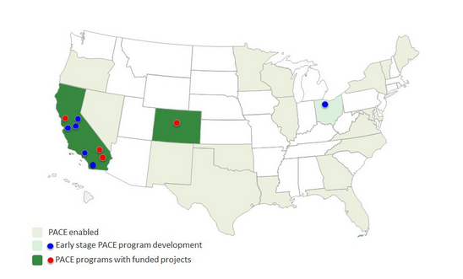
PACE 101: Market in 2010
Source: PACENow

Slide 19
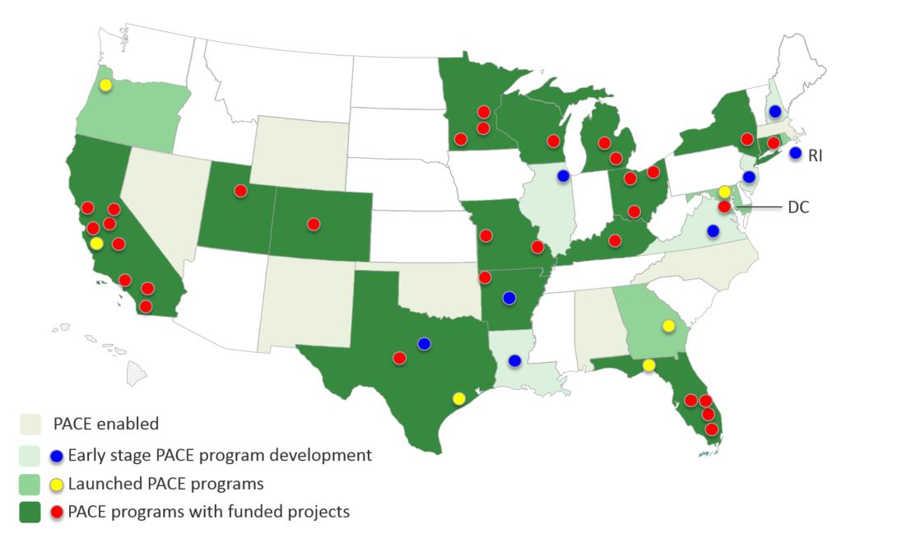
PACE 101: Market in 2016
32 states & DC have PACE-enabling legislation
16 states have an active PACE program
35 states have PACE programs in operation
Source: PACENow

Slide 20
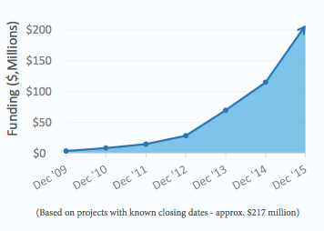
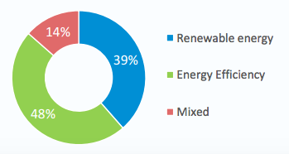
PACE 101: Commercial Market (2009-2015)
From 2009-2015, PACE provided $220 million in financing for energy upgrades for over 560 commercial buildings. In 2015 alone, PACE financed $93 million for 140 buildings.
Figure 1: Cumulative C-PACE funding
Figure 2: Funding by improvement type

Slide 21
Tax Exempt PACE: Nonprofit HQ & For-profit Retail
Project: PACE as a layer in capital stack for gut rehab of an abandoned building to serve as new HQ of a non-profit with retail tenants.
Challenge:
Structure tax-exempt PACE to sit alongside tax-exempt IRB financing
Construct an energy baseline for property without utility usage history
Solution:
Constructed baseline that qualifies property for $2 M in PACE financing for energy efficient HVAC equipment, LED lighting, envelope improvements, efficient kitchen equipment for restaurant

Slide 22
Tax Exempt PACE: Nonprofit HQ & For-profit Retail
Sources & Uses
IRB (tax-exempt) | $6,000,000
Taxable Mortgage | $2,000,000
Local Govt. Grant | $3,000,000
Financing Gap | $2,000,000
Project Cost | $14,000,000
No first-cost barrier allows energy upgrade
HVAC, LED Envelope, Restaurant Equipt.
Bond counsel approved tax-exempt use of PACE
PACE Provides $2M of Equity into $14M rehab
Tax-exempt / taxable PACE split mirrors IRB
$2.9 M savings above code over 20 years qualifies the property for $2 M+ in PACE
PACE Financing
Tax-Exempt PACE | $1,500,000
Taxable PACE | $500,000
Total PACE | $2,000,000
Project financials simplified for illustrative purposes.

