Slide 1


Slide 2
Increasing Returns on Energy Efficiency Investments
Working with the DCSEU to reach your energy goals
gkunkel@dcseu.com
Notes:
Good morning.
How is everyone today?

Slide 3
History of the DCSEU
Former efficiency program run by local utilities
Clean and Affordable Energy Act (2008)
Sustainable Energy Trust Fund (SETF)
DCSEU opened its doors in 2011
Notes:
Prior to 2008 ee rebates were offered by Washington Gas and Pepco
In 2008 the DC Council passed the Clean and Affordable Energy Act which created the DCSEU and the Sustainable Energy Trust Fund, our funding mechanism. More on that later.
What did this do? This gave DCSEU the authority to provide rebates and support for energy efficiency in the District to DC buildings and residents.

Slide 4







Electricity Savings
Gas
Savings
Green
Job
Creation
Local Economic
Development
Low-Income Spending
Renewables

Slide 5
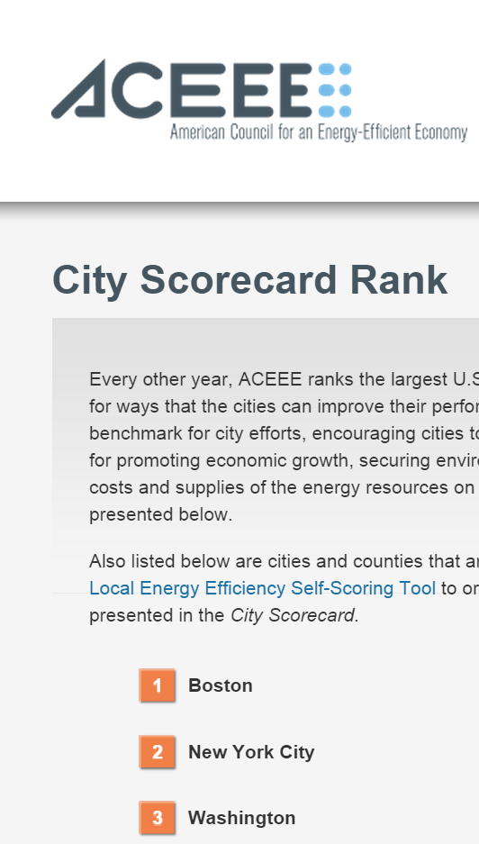
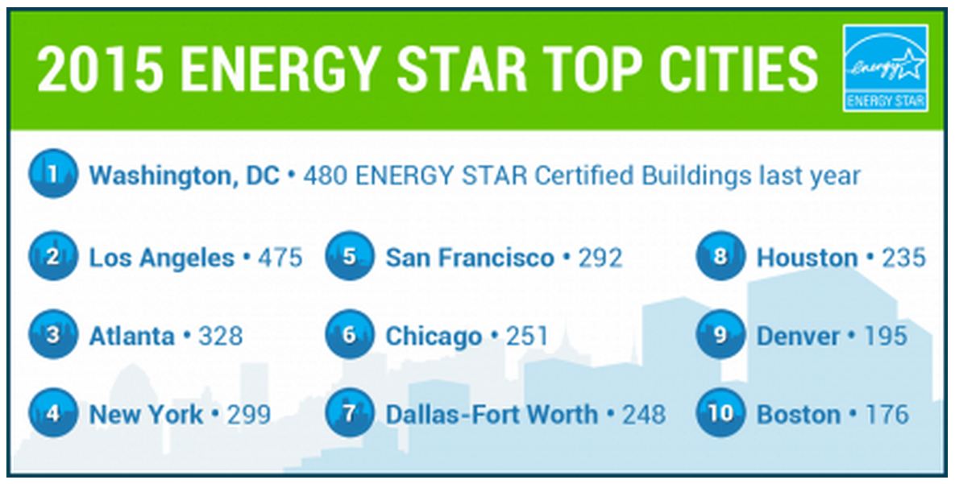
Results – DC is a Champion of Energy Efficiency

Slide 6

The DCSEU & Commercial & Institutional Customers

Slide 7
Getting the most from your investment
Technical Assistance
Financial Incentives
No cost for DC Customers
Notes:
*Upon customer request (specify)

Slide 8

Technical Assistance
What technical barriers exist?
  What do I do now?
  What’s better than what I currently have?
  How do I stay on top of the newest technologies?
  Are those technologies right for me?
  Are we really going to see THIS much in savings from our investment?
Notes:
Think about your own steps
What do you have to go through in your process?
***3rd party independent review***
A lot of these are questions you need answered before moving forward with a project
Stories:
Sirius
Flat plate heat exchanger connection
DIA alignment meeting
Vendor over promising story – Arena Stage

Slide 9
Financial Assistance
Bridging the gap between lower and higher efficiency
Extending energy efficiency budget
Could help lower agency ROI requirements
Notes:
If something lasts 30 years, but the payback is 12 years and your funding source requires a 10 yr payback, our finicial incentives could be used to help buy downt he cost of the ROI
Any Questions????

Slide 10
How We Bring Value to Commercial Customers

Slide 11
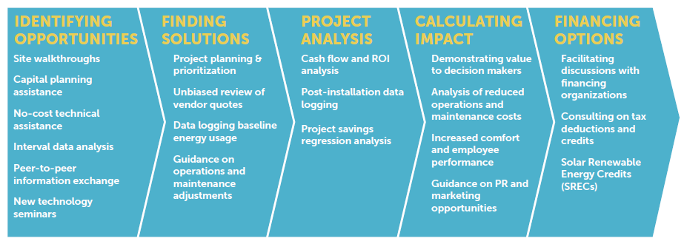
Helping to Solve Energy Questions
Benchmarking Assist
Interval Data Review
Walkthroughs
Sequence of Operation Review
Energy Management in Tenant Spaces
Pilot Studies
The DCSEU is here to be your ally in reaching your energy goals

Slide 12
Next Steps
Contact the DCSEU to discuss upcoming projects or energy savings strategies and goals
DCSEU Account Managers can assist through planning stages and project coordination
  Onsite meeting
  Walkthrough
  Tech Assist
DCSEU engineer performs savings analysis

Slide 13
Questions?
Notes:
This wraps up our presentation. We’ve got some time for questions.
No questions? I’ve got a few questions for you:
We’re in the heating season, is anyone considering replacing their chillers right now?
Does anyone have a plan for meeting their energy efficiency goals for the new fiscal year?

Slide 14
How to Reach the DCSEU
DCSEU.com
info@dcseu.com
202-479-2222

Slide 15

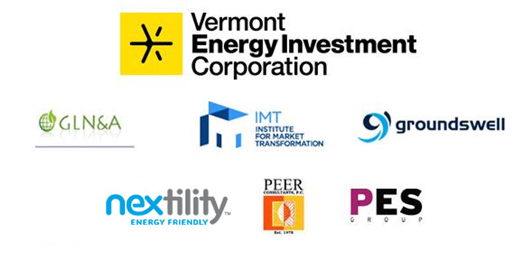

THE
SUSTAINABLE ENERGY PARTNERSHIP
The DC Sustainable Energy Utility is a project of the Sustainable Energy Partnership under contract to the Department of Energy & Environment (DOEE).

