Slide 1
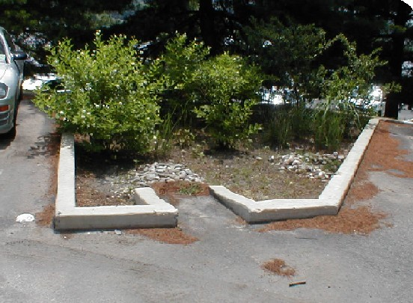
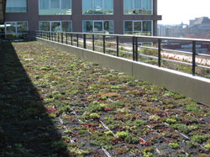
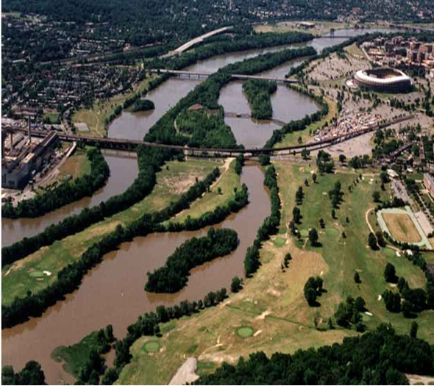
DC Draft Phase II Watershed Implementation Plan Stakeholder Meeting
March 1, 2012
Metropolitan Washington Council Of Governments
Hamid Karimi
Deputy Director Office of Natural Resources
District Department of the Environment

Slide 2
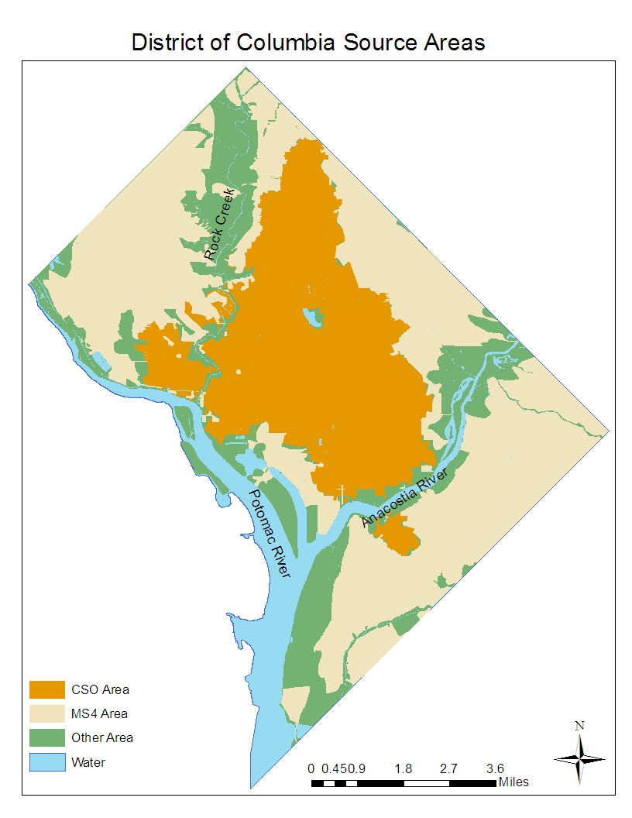
Allocation Areas

Slide 3
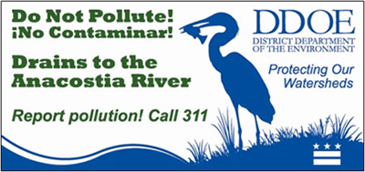
How Will Allocations be Met?
DC Water
Major investment at Blue Plains (ENR)
Clean Rivers Program, formerly LTCP
MS4 Permit
Stormwater Regulations
Federal Agency Partnerships

Slide 4
MS4 Permit
Final MS4 permit issued in Oct. 2011
Requires stormwater regulations with a 1.2 inch retention standard for new or re-development
Requires specific practices to be installed :
Trees (4,150 net plantings per yr)
Green Roofs (350,000 SF over 5 yrs)
Impervious Surface Retrofits (18 Mil SF over 5 yrs)

Slide 5
MS4 Permit Cost Impacts
New stormwater regulations will be driver to achieve metrics
Only impacts new and redevelopment projects
Drafted to achieve environmental benefit while maximizing flexibility for regulated sites.
Off-site mitigation and/or fee-in-lieu with a baseline on-site retention
Consultant analysis determined regulations would result in a small incremental cost increase for development projects
DDOE experience demonstrating similar results
Smart Growth study finds that storwmater regulations are not a driving factor influencing redevelopment

Slide 6
Federal Partnership
Information submitted by 10 Federal Agencies!
Partnering approach works to improve water quality and control stormwater runoff
Agencies accepted/acknowledged DDOE assigned target load allocations for N, P, TSS
All deliverable deadlines were met by Federal Partners
Information submitted includes:
Narrative about the agencies
Narratives about proposed actions and goals
2012-13 Two Year Milestones
DC Area in Acres
DC Total | Federal Agencies Total
39,066 | 9,742

Slide 7
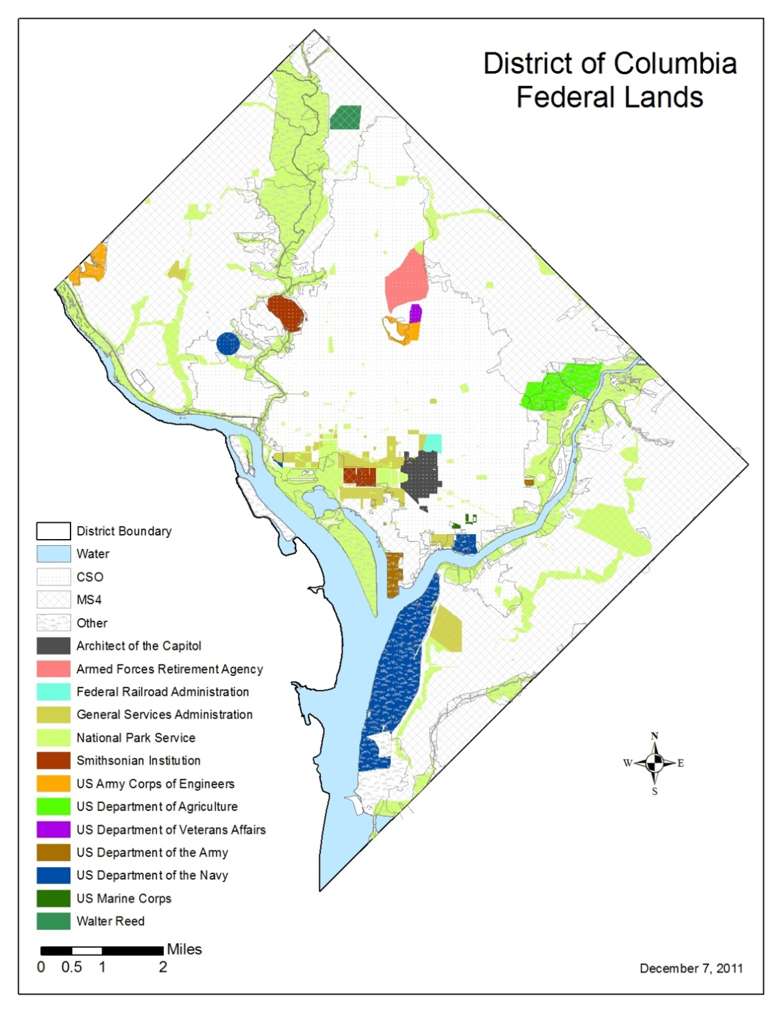

Slide 8
2012-13 Two Year Milestones Federal Partners
Agencies catalogued existing installed BMPs
Practices to be installed through 2013 were submitted by agencies
Long-term (programmatic) practices were submitted by agencies
Such as: managing areas as fields, allowing reforestation, removing permeable areas, developing sustainability, pollution prevention and LID policies

Slide 9
2012-13 Two Year Milestones DDOE
Expand urban tree canopy
Plant 4,150 trees per year
RiverSmart Homes/Schools/Rooftops
~ 2,000 Homes audited
4 Schools
140,000 sq ft of green roof to be installed
RiverSmart Washington Demo project
Retrofit 22 acres with LID to max extent practical
Stream Restoration
7800 ft of stream to be restored

Slide 10
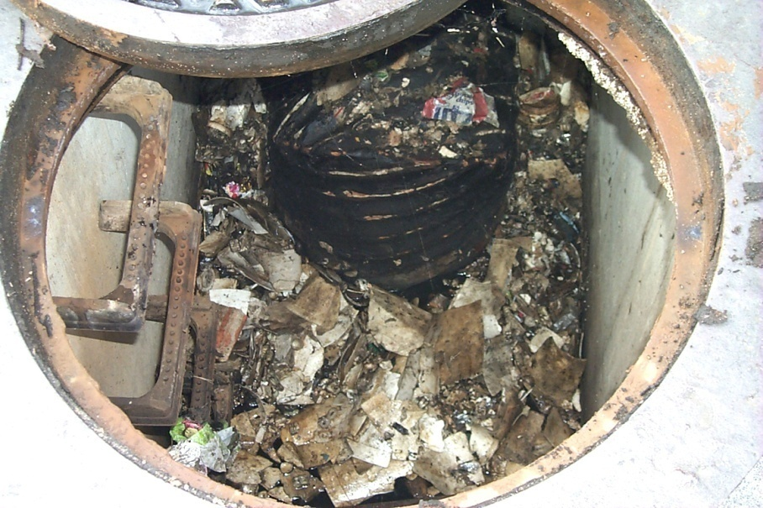
BMP Inspection and Maintenance
All BMPs need to
be inspected and
maintained in order to:
Protect monetary
investment
Ensure performance
Maintenance is mandatory
DDOE inspects BMPs
submitted through soil and erosion regulations for installation, completion, and maintenance
Practices that have gone through the DDOE process are put on an inspection and maintenance schedule
Notes:
Clogged manhole sand filter

Slide 11
Tracking and Reporting
Open communication
Strict observance of reporting periods
Short term goal = Development of a spreadsheet which could be used by all agencies for reporting
Long term goal = Central interactive reporting tool (to be developed by EPA per 7/6/11 two year milestone guidance)

Slide 12
What’s Next?
Final WIP due to EPA March 30th
Promulgation and implementation of stormwater regs
MOU with Federal Agencies
Ongoing Inspection and Maintenance of all existing BMPs in the District
Tracking and Reporting on implementation……
Yearly progress
Two year milestones
Explore utilizing new and emerging practices and technologies
Thank you for ‘partnering’ to help us all achieve a clean Chesapeake Bay!

Slide 13
Important Links/Contacts
DDOE Chesapeake Bay WIP Page:
http://ddoe.dc.gov/service/total-maximum-daily-load-tmdl-chesapeake-bay
DC Draft Phase II WIP:
http://ddoe.dc.gov/sites/default/files/dc/sites/ddoe/publication/attachments/DC_Chesapeake_Bay_Draft_Phase_2_WIP.pdf
EPA Chesapeake Bay TMDL Page:
http://www.epa.gov/reg3wapd/tmdl/ChesapeakeBay/index.html
DC Contacts:
Diane Davis: diane.davis2@dc.gov
Sarah Sand: sarah.sand@dc.gov

