Slide 1

Developing Final Phase II WIPs and Milestones
Katherine Antos
Chesapeake Bay Program Office
Jenny Molloy
Water Protection Division
DC Draft Phase II WIP Stakeholder Meeting
March 1, 2012

Slide 2
Objectives
TMDL and WIP Process Background
Evaluation of Draft Phase II WIPs and 2012-2013 Milestones
Status of Key Stormwater Initiatives

Slide 3
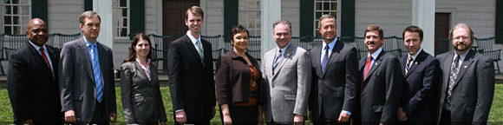
Practices in Place by 2025
Chesapeake Bay Executive Council, 2009

Slide 4
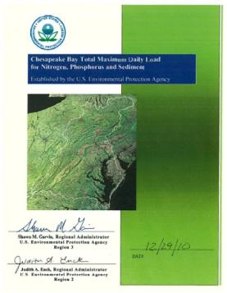
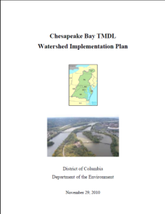
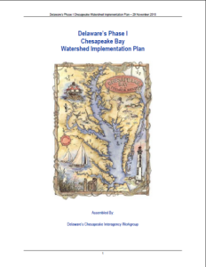
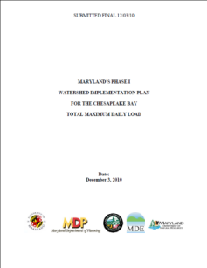
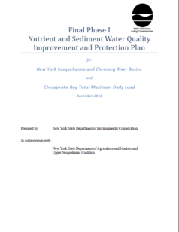
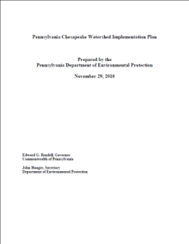
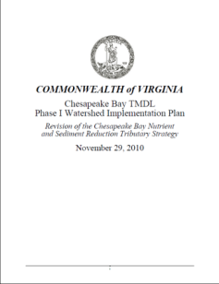
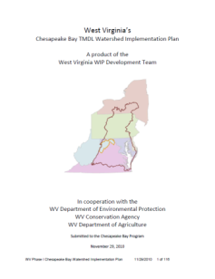
Bay TMDL Based on Jurisdictions’ Plans
4

Slide 5

TMDL and WIP Development Schedule: 2009 - Ph. II WIP
Major basin
jurisdiction
loading
targets
Final WIP I
November-December 2010
Oct 2009
Final
TMDL
Established
November-December 2009
Bay TMDL Public Meetings
December 2010
Phase II Watershed Implementation Plans: Starting 2011
Provide Local Planning Targets for smaller Watersheds,
Counties,
Federal
Agencies
Draft Phase I Watershed Implementation Plans: November 2009 – Sept.1 2010
Local Program Capacity/Gap Evaluation
2-year
milestones, reporting, modeling, monitoring
July 1 and August 13 Allocations
January 2012: 2012/2013
milestones
Draft TMDL
Sept. 24, 2010
(45 days)
Public
Review
And
Comment
Final Phase II WIP & Milestones -March 30th 2012

Slide 6
Watershed-wide Assessment of Phase II WIPs and Milestones
  EPA provided feedback on February 15.
  EPA working with jurisdictions to address comments for final WIPs expected by March 30, 2012.
  Across the watershed:
    Jurisdictions generally on track to meet pollution reduction targets for 2017 and 2025.
    Overall draft Phase II WIPs and milestones include more specificity on cleanup strategies and local implementation.
  District of Columbia WIP and milestones met EPA expectations and provided a model for engaging federal agencies as local partners towards implementing targets.

Slide 7
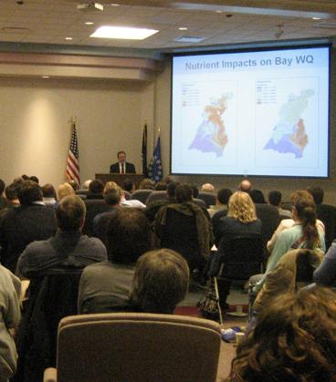
Federal Facilities in DC WIP II and Milestones
In July 2011, DDOE provided federal agencies with proposed planning targets.
Draft Phase II WIP includes federal agency strategies to meet targets.
Federal agencies submitted two year milestones for 2012-2013 – programmatic and BMPs to DDOE.
Milestones include practices in the ground from 2006 -2012 and upcoming practices through 2013.

Slide 8

Sample DC Federal Agency Milestone Submissions
General Services Administration
  Install bio-retention at St Elizabeth site to treat stormwater runoff from over 352,000 sq ft (8 acres) of land area.
  Install green roofs at St Elizabeth site to manage over 550,000 sq ft of roof area.
National Park Service
  Install forest buffers as part of reforestation of over 15 acres of park land.
  Install approximately 8 miles of riparian buffer.

Slide 9
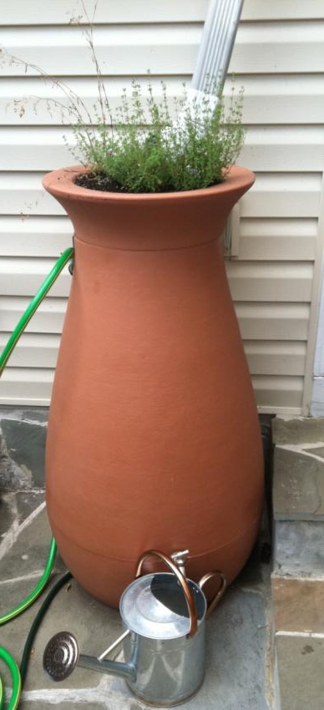
EPA Evaluation of DC Draft Phase II WIP
Strengths
  Strengthens reasonable assurance for stormwater.
  Reflects MS4 permit provisions.
  Commits to maximizing use of Riversmart Programs.
  Provides more information on insignificant facilities.
  Proposes offsets program through retention credits.
Areas for Improvement
  Resolve inconsistencies between input decks for WIPs and milestones.
  Include plan to address DC-specific recommendations from EPA offsets and trading program assessment by end of 2012 and recommendations common across jurisdictions by end of 2013.

Slide 10
EPA Evaluation of DC 2012-2013 Milestones
2012-2013 Milestones – Strengths
  Federal agencies created input decks identifying specific BMPs that would be implemented in the 2012-2013 milestone period.
  Includes progress under the Long term Control Plan to minimize combined sewer overflows.
2012-2013 Milestones – Areas for Improvement
  Add milestones to finalize stormwater regulations and stormwater guidebook.
  Consider adding milestones to reflect specific MS4 permit and draft Phase WIP commitments (e.g. retrofit).
  Add milestone to have fully effective offsets program in place by December 2013 for growth sectors.

Slide 11
Timeline for Finalizing Phase II WIP
DC and EPA working to resolve comments on WIP and milestones.
Final DC WIP and milestones expected by March 30, 2012.
EPA will evaluate final Phase II WIPs and milestones.

Slide 12
Federal Agreement on Stormwater in DC
Outline specific expectations and objectives related to EOs, EISA, MS4 permit, WIP, etc.
Initial discussion included EPA-DOD; has been expanded to include all federal agencies with facilities in DC.
Technical session in February to discuss current agency efforts related to technical.
Follow-up policy session in March.

Slide 13
MS4 Permit for District of Columbia
DC MS4 permit contested by 2 different groups of appellants.
DDOE filed a petition to intervene. Motion granted.
All parties agreed to attempt resolution via Alternative Dispute Resolution.
Several briefs, motions, etc. filed at the request of EAB; several orders issued by EAB.
Initial ADR meetings scheduled for March.
DC is continuing to implement most elements of the permit. Stay in effect for several provisions.
http://yosemite.epa.gov/oa/EAB_Web_Docket.nsf/Active+Dockets?OpenView. Date filed 11/04/2011.

Slide 14
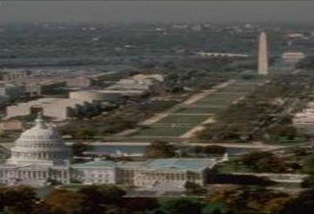
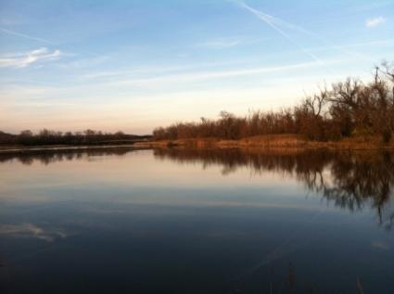

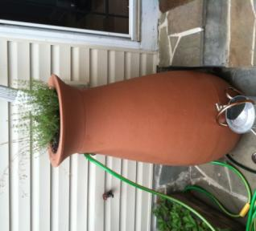
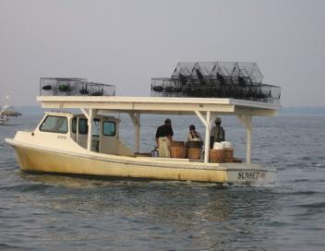
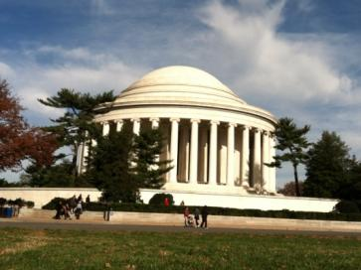
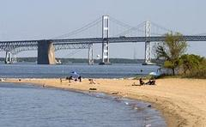
QUESTIONS
antos.katherine@epa.gov, (410) 295-1358
molloy.jennifer@epa.gov, (215) 837-8011
www.epa.gov/chesapeakebaytmdl

