Slide 1
Environmental Compliance and Technical Assistance for Auto Service Professionals -- RCRA C Hazardous Waste
Victoria North
Toxic Substances Division Hazardous Waste Program
Compliance Assistance
Victoria.North@dc.gov
202 535 1909
Notes:
1

Slide 2
This information was prepared specifically for building managers and may not be
appropriate for other facilities.
This information is highly condensed and does not include all regulatory
requirements. It CANNOT be used as training material.
This information includes best practices which may exceed the regulatory
requirements.
DDOE cannot attest to the accuracy of information provided at the links
below. Providing these links does not constitute an endorsement by DDOE or
any of its employees.
Notes:
2

Slide 3
What can get you in trouble?
Failing to get an EPA ID #
- (also called an EPA Handler ID # or an
EPA Generator ID#).
Failing to identify Hazardous Wastes (HW).
Failing to properly manage Hazardous Wastes (HW),
Universal Waste (UW), or Used Oil.
Failing to properly dispose of Hazardous Wastes
(HW), Universal Waste (UW), or Used Oil.
Failing to keep paperwork to show you did everything
right.
Notes:
3

Slide 4
Penalties!
No EPA ID # is a $2,000 fine.
Not properly managing regulated wastes has fines ranging
from $500 to $2,000 per infraction.
Not submitting the annual renewal fee is a $500 fine.
Not submitting the annual Self Certification of Compliance
is a $500 fine.
Clean up expenses caused by not properly managing or
disposing of regulated wastes cost many thousands of
dollars.
Failure to properly manage regulated wastes puts you,
your staff, your family, and the environment at risk.
Notes:
4

Slide 5
How to stay out of trouble:
1 - Get an EPA ID #.
All generators of HW, UW, or used oil in the District must have an EPA ID #.
An EPA ID # looks like this: DCR 000 500 109.
To get an EPA ID number, fill out EPA form 8700-12 and submit it, with the
registration fee, to the DDOE-HW program.
2 - Identify all the items in your facility that will be Hazardous
Waste if you can’t use them.
3 - Properly manage and dispose of HW, UW, or Used Oil.
4 - Train your staff to follow the rules.
5 - Keep your paperwork to prove you did everything right!
Notes:
5

Slide 6
Commonly found wastes at auto shops which are regulated under the RCRA C Hazardous Waste (HW) Program
Used oil
Some parts washer solutions (HW) (ignitable)
Some paints and paint thinners (HW) (ignitable)
Lead Wheel weights (HW) (toxic)
Some concentrated cleaning products (HW) (corrosive)
Battery acid (HW) (corrosive)
Most aerosol products (HW) (ignitable)
Spoiled gasoline (HW) (ignitable)
Car or forklift batteries (UW)
Fluorescent lamps (UW)
Mercury thermostats(UW)
Notes:
6

Slide 7
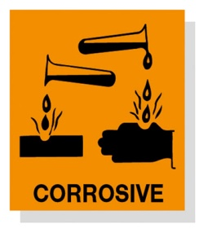
It might be Hazardous Waste if…
If it says ‘danger’ on it
If it says ‘flammable’ on it
If it says ‘toxic’ on it
If it says ‘poison’ on it
If it says ‘warning’ on it
If it has a picture of a skull and cross bones on it
If it has a picture of a fire on it
If it is an acid
If it is a base
If it is a solvent
These items should be evaluated to see if they must be managed as HW.
Note: this list is not exhaustive, it is intended to initiate the evaluation process.
Notes:
7

Slide 8
The regulation defines RCRA C regulated Hazardous Wastes as:
Listed wastes
Characteristic wastes
Ignitable (flash point below 140ºF or 60ºC)
Corrosive (pH <2 or pH >12.5)
Reactive
Toxic
Anything the Administrator or the Director says is
HW
Anything you say is HW
Notes:
8

Slide 9
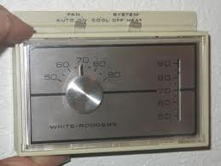
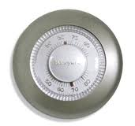
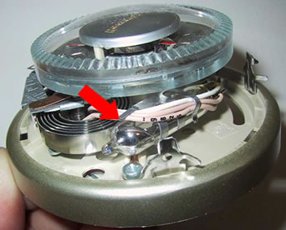
Other RCRA C regulated Wastes
Universal Waste is a subcategory of HW.
Spent florescent lamps (intact only, crushed lamps are usually
HW)
Some batteries
Some pesticides
Mercury thermostats
Used oil is also regulated
Notes:
9

Slide 10
How to figure out if the item is a Hazardous Waste
1 - Decide if it is a waste. Remember, the regulations only apply to waste, not to products you are currently using.
2 - Determine if the waste meets or exceeds one of the criteria in the regulation (see slides 8 & 9).
- Review a current MSDS for the product, the flash point and pH will be listed. Also, many MSDSs now state if the item will be regulated when it becomes a waste.
Ask the vendor for the flashpoint, pH, and ingredients.
Submit a sample for testing
3 – Any waste which meets or exceeds one of the criteria, is a Hazardous Waste.
Notes:
10

Slide 11
How to manage your - Hazardous Waste items
Identify it
Label it
Date it
Close it
Contain it
Inspect it
Dispose of it (correctly)
Train staff
Notes:
11

Slide 12
How to manage your - HW items (continued)
Identify it
Make a determination on all waste to identify all which require management under the regulation
Label it
With the contents if it is not waste
“Hazardous Waste” if it is HW
Universal waste allows several variants (see slides 13 and 14)
Date it - with the accumulation start date
Close it – keep it in a closed container
Contain it – Use secondary containment
Inspect it – conduct weekly inspections, and keep a log
Dispose of it (correctly). Arrange for appropriate disposal using a licensed
contractor on a schedule. You will get a manifest. Keep the manifest for your
records.
Using small bottles helps
Train staff
Notes:
12

Slide 13
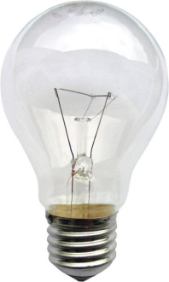
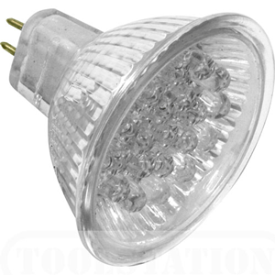
How to manage your - UW lamps
Contain it – put spent lamps in a drum, box, or carton
Label it - “Universal Waste - Lamps” or “Waste Lamps” or “Used Lamps.”
You can’t call them tubes or bulbs, only lamps.
Date it - with the accumulation start date
Close it – keep it in a closed container
Dispose of it (correctly). - You may store UW at your site for up to 1 year.
Arrange for appropriate disposal by a licensed contractor on a schedule
Train staff
Incandescent lamps and LED lights are not UW
Remember that broken or crushed lamps are
never Universal Waste; they are usually
Hazardous Waste,
Notes:
13

Slide 14
How to manage your - UW batteries
Label it - "Universal Waste Battery(ies)" or "Waste
Battery(ies)" or "Used Battery(ies)."
Date it - with the accumulation start date
Dispose of it (correctly). - You may store UW at your site
for up to 1 year.
Arrange for appropriate disposal by a licensed contractor on a schedule
Train staff
Alkaline batteries are not UW
Notes:
14

Slide 15
How to manage your - Used Oil
Label it - “Used Oil”
Close it – Keep the container closed
Contain it – Use secondary containment
Train staff
You cannot burn used oil in the District
Cooking oil is not regulated, only motor oil
Notes:
15

Slide 16
Other regulatory bodies
DDOE
Water Quality Division
Lead Program
Air Quality Program
OSHA
WASA / DC Water
Fire Marshall
DOT
others
Notes:
16

Slide 17
Reminders:
Each site must maintain current information on file with
DDOE-HW.
Remember to send in a revised 8700-12 when the contact person changes, the mailing address changes, the waste streams change, or the generator status changes.
It’s free to update the information!
An annual fee is due every March 1st.
A Self Certification of Compliance is due every March 1st.
Notes:
17

Slide 18
Examples
Notes:
18

Slide 19
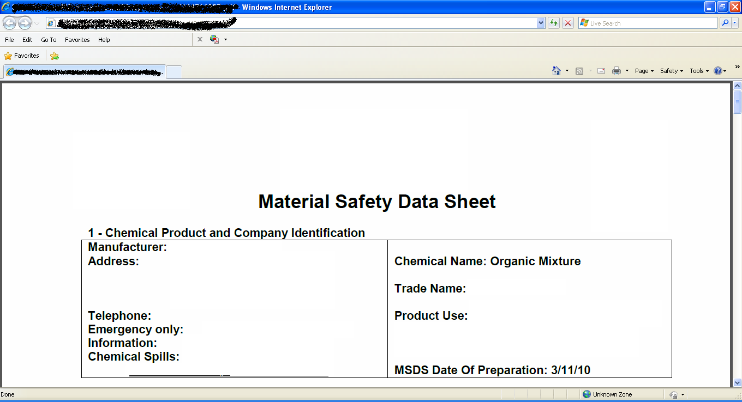
Where is the info on an MSDS? This is what the front page of an MSDS looks like:
Notes:
19

Slide 20
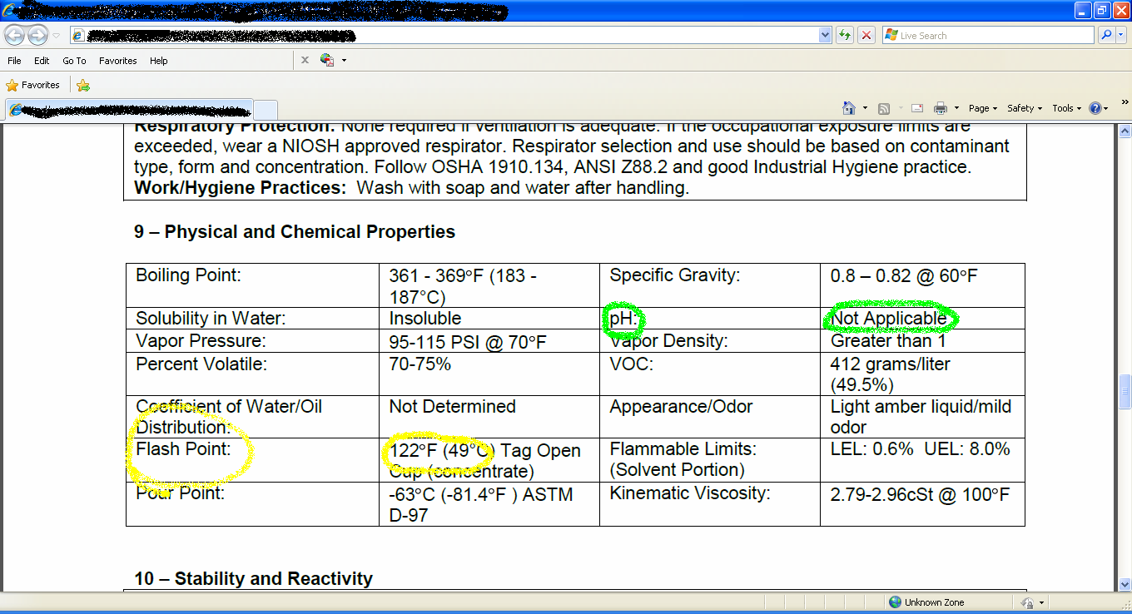
Where is the info on an MSDS? pH and flashpoint area ALWAYS called out.
Notes:
20

Slide 21
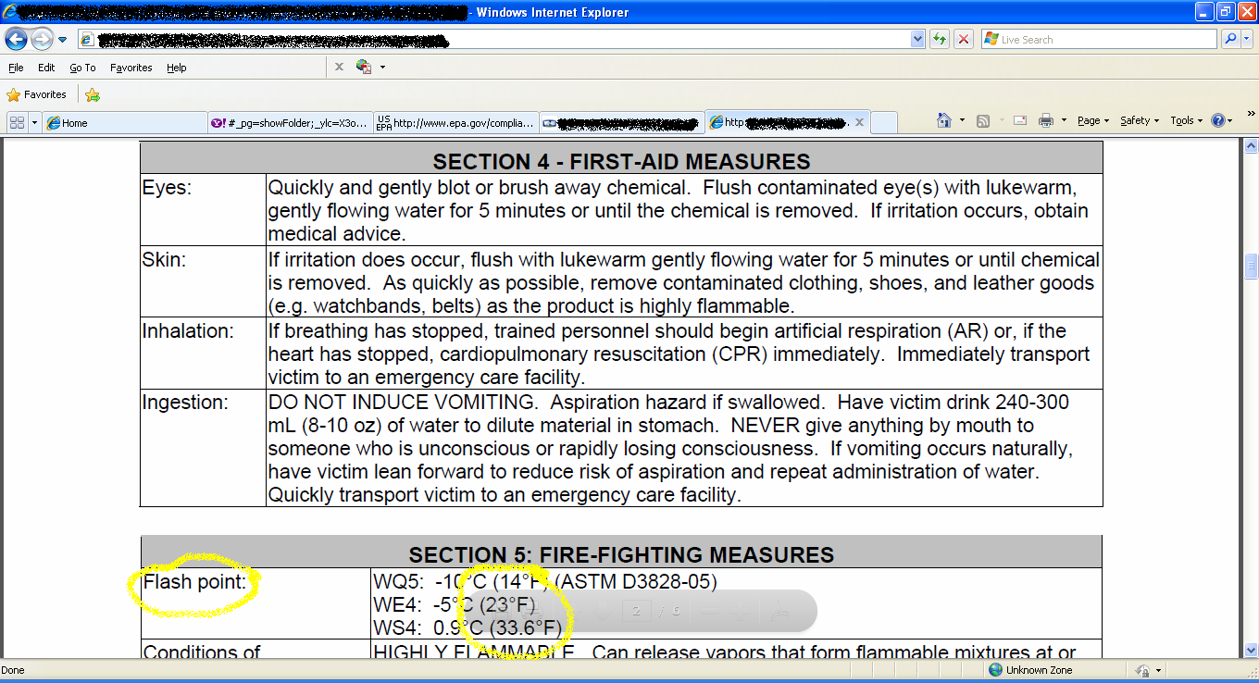
Where is the info on an MSDS? Flash point is not always in the same spot, but it will always be listed.
Notes:
21

Slide 22
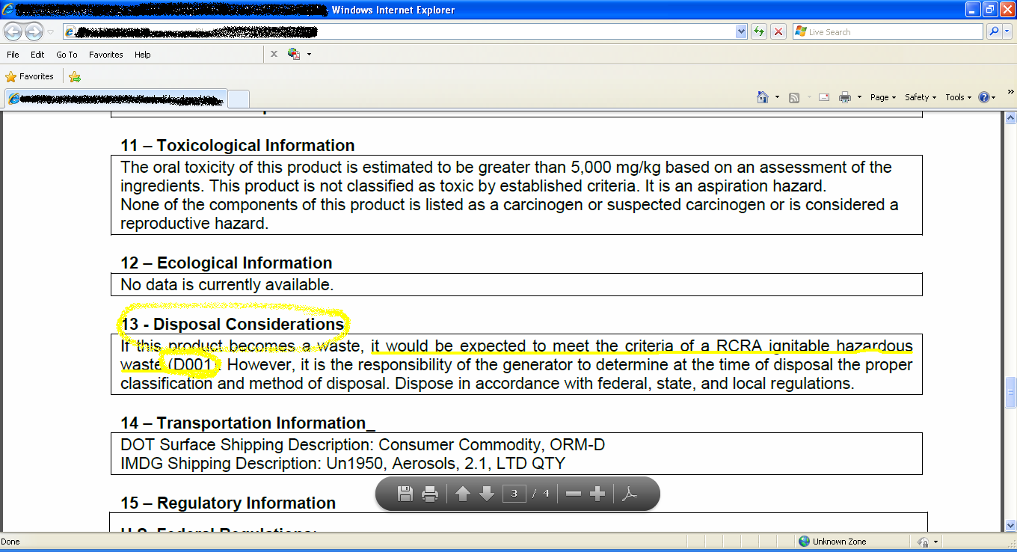
Where is the info on an MSDS? Check the ‘disposal considerations’ for useful information.
Notes:
22

Slide 23
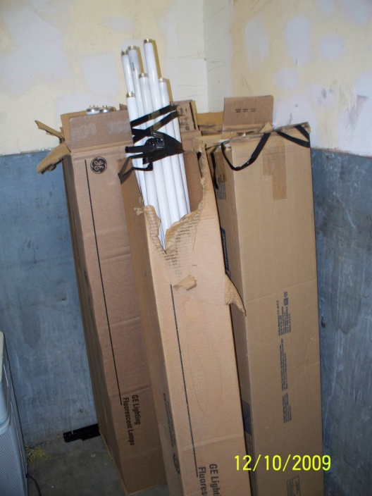
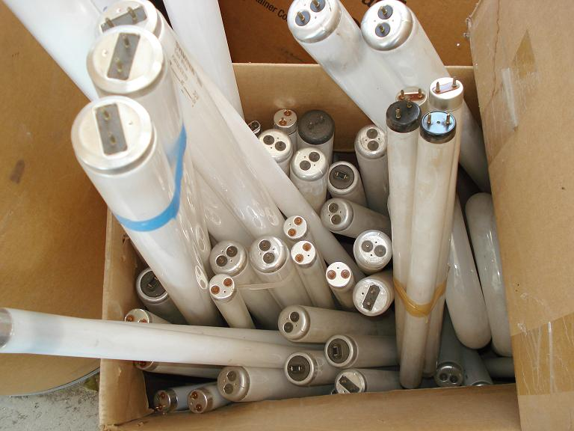
What NOT to do
UW Lamps must be
- in boxes
- which are closed
- are labeled
- and are dated
Notes:
23

Slide 24
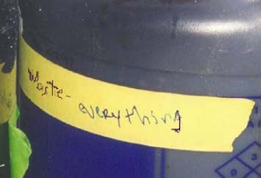
What NOT to do
Labels must be meaningful!
Hazardous Waste must bear the words “Hazardous Waste” and the date it was determined to be a waste.
Notes:
24

Slide 25
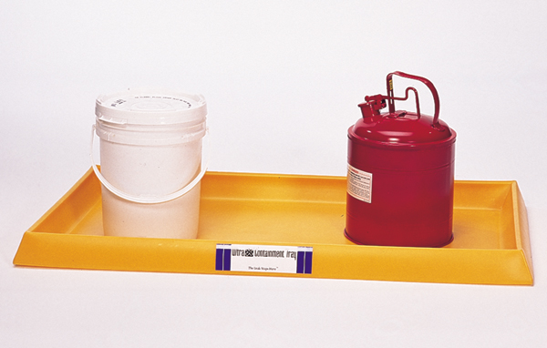
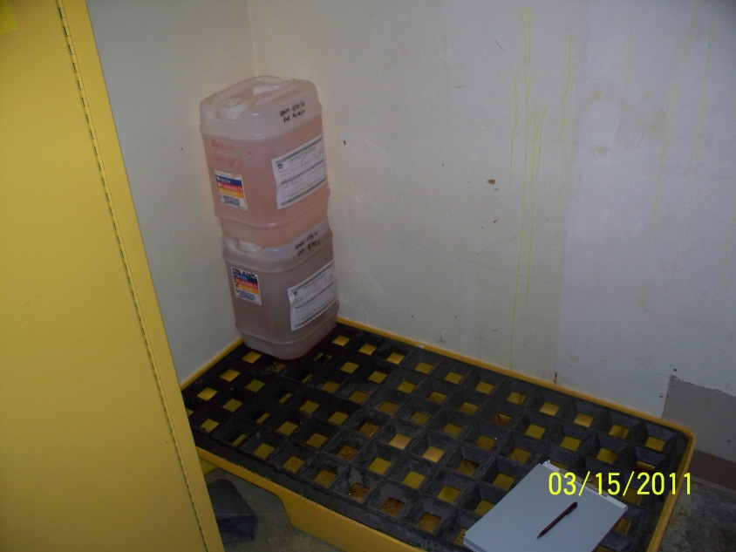
Secondary containment for small containers
Secondary containment units must be capable of containing the volume of the largest container placed on or in it OR 10% of the total volume placed on or in it, whichever is larger.
The secondary containment on the left is very shallow and is meant for use only with small containers. Use this style with caution, it is easy to put too large a container on it.
The unit on the right is much taller (deeper) and will hold more volume.
Notes:
25

Slide 26
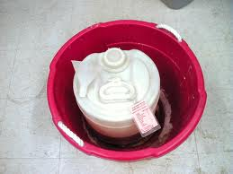
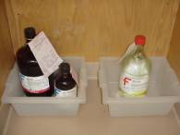
Secondary containment for small containers (continued)
Secondary containment does not have to be fancy or pretty, it just needs to work!
You may have something appropriate onsite already.
Notes:
26

Slide 27
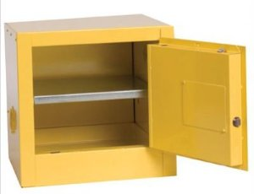
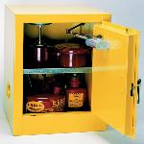
Secondary containment for small containers (continued)
A flammables or corrosives cabinet is often suitable.
Confirm that the unit you have has a tray in the bottom, older units may not have one.
Also, check the tray occasionally to make sure it is not rusted out.
Notes:
27

Slide 28
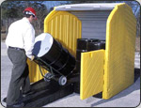
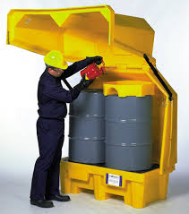
Secondary containment for large containers
These are suitable for use outdoors. There are different styles available.
Notes:
28

Slide 29
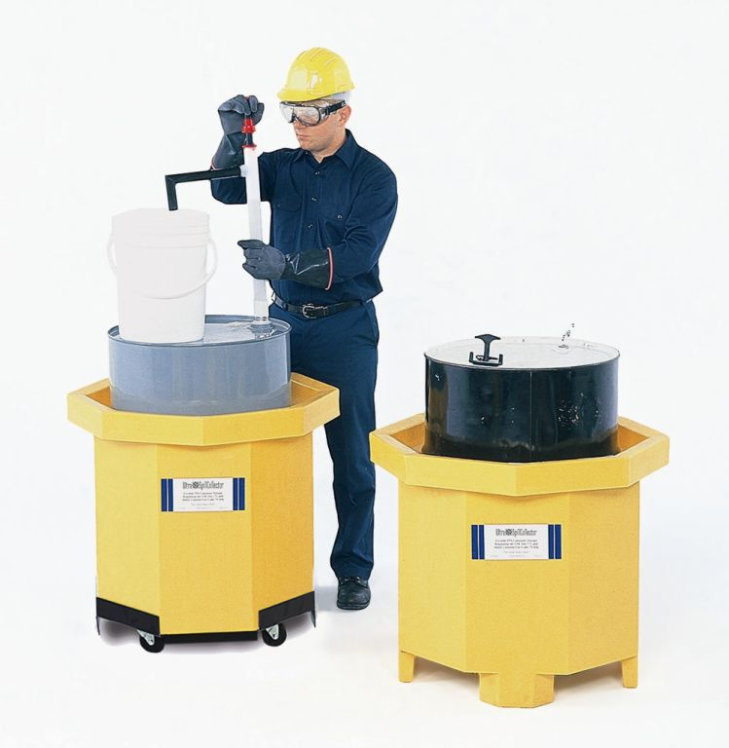
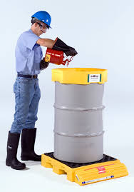
Secondary containment for large containers (continued)
These are not suitable for use outdoors.
A variety of configurations are available, pick one that works in your space.
Notes:
29

Slide 30
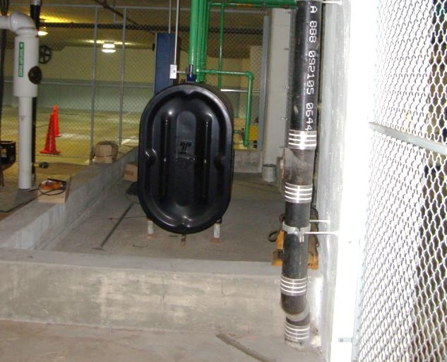
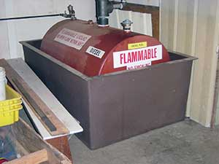
Secondary containment for ASTs
Notes:
30

Slide 31
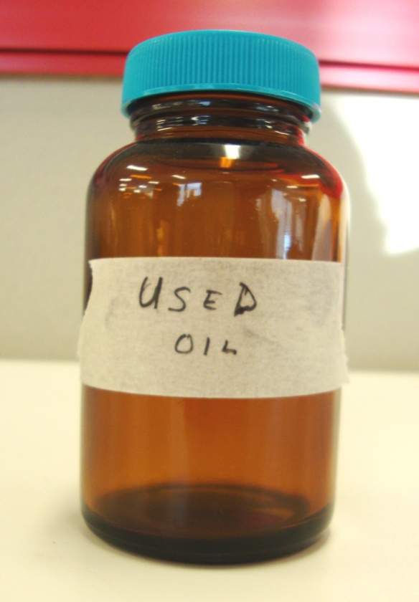
Used oil labels - examples
Handmade labels are ok. Be sure to put the bottle of used oil in secondary containment.
Notes:
31

Slide 32
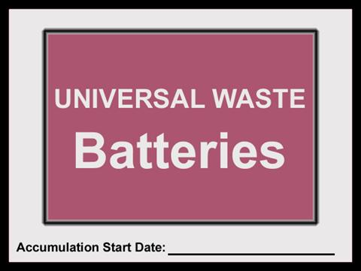
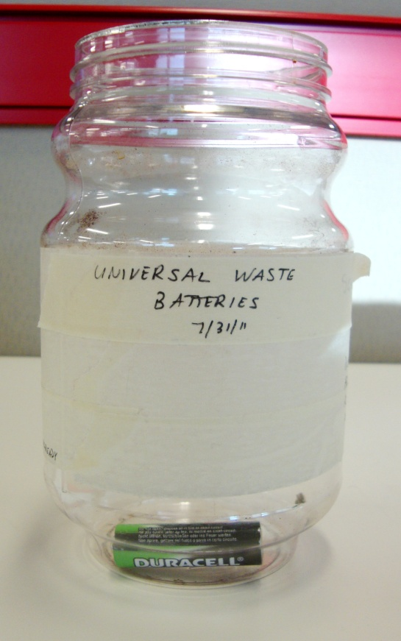
UW battery labels - examples
Handmade labels are ok.
It may be easier to put small batteries in a container and label and date the container than to label each individual battery.
Notes:
32

Slide 33
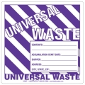
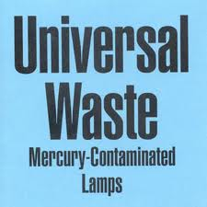
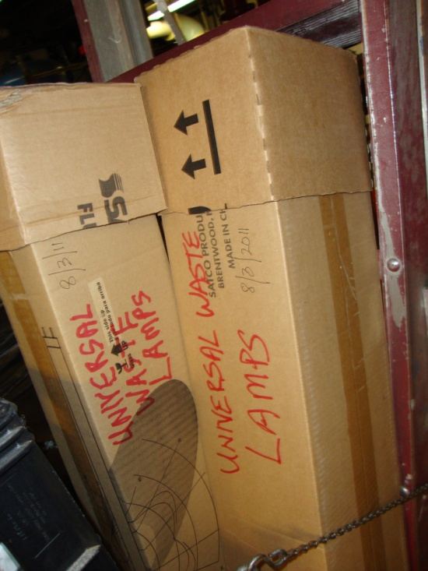
UW lamp labels - examples
Hand written labels are ok. Make sure the date is included (in this photo the date is very faint)
Both labels above need to have a date added to them.
Notes:
33

Slide 34
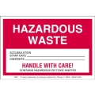
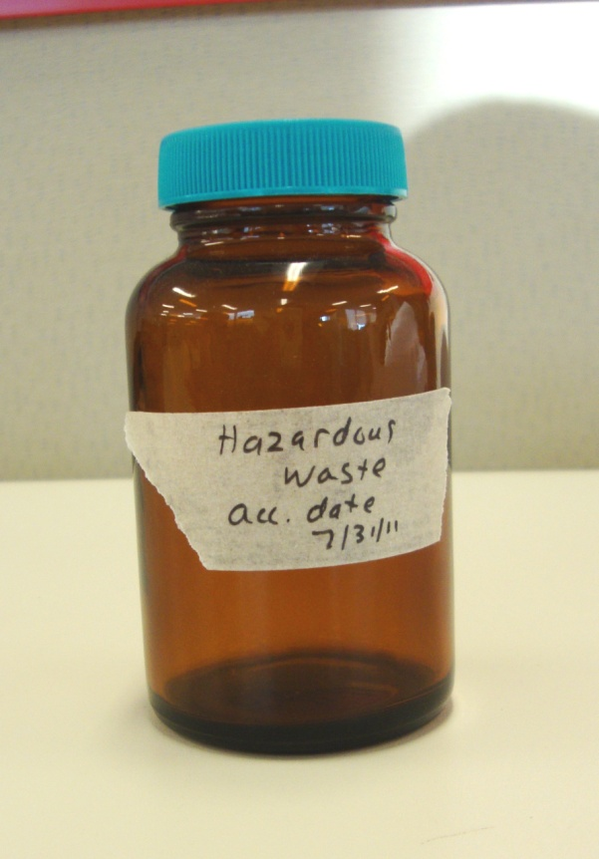
HW labels - examples
Hand written labels are ok. Be sure to put the bottle of HW in secondary containment.
Notes:
34

Slide 35
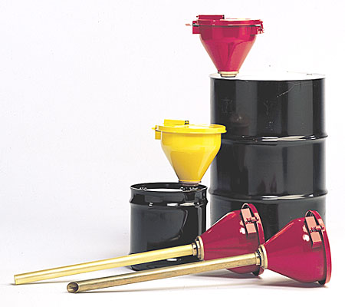
Containers of used oil must be closed, a self closing funnel may be used
Notes:
35

Slide 36
Resources
District Regulations may be viewed online at: http://www.dcregs.org/Gateway/ChapterHome.aspx?ChapterNumber=20-42
AND
http://www.dcregs.org/Gateway/ChapterHome.aspx?ChapterNumber=20-43
District Law may be viewed online at: http://ddoe.dc.gov/sites/default/files/dc/sites/ddoe/publication/attachments/Haz.Waste%20Managment_law_1977.pdf
EPA form 8700-12 can be found here:
http://www.epa.gov/osw/inforesources/data/form8700/8700-12.pdf
District Department of the Environment website:
www.green.dc.gov
Questions can be answered by contacting DDOE Hazardous Waste Program at: (202) 535-2290
EPA Regulations may be viewed online at: http://www.epa.gov/lawsregs/search/40cfr.html
EPA Assistance document for Managing Hazardous Waste for Small Businesses:
http://www.epa.gov/osw/hazard/generation/sqg/handbook/k01005.pdf
Notes:
36

