Slide 1
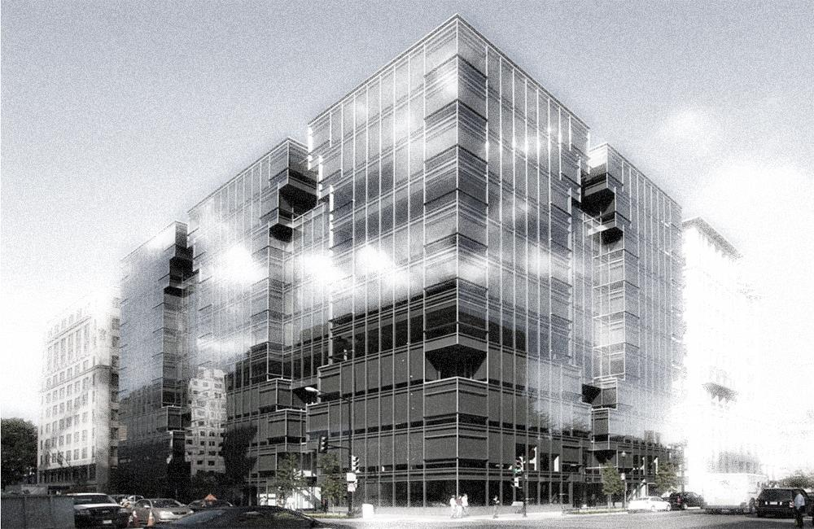
Energy Benchmarking: How to Enroll in Automatic Reporting

Slide 2
Sustainable DC VISION
Make DC the healthiest, greenest, most livable city in the country.

Slide 3
GOALS: 2032
ADAPT TO CLIMATE CHANGE
CLIMATE READY BUILDINGS
CUT ENERGY USE 50%
50% RENEWABLE ENERGY
NET ZERO NEW BUILDINGS
NET ZERO RETROFITS
CUT GHG EMISSIONS 50%
MAYOR BOWSER: COMMITTED TO ZERO CARBON BY 2050

Slide 4
CLEAN ENERGY DC
MEANS….
NEW BUILDINGS
Adopt a Net Zero Energy building code by 2026
EXISTING BUILDINGS
Improve the performance of existing buildings by implementing a Building Energy Performance Standard
100% RENEWABLE ELECTRICITY
Require 100% renewable electricity by 2032, and 10% from local solar by 2041
CLEAN ENERGY DC OMNIBUS ACT OF 2018

Slide 5
Benchmarking Basics
Clean and Affordable Energy Act of 2008 requires all private buildings >50,000 square feet to report their annual energy and water use
Annual reporting deadline is April 1 of each year
All reporting is done through the US EPA’s ENERGY STAR Portfolio Manager
Failure to meet the reporting requirements results in a fine of up to $100/day for every day that buildings are not in compliance
In 2022 (reporting 2021 data), the benchmarking building size threshold drops to 25k sq ft, and in 2024 (reporting 2023 data) it drops to 10k sq ft
Notes:
Clean and Affordable Energy Act of 2008: https://doee.dc.gov/sites/default/files/dc/sites/ddoe/publication/attachments/CAEA_of_2008_B17-0492.pdf
Portfolio Manager login: https://portfoliomanager.energystar.gov/pm/login.html
Clean Energy DC Omnibus Act of 2018: https://code.dccouncil.us/dc/council/laws/22-257.html

Slide 6
Benchmarking Resources
ENERGY STAR Portfolio Manager offers a number of webinars and recorded videos that cover the basics of how to benchmark a building and use the Portfolio Manager tool
We recommend Portfolio Manager 101 for buildings that are benchmarking for the first time
Full list of upcoming webinars, recorded presentations, and demonstration videos found here: www.energystar.gov/buildings/training/training
Portfolio Manager also maintains a comprehensive list of FAQs found here: https://portfoliomanager.zendesk.com/hc/en-us

Slide 7
Benefits of Automatic Reporting
Automatic Annual Reporting is done through Portfolio Manager Web Services
Allows DOEE to automatically download property use details and energy and water data from your Portfolio Manager account
One-time enrollment process and replaces manual submission of benchmarking reports
Updates or changes to your report are automatically transferred to DOEE without needing to resubmit report
Easy transfer of ownership in Portfolio Manager
Pre-reporting compliance assistance and data quality checks

Slide 8
Disclaimers
You will still need to update energy and water use information in Portfolio Manager every year before the reporting deadline
DOEE is able to see and download data from your property, but it does NOT have the ability to edit, add, or delete any records
DOEE will be able to see all data input into your Portfolio Manager property, including cost information. However, DOEE will NOT collect, download, or disclose any financial information during reporting process

Slide 9
Prior to Submitting Your Report
Enter complete property use details and energy and water data into your Portfolio Manager account for the applicable calendar year. If you are benchmarking for the first time, refer to Portfolio Manager 101 training and the District’s Data Collection Worksheet to see what is required
To be reported, your property must have an address with “District of Columbia (D.C.)” set as the state, and have an Energy Use Intensity (EUI) number
Identify your properties in Portfolio Manager using the District of Columbia Real Property Unique ID
Run the Data Quality Checker in Portfolio Manager to identify any missing or unusual values in your report
Notes:
DOEE updates the Covered Building List each year with the most recent Real Property Unique ID based on tax lot data: https://doee.dc.gov/page/am-i-required-benchmark
District Data Collection Worksheet: https://doee.dc.gov/sites/default/files/dc/sites/ddoe/publication/attachments/District%20Data%20Collection%20Worksheet%2C%202019.pdf
Portfolio Manager Trainings: www.energystar.gov/buildings/training/training

Slide 10
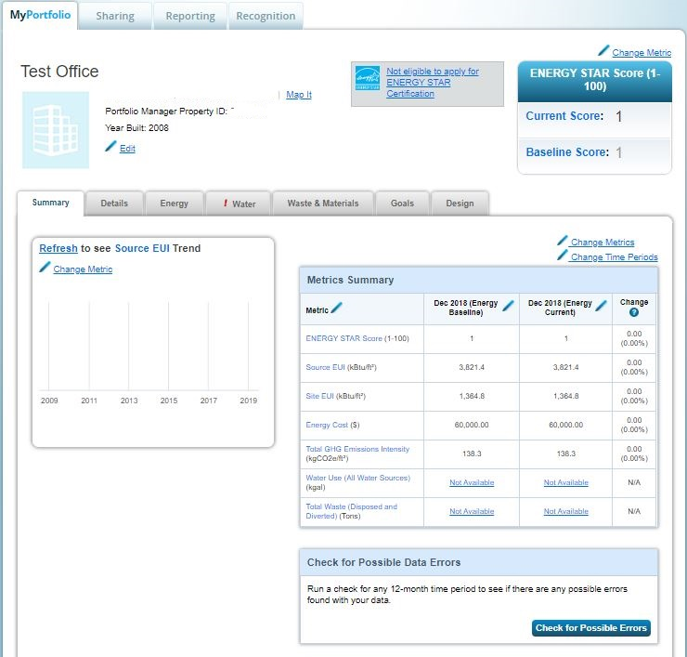
Running Data Quality Checker:
Once you click the button to “Check Data Quality,” Select December for the month, select the year for which you are attempting to report, and click “Run Checker”
Make sure to fix any relevant alerts before reporting data to DOEE
Any alerts regarding waste can be disregarded - reporting waste consumption is not required

Slide 11
Step by Step: Enrolling in Automatic Reporting through Portfolio Manager Demonstration

Slide 12
Post-Reporting Timeline
March 1: DOEE will start reviewing data for quality issues and sending emails alerting reporters of errors and how to fix them
We will NOT check for compliance until after the April 1 reporting deadline; this is for pre-reporting compliance assistance purposes only
April 1: Benchmarking reports due to DOEE
After April 1 : DOEE will start sending compliance and data quality emails
If report is complete and accurate, you will receive email confirmation that your report has been accepted
If report has incomplete or inaccurate data, you will receive an email with these errors flagged and steps to remedy them

Slide 13
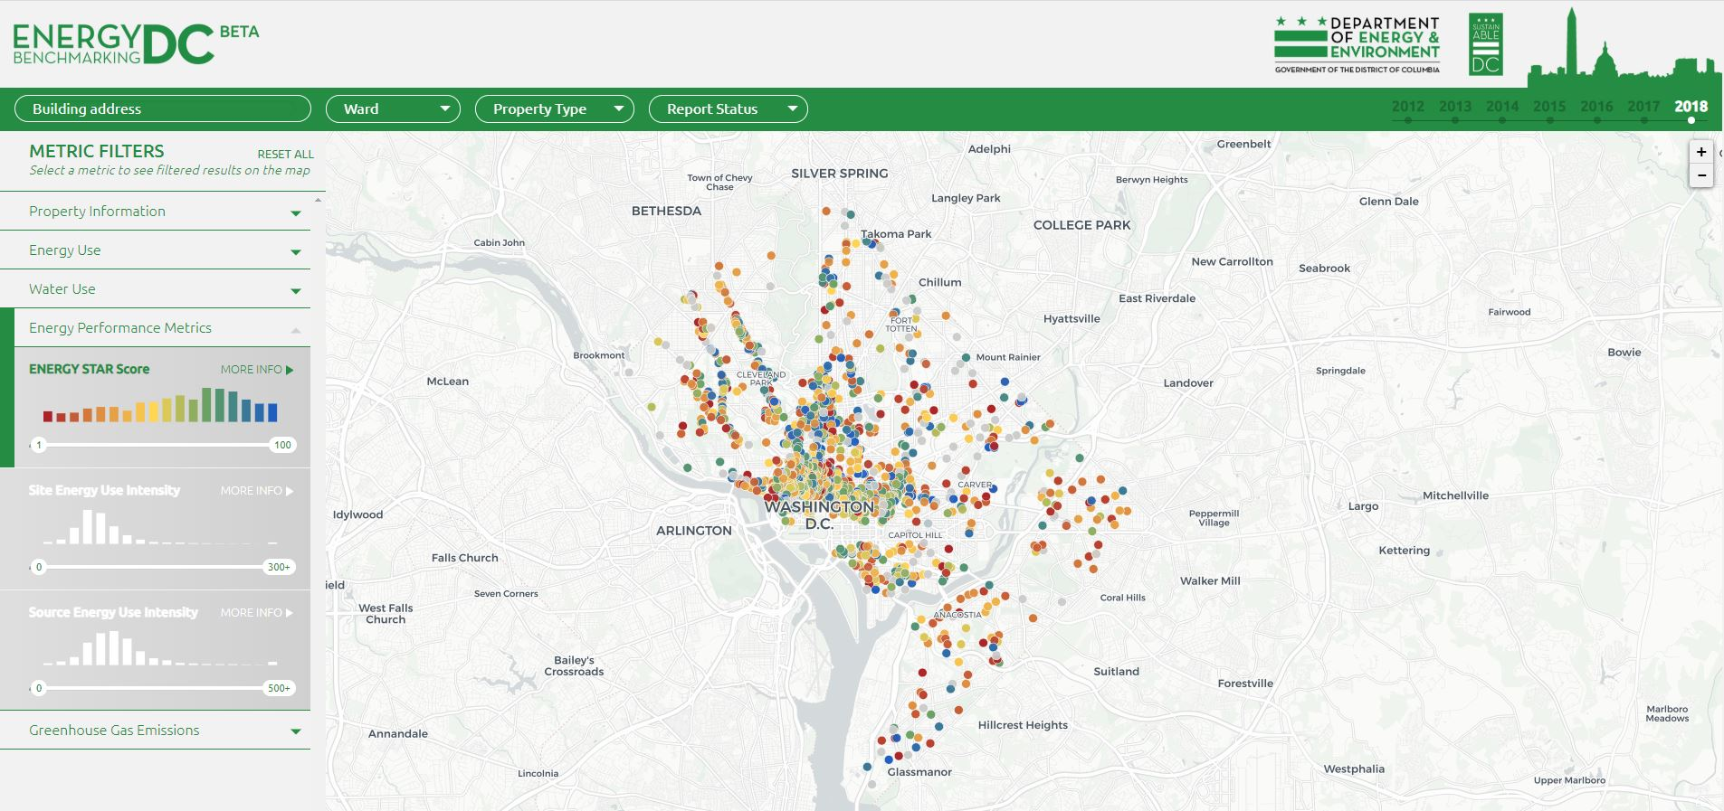
Public Disclosure
Once DOEE has received all benchmarking reports, they are publically disclosed on our benchmarking disclosure map and OpenDataDC
Map: energybenchmarkingdc.org
OpenData: opendata.dc.gov/datasets/building-energy-benchmarks

Slide 14
Additional Analysis Resources
ENERGY STAR Score: your ES score is a screening tool that can help you assess your building’s performance
A score of 50 is the national median – so if your score is above a 50 it means your building is performing better than 50% of its peers across the U.S.
Notes:
Understanding your ES Score: https://www.energystar.gov/buildings/facility-owners-and-managers/existing-buildings/use-portfolio-manager/interpret-your-results/what
What goes into your ES score by property type: https://portfoliomanager.energystar.gov/pm/dataCollectionWorksheet

Slide 15
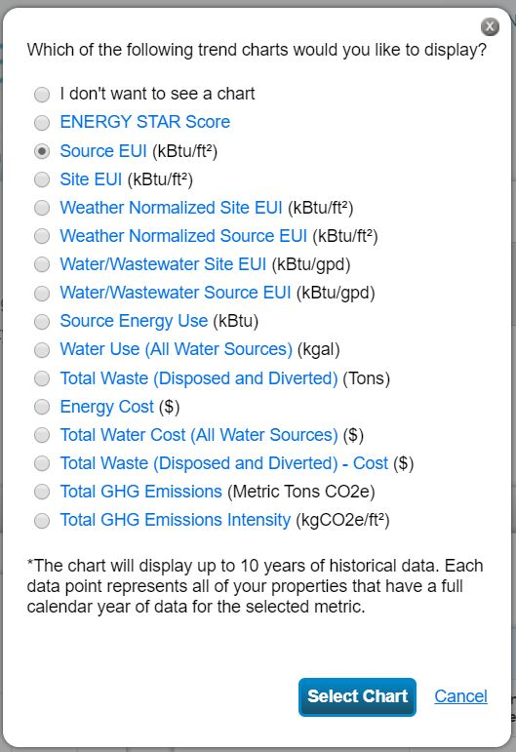
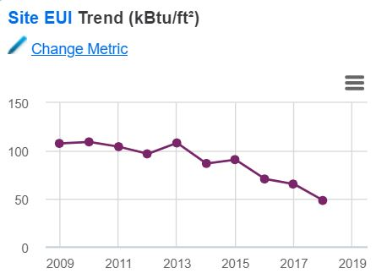
Additional Analysis Resources
Evaluating Trends: use Portfolio Manager to track your building’s performance over the years
Summary Tab: see a quick overview of yearly performance using different performance metrics

Slide 16
Additional Analysis Resources
Charts and Graphs: under the Reporting tab, use Portfolio Manager’s existing charts and graphs templates, or create your own specialized report to evaluate specific metrics.
Portfolio Manager training video on how to create reports and graphs found here: https://www.energystar.gov/buildings/facility-owners-and-managers/existing-buildings/use-portfolio-manager/interpret-your-results/create
Notes:
Portfolio Manager demonstration video - Creating Reports and Graphs: https://www.energystar.gov/buildings/facility-owners-and-managers/existing-buildings/use-portfolio-manager/interpret-your-results/create

Slide 17
Contact Information
If you have additional questions please contact the Benchmarking Help Center:
Email: info.benchmark@dc.gov
Phone Number: 202-671-3300
Website: doee.dc.gov/energybenchmarking

Slide 18
Question &
Answer

