Slide 1
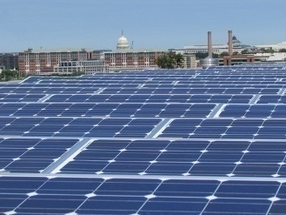
GREEN BUILDING REPORT
2018

Slide 2
GREEN BUILDING PROGRESS
GREENHOUSE GAS EMISSIONS PER SECTOR
2006
2016
2017
10.4 MTCO2e
7.5 MTCO2e
7.3 MTCO2e
Data received from DOEE’S Urban Sustainability Administration
@DOEE_DC
Notes:
The District has made significant progress towards its goal of significantly reducing greenhouse gas emissions by implementing the Green Building Act and other policies to cut energy use and increase the use of renewable energy. Between 2006 and 2017*, citywide greenhouse gas emissions decreased by 30%, even while the District’s population increased by 19% and the economy grew by 18%. Emissions attributed to buildings also fell 34% between 2006 and 2017.
The graphic above shows the District’s greenhouse gas emissions broken down by sector. The building and energy sector includes residential, non-residential, and federal properties of the General Service Administration. The building and energy sector also includes fugitive emissions – emissions associated with unintended natural gas leakage – due to the fact that the vast majority of these emissions come from energy use. Transportation emissions result from Metrorail and on-road vehicles such as buses, trains, and cars. The waste sector encompasses emissions associated with treating and disposing of waste and wastewater generated in the District, such as emissions that are released from landfills, incinerators, and from the Blue Plains wastewater treatment facility.
Changes to the regional electrical grid were by far the most significant factor driving emissions reductions between 2006 and 2017. This is largely due to the increasing share of electricity generated by natural gas power plants and the corresponding decline in power generation from coal-fired power plants. Shifting from burning coal to natural gas has reduced the greenhouse gas emissions associated with each kilowatt of electricity used in the city. Grid changes accounted for 64% of the total reduction between 2006 and 2017.
As buildings account for the largest share of the District’s emissions, reducing building energy use will be critical as the District moves towards its goal to be carbon neutral by 2050.
*2017 is the most recent year for which the District has completed a greenhouse gas inventory The District will publish a 2018 inventory in 2020. Emissions are reported in metric tons of carbon dioxide equivalent (MTCO₂e).
Resources:
https://doee.dc.gov/service/greenhouse-gas-inventories

Slide 3
THE DISTRICT’S PERFORMANCE NATIONALLY
Ranked #1 nationally for green roof installations
2nd in nation in community green power purchasing
#1 nationally in LEED per capita certified gross square feet for 5 years running
#2 metro area nationally with the most ENERGY STAR certified buildings
@DOEE_DC
Notes:
The District’s innovative policies and ambitious programs for green building have resulted in many significant accomplishments. As a consequence of the city’s green building practices, the District has been recognized as a leader nationally in several areas.
The following accomplishments are highlights of the District’s successes in the green building space in 2018:
Ranked #1 nationally in LEED certified gross square-foot per capita among states
Ranked #2 in national metro area with the most ENERGY STAR certified buildings
18 new projects achieved Green Communities Prebuild approval through Enterprise Green Communities; 11 projects achieved certification (completed both Prebuild and Postbuild)
Installed 437,292 square feet of new green roofs
Installed 6,212,677 square feet of green infrastructure Best Management Practices across the District
2nd in nation for community green power purchasing
Resources:
https://www.usgbc.org/articles/us-green-building-council-announces-annual-top-10-states-leed-green-building-2018
https://doee.dc.gov/publication/inventory-green-roofs
https://livingarchitecturemonitor.com/news/2019/10/9/15th-annual-green-roof-industry-survey-shows-washington-dc-with-most-green-roofs-installed
https://www.epa.gov/greenpower/green-power-communities
https://doee.dc.gov/service/greenhouse-gas-inventories

Slide 4
THE DISTRICT’S PERFORMANCE: LEADERSHIP IN ENERGY AND ENVIRONMENTAL DESIGN (LEED)
111 DISTRICT BUILDINGS RECEIVED LEED CERTIFICATIONS IN 2018
LEED CERTIFICATIONS BY TYPE 2014-2018
LEED CERTIFICATION BY YEAR
CERTIFIED
PROJECTS
CERTIFIED
PROJECTS
Data received from the US Green Building Council
@DOEE_DC
Notes:
As a result of the District’s green building legislation and the push to make the city’s buildings more sustainable and energy-efficient, the number of LEED-certified buildings in the District has significantly increased in recent years. LEED (Leadership in Energy and Environmental Design) is one of the most widely used green building rating systems in the world and provides a framework to promote healthy, efficient, and cost-saving buildings. LEED-certified spaces generally use less energy and emit fewer greenhouse gas emissions than their non-certified counterparts.

Slide 5
BENCHMARKING
WHO MUST REPORT
Type | Threshold | Requirement
Private Buildings | Over 50,000 SF | Must report energy and water consumption
Public Buildings | Over 10,000 SF
Identify
Collect
Benchmark
Submit
Disclosure/ Enforcement
BENCHMARKING REPORTING PROCESS
@DOEE_DC
Notes:
The Clean and Affordable Energy Act of 2008 created the mandate for benchmarking and disclosing building energy and water use in the District. The passage of this Act made the District one of the first cities in the nation to pass a law requiring public and private buildings to track and report energy and water performance data using standard metrics. Since its passage, the benchmarking requirements provide transparency to prospective tenants and have encouraged building owners to cut their energy use. To better understand how the District’s buildings were utilizing energy and water, the District required that public buildings of 10,000 square feet (SF) or larger and private buildings of at least 50,000 square feet report their energy data using the ENERGY STAR portfolio manager (ESPM) tool. Publicly financed buildings over 10,000 SF also must report benchmarking data. This class of buildings is not yet on the covered buildings list, though listing and disclosure is forthcoming. Currently, nearly half of the District’s total floor area is covered by the benchmarking and disclosure requirements. The Clean Energy DC Omnibus Amendment Act of 2018 expanded the requirements to include buildings that are 25,000 SF or more in 2021 and 10,000 SF or more in 2024.
The reporting process for any building consists of several key steps:
A property team must first identify that the property is covered by the Clean and Energy Act of 2008 and then establish the staff or consultants responsible to complete the building’s benchmarking requirements.
Next, the property team must create a profile on ENERGY STAR Portfolio Manager (ESPM) as well as review the DOEE guidelines online.
The property team must then collect the property’s DC Real Property ID, gross floor area, property use information, and complete utility data.
Next, the team must create entries for each of the properties on the ESPM.
Then, the space use data and meter data must be entered.
The data must be submitted using DOEE’s reporting template after the data has been verified as accurate by the property team. The law requires that these records be saved for three years.
DOEE reviews the data and follows up if errors are present.
Finally, the data and reports are publicly disclosed through DOEE’s website and interactive mapping tool.
Resources:
https://doee.dc.gov/energybenchmarking

Slide 6
BENCHMARKING CHANGES (changed in Clean Energy DC Act)
022
2009
2013
2020
2013
2020
2013
2022
2025
Benchmarking private-owned
> 50K sf
Benchmarking private-owned drops to 25K sf for 2021 data
Third Party Verification Required for 2019 data
Benchmarking private-owned drops to 10K sf for 2024 data
Benchmarking DC-owned
> 10K sf
@DOEE_DC
Notes:
The Clean Energy DC Act requires that starting in 2020, benchmarking data will need to be verified by a third party. Verification is then now every three years thereafter.
The new Benchmarking Performance and Enforcement Branch sent out personalized scorecards to building owners based on their 2018 benchmarking data in Fall 2019. The scorecards informed owners how their building performed in the last reporting cycle, how their buildings compare to other similar buildings in the District, and where to get help to improve the efficiency of their buildings.
Resources:
https://doee.dc.gov/node/1442826

Slide 7
BENCHMARKING IMPLEMENTATION
% OF COMPLETE REPORTS RECEIVED 2014 – 2018
(PUBLIC & PRIVATE BUILDINGS)
CALENDAR YEAR
Data received from DOEE’s Energy Administration
@DOEE_DC
Notes:
The above graph highlights the rate of complete reports received from both public and private buildings between 2014 and 2018. As the graph demonstrates, there has been an increase in the number of reports received by the April 1 deadline. There has also been an increase in total number of reports received between 2014-2018. In 2018, 1,577 buildings submitted complete reports out of the 1,686 buildings required to benchmark.
From this slide on, all of the data was provided by the District’s Energy Administration. This data was collected through requirements of the District’s Green Building Act and the Clean and Affordable Energy Act, D.C. Official Code § 6-1451.03(c), implementing regulations in 20 DCMR 3513. From this slide on, the data will be cited as “Data received from DOEE’s Energy Administration.”
The data provided in the following slides includes information that has been analyzed differently than previous years. Historically, the Energy Administration only included data for a building if it had data for every single reporting year. If data was missing, a building and its data were not included. For reporting year 2018, estimates were made for buildings that had data missing for a complete calendar year. The data was interpolated and either back-casted or forecasted to estimate the missing years. As such, the 2018 data has higher building counts.
It should also be noted that across both the public and private sector the weather normalized site energy use intensity has increased for the 2018 data reported. In the past the data reported by some multifamily buildings has only included common areas instead of whole building data. The Energy Administration worked with building owners and managers in the more recent reporting cycles to obtain aggregated whole building data from District Utilities.
Resources:
http://energybenchmarkingdc.org/#dc/2018?categories[0][field]=report_status&categories[0][values][]=In+Compliance&categories[0][other]=false&layer=energy_star_score&metrics[]=energy_star_score&sort=energy_star_score&order=desc&lat=38.889931&lng=-77.009003&zoom=12

Slide 8
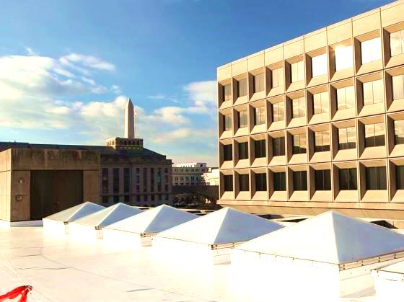
PUBLIC BUILDING PERFORMANCE
ENERGY BENCHMARKING – PUBLIC SECTOR KEY TRENDS
Public Buildings saw a 0.5% decrease in weather-normalized Site Energy Use Intensity (EUI) from 2014-2018. EUI is a measure of energy use. From 2014-2018:
K-12 public schools Site EUI decreased 2.1%
District multifamily housing Site EUI increased 19.4%
Data received from DOEE’s Energy Administration
@DOEE_DC
Notes:
This slide summarizes the key trends in public building performance shown in the next two slides.
One metric by which building performance can be measured is through weather-normalized site energy use intensity (EUI). Site EUI is a standard metric used to measure building energy use by square foot. When the Site EUI is weather-normalized it means that the data has been smoothed out such that changes in weather from year to year do not affect measured energy use.
Resources:
https://opendata.dc.gov/datasets/building-energy-benchmarks/data

Slide 9
PUBLIC BUILDING PERFORMANCE
WEATHER NORMALIZED SITE ENERGY USE INTENSITY 2014-2018
(PUBLIC BUILDINGS)
N=235 buildings
Weather Normalized
Site EUI
(kBtu/ft²)
CALENDAR YEAR
Data received from DOEE’s Energy Administration
@DOEE_DC
Notes:
This graph shows the weather-normalized site EUI for public buildings in the District in kbtu of energy used per square foot. It should be noted that the scale of the graph has been set to better demonstrate this downward trend. Despite some year-to-year fluctuations, partly due to a small sample size, the weather-normalized site EUI for public buildings has fallen 0.5% between 2014 and 2018.

Slide 10
PUBLIC BUILDING PERFORMANCE BY SECTOR
WEATHER-NORMALIZED SITE EUI FOR PUBLIC BUILDINGS BY SECTOR
N=143 Buildings
WEATHER NORMALIZED
SITE EUI
(KBTU/FT²)
Calendar Year
Data received from DOEE’s Energy Administration
@DOEE_DC
Notes:
The above graph shows the weather-normalized Site EUI for public buildings by sector. From 2014-2018, the weather-normalized site EUI has decreased 2.1% for District public schools and increased 19.4% for multi-family housing owned by the DC Housing Authority. Libraries and other public building types are not shown due to the limited number of data points.
Resources:
https://opendata.dc.gov/datasets/building-energy-benchmarks/data

Slide 11
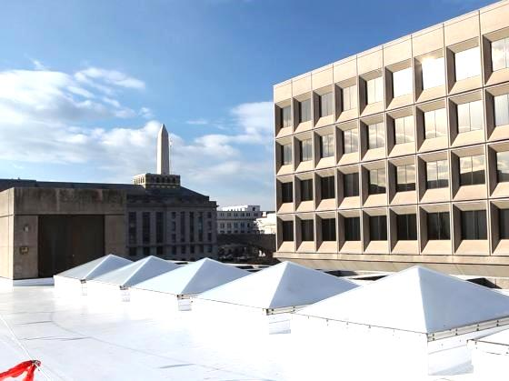
PRIVATE BUILDING PERFORMANCE
ENERGY BENCHMARKING – PRIVATE SECTOR KEY TRENDS
Private Buildings saw a 1% decrease in weather-normalized Site Energy Use Intensity from 2014-2018. From 2014-2018:
Office buildings’ Site EUI decreased by 5.5%
Multifamily housing buildings’ Site EUI increased by 7%
Hotels’ Site EUI decreased by 3%
@DOEE_DC
Notes:
The above slide summarizes the key trends in private building performance graphs shown in the next three slides.
Prior to 2013, building performance data from the private sector did not include buildings under 100,000 square feet. In order to consider the largest data set feasible for this report, the analysis of private sector building performance begins in 2013, when private buildings 50,000 square feet or greater began reporting performance data.
It should be noted that while past reports have included a District vs. National Private Buildings Median Site EUI comparison, this report does not. This is because the national median site EUI is different from prior years as the EPA updated their national median reference data to reflect 2012 Commercial Buildings Energy Consumption Survey (CBECS) data. As a result, national ENERGY STAR scores were recalibrated and cannot be compared to the District’s Median Site EUI.
Resources:
https://www.energystar.gov/buildings/facility-owners-managers/existing-buildings/use-portfolio-manager/update-energy-star-scores-cbecs

Slide 12
PRIVATE BUILDING PERFORMANCE
WEATHER NORMALIZED SITE ENERGY USE INTENSITY 2014-2018
(PRIVATE BUILDINGS)
N= 1578 Buildings
1% decrease from 2014-2018
WEATHER NORMALIZED SITE EUI (KBTU/FT²
CALENDAR YEAR
Data received from DOEE’s Energy Administration
@DOEE_DC
Notes:
Private building performance has improved from 2014-2018. The above graph shows the weather-normalized Site EUI for 1578 private buildings in the District. Overall, weather-normalized Site EUI in private buildings the District fell 1.0% from 2014-2018.
Broken down by sector, weather-normalized Site EUI decreased 5.5% in office buildings, by 3.0% in hotels, yet rose in multifamily buildings by 7%, and colleges/universities by 8.2%. The analysis includes data from 564 office buildings, 633 multifamily housing buildings, 133 hotels, and 18 colleges/universities’ properties.. It should be noted that the College/University building analysis only included buildings that self-designated as “College/University” in Portfolio Manager and have been reporting consistently since 2013. As a result, a relatively small sample size was used which could help explain large annual fluctuations in energy performance.

Slide 13
PRIVATE BUILDING PERFORMANCE BY SECTOR: OFFICE BUILDINGS
WEATHER NORMALIZED SITE ENERGY USE INTENSITY 2014-2018
(OFFICE BUILDINGS)
N= 564 Buildings
WEATHER NORMALIZED SITE EUI (KBTU/FT²)
CALENDAR YEAR
Data received from DOEE’s Energy Administration
@DOEE_DC
Notes:
The above graph displays the weather-normalized Site EUI for 564 office buildings from 2014-2018. Private office buildings’ weather-normalized Site EUI fell 5.5% between 2014-2018.

Slide 14
PRIVATE BUILDING PERFORMANCE BY SECTOR: MULTIFAMILY HOUSING
N= 633 Buildings
WEATHER NORMALIZED SITE EUI (KBTU/FT²
CALENDAR YEAR
Data received from DOEE’s Energy Administration
@DOEE_DC
Notes:
The above graph displays the weather-normalized Site EUI for multifamily housing buildings from 2014-2018. The weather-normalized Site EUI rose 7.0% in multifamily housing between 2014-2018.

Slide 15
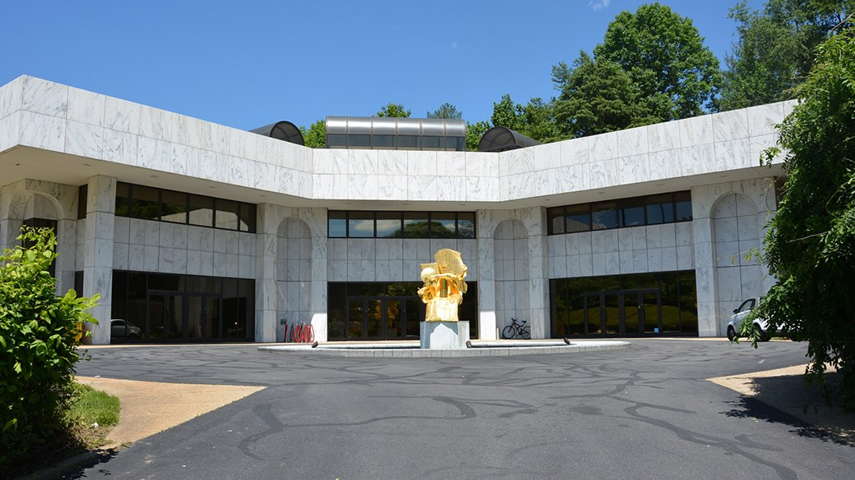
ENERGY PERFORMANCE SPOTLIGHT
The Embassy of France is the first Embassy in the United States to receive the LEED Gold v4 Certification for Existing Building Operations & Maintenance
FRENCH EMBASSY 4101 RESERVOIR RD NW
The sustainability features include:
Installed building management system and cut energy use over 30% since 2010
Installed 10,000 SF green roof and beehives
Electric bikes available for employees
Publication of a monthly letter: “The Green Embassy Post”
Project accomplishments
@DOEE_DC
Notes:
In 2018, The Embassy of France (217,349 square feet) became the first Embassy in the United States to earn the LEED Gold v4 certification. It has been ENERGY STAR certified since 2012, and its score in 2018 was 92. The “Green Embassy” project was launched to improve the performance of French Embassies worldwide by renovating buildings and optimizing daily practices. Additional sustainability initiatives implemented include:
Upgrading the central plant by replacing the chillers, boilers, and pumps and including variable frequency drives in the new equipment;
Retrofitting all lighting in office and occupant traffic areas with LED; and
Decreasing hot water temperature by 20 degrees Fahrenheit in restrooms.
These measures will prevent a total emissions of 9,300 metric tons over their useful lives. Between buying electricity generated by wind power and taking part in an offsite solar farm, the Embassy sources 85% of its power from renewable sources.
Resources:
https://www.dcseu.com/news-blog/news-blog/blog-posts/greening-the-embassy-of-france
https://fr.franceintheus.org/spip.php?rubrique246

Slide 16
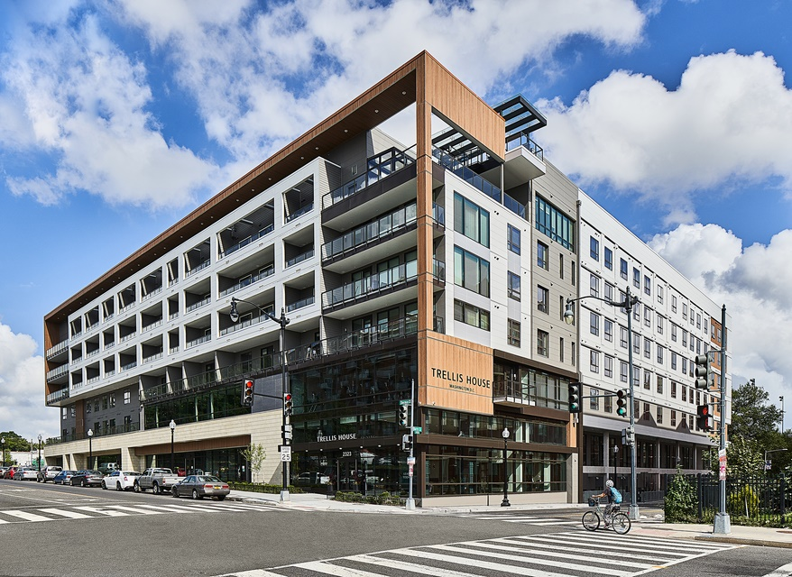
ENERGY PERFORMANCE SPOTLIGHT
Trellis House at 2323 Sherman Avenue NW is the first LEED Platinum Building Design and Construction certification: Multifamily Midrise v2010 project in The District.
The sustainability features include:
21% energy use reduction
30% water use reduction
Installed enhanced fresh air ventilation
Indoor hydroponic garden on sky terrace
85% of construction waste was diverted for recycling
@DOEE_DC
Notes:
The mixed-use housing development’s additional sustainability features include:
Highly efficient plumbing fixtures and fittings (surpassing building code standards by 30%)
Environmentally preferable product choices (low-emitting, locally sourced, high recycled content)
Building policy preventing smoking on site
Radon mitigation measures preventing soil gas accumulation within the building
The 29,000 SF green roof, LED lighting, and high performance HVAC equipment all contributed to the 21% energy use reduction
Resources:
https://www.nilesbolton.com/news/2019/trellis-house-leed-platinum
https://www.usgbc.org/projects/trellis-house
https://www.trellishousedc.com/wp-content/uploads/2018/09/LEED-Project-One-Sheet-Trellis-House.pdf

Slide 17
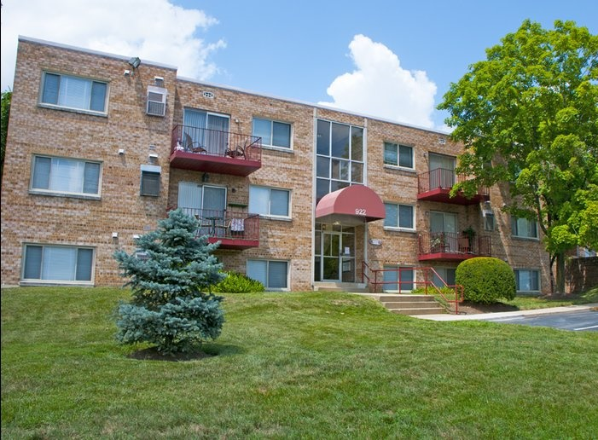
ENERGY PERFORMANCE SPOTLIGHT
Hilltop Apartments at 908 Eastern Avenue NE completed renovation in 2018.
BUILT: mid 1970s
ENERGY STAR Score: 90
2017 Site EUI: 71.8
2017-18 Energy Reduction: 21%
ENERGY UPGRADES:
High efficiency furnaces and HVAC
Balanced ventilation including new fresh air supply in kitchens and bathrooms
High efficiency central domestic water heaters in each building
@DOEE_DC
Notes:
Energy modeling and inspections were conducted throughout the comprehensive renovation. Performance testing was also done to verify air leakage and infiltration. The site’s energy consumption was reduced to meet a specific HERS energy modeling threshold of 85. There are plans to install 224 KW of solar PV. The multifamily building also achieved Enterprise Green Communities certification.
Additional energy efficiency features include:
High performance ENERGY STAR certified windows throughout
New LED light fixtures in every apartment, as well as common areas and exteriors
High efficiency furnaces and central air conditioning (95% AFUE, 16 SEER) as well as thorough duct sealing
Programmable thermostats
ENERGY STAR appliances
Resources:
Contact for more information: Christina McPike, Winn Companies, Director, Energy & Sustainability (cmcpike@winnco.com)

Slide 18
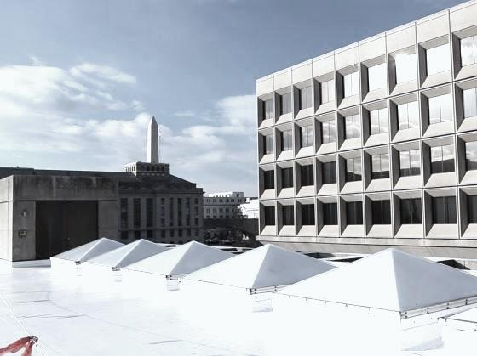
PRIVATE BUILDING PERFORMANCE
ONE GREEN BUILDING ACT EXEMPTION WAS REQUESTED IN 2018 AND DENIED IN PART IN 2019.
One company requested exemption from compliance with the Building Energy Benchmarking Program.
In October 2018 a private company requested an exemption from the Building Energy Benchmarking program due to national security concerns. In February 2019 DOEE denied the request to exempt the company from reporting its data, and required that the entity privately report the data to DOEE. However, DOEE will not publicly disclose the data.
@DOEE_DC
Notes:
The Green Building Act mandates that any exemptions granted to the requirements of the Act be reported. These are reviewed on a case-by-case basis by the Green Building Advisory Council and DOEE staff after proper documentation is provided by the owner or owner’s representative. In 2018 one exemption request was filed.
The District’s green building staff at DOEE and DCRA helps to support projects who must comply with the Green Building Act.

Slide 19
THE GREEN BUILDING FUND
The Green Building Fund supports:
Innovation
15.13 staff positions
Education, training, and outreach
Project seed funding
Resources to overcome barriers in achieving energy efficient buildings
Fiscal Year | Revenues | Expenditures | Fund Balance
2017 | $1,896,147 | $1,892,839 | $1,148,255
2018 | $1,953,422 | $2,086,206 | $1,015,471
Ending Fund Balance = Beginning Fund Balance + Current Year Revenues – Current Expenditures – Any Fund Balance Sweeps
@DOEE_DC
Notes:
The Green Building Fund was created by the Green Building Act as special purpose revenue separate from the General Fund of the District of Columbia. Financed through the financial security and green building fees that were also established by the Act, the Green Building Fund’s purpose is to advance green building in the District.
More specifically, the fund is used for several key purposes:
The staffing and operating costs to provide technical assistance, plan review, inspections, and monitoring for green building projects
Education, training, and outreach to the public and private sectors on green building practices
The research and development of new green building practices and policies
Seed funding for projects that advance sustainability in the District
In FY2018 the Green Building Fund provided the necessary financial support for 15.13 positions at DCRA and DOEE. Through increasing the staffing capacity of DOEE and DCRA for green building, the Fund has allowed the District to successfully implement and enforce the Green Building Act and green building practices.

Slide 20
GREEN BUILDING GRANT PROGRAM
$
 |  |  | Research | Educate | Engage | Innovate | Implement | Total Award
2017 |  | Microgrid Feasibility Study (began in 2016) | X |  |  | X | X | $300,000
 |  | Sustainable Community Planning (began in 2016) |  | X |  | X | X | $237,452
 |  | Historic Building Sustainability Guidelines |  | X |  |  | X | $139,980
 | 2018 | Tools for Deep Green Building in DC |  | X | X | X |  | $100,000
 |  | Climate Ready DC - Resilient Design Guidelines | X | X |  |  | X | $90,000
 |  | Sustainable DC 2.0 - Technical Analysis | X |  |  |  |  | $80,000
 |  | Urban Heat Island Mapping | X | X |  |  |  | $25,000
 |  |  |  |  |  |  |  | $972,432
@DOEE_DC
Notes:
DOEE, in partnership with the DCRA, uses the Green Building Fund to support innovative projects to advance green building in the District through the Green Building Grant program. Projects that receive grants focus on research, education, engagement, innovation, and implementation.
Since 2013, over $2.8 million dollars have been awarded through Green Building Fund Grants. In 2018, 4 new projects were awarded funding. More information about each past project and their outcomes can be found on DOEE’s website.
Resources:
https://doee.dc.gov/node/1144081

Slide 21
Clean Energy DC Plan
Sustainable
DC 2.0
Net Zero Building Codes
Net Zero Carbon Buildings
Building Energy Performance Standards
POLICY MILESTONES
2018
2019
2021
2026
2030
Moves towards net zero emissions for new construction and energy retrofits for existing buildings. Green Bank established.
Updates D.C.’s city-wide sustainability plan to reflect changes in policies, programs and technologies.
Establishes minimum energy performance standards to lower site EUI and help the District meet short and long term climate goals.
Building code updates to require all new buildings achieve net-zero energy use or better.
Pledges that all new buildings will be net-zero carbon by 2030.
@DOEE_DC
Notes:
The District will continue to support innovation in the building sector in order to reduce greenhouse gas emissions and meet the goals laid out in the Sustainable DC, Clean Energy DC, and Climate Ready DC plans.
The Clean Energy DC plan, finalized in 2018, lays out a roadmap for achieving the District’s goal to cut GHG emissions 50% by 2032, while modernizing the city’s energy system. The plan focuses on emissions reductions in buildings, the energy supply, and transportation. Within the building sector, the Clean Energy DC plan focuses on a series of strategies to reduce energy use in both new and existing buildings.
The Clean Energy DC Omnibus Amendment Act, passed by Council in 2018 and signed into law by Mayor Bowser in 2019, incorporates many of the key strategies from the Clean Energy DC Plan. One key component of the Clean Energy DC Act is the establishment of Building Energy Performance Standards (BEPS), which will be rolled out beginning January, 2021. The BEPS will require large buildings that fail to meet a minimum energy performance standard to reduce their energy use within five years. DOEE will work with the building industry over the next two years to develop the program rules and supporting incentives and technical assistance programs.
The Clean Energy DC plan also calls for the implementation of net-zero energy building codes by 2026. These new codes will require that all new buildings achieve net-zero energy use or better. Reaching the District’s goal to eliminate carbon emissions by 2050 will require all new buildings to achieve net-zero energy in the near term, as the buildings built today will exist well into the future.
In 2018 at the landmark Global Climate Action Summit, the District joined 18 global cities in pledging to ensure that all new buildings will meet net-zero carbon standards by 2030 and that all buildings, new and existing, will be net-zero carbon by 2050. The Net-Zero Carbon Buildings Declaration is an additional commitment instituted by C40 Cities to deliver on the goals of the Paris Agreement. Buildings account for roughly 75% of the District’s greenhouse gas emissions so this net-zero carbon pledge is a critical step to drastically reduce building emissions and to meet the city’s 2050 carbon neutrality goal.

Slide 22
BUILDING ENERGY PERFORMANCE STANDARD
1
DOEE must establish a minimum threshold for energy performance – will be “at least” the local median ENERGY STAR score by property type (or equivalent)
2
5-year compliance cycles – 1st cycle begins January 2021
3
Compliance paths for buildings below minimum:
Performance: Reduce energy usage 20%
Prescriptive: Implement cost- effective energy efficiency measures
Other as determined by DOEE
@DOEE_DC
Notes:
The Clean Energy DC Plan includes an action to increase energy efficiency in existing buildings and reduce their reliance on fossil fuels. The Building Energy Performance standards were set forth in Title III of the Clean Energy DC Omnibus Act of 2018. The Act states that, starting in 2021, owners of buildings over 50,000 SF that do not meet a specific energy performance threshold will be required to improve their energy efficiency over a 5-year compliance cycle. The standard will be at least the local median ENERGY STAR score by property type (or equivalent metric). These requirements build upon the success of the District’s Energy Benchmarking program, which has been collecting energy and water performance data on properties over 50,000 square feet since 2013.
Currently, a building owner can request technical assistance and financial incentives from the DC Sustainable Energy Utility (DCSEU). Financing is also available through the DC PACE program and will be available in 2020 from the new DC Green Bank. The Act establishes additional funding for the Sustainable Energy Trust Fund (SETF) that will increase and enhance the efficiency programs offered in the District and the DC Green Bank. With the assistance of partners, DOEE is also supporting the development of a high performance building hub to develop the capacity, training, knowledge, and confidence necessary for building owners to meet their energy efficiency goals.
Resources: https://doee.dc.gov/service/building-energy-performance-standards

Slide 23
BEPS COMPLIANCE CYCLES
Jan 1 2021
Dec 31 2025
Jan 1
2027
Jan 1
2033
2022
1st BEPS Compliance Cycle Begins for Private 50K+ and Public 10K+
1st BEPS Compliance Cycle ENDS for Private 50K+ and Public 10K+
2nd BEPS Compliance Cycle Begins for Private 25K+ and Public 10K+
3rd BEPS Compliance Cycle Begins for Private and Public 10K+
* Standard set every 6 years. Compliance evaluated for a 5-year period.
@DOEE_DC
Notes:
DOEE will establish the first BEPS for privately-owned buildings 50,000 square feet and above and District-owned properties over 10,000 square feet by January 1, 2021.
Privately-owned buildings between 25,000 and 49,999 square feet will be held to the standard starting January 1, 2027.
Privately-owned buildings between 10,000 and 24,999 square feet start on January 1, 2033.
Building owners will be able to choose amongst multiple paths to achieve compliance over a 5-year period: A performance pathway of a 20% decrease in site energy use intensity (energy use per square foot),
A prescriptive pathway of cost-effective energy efficiency measures, or
Other compliance paths established by DOEE.

Slide 24
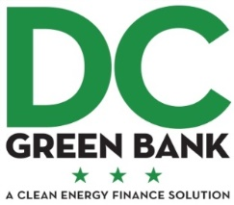
DC GREEN BUILDING INCENTIVES ALIGNMENT
SPECIAL TAX ASSESSMENT
REBATES
CASH-FLOW POSITIVE
PAY FOR PERFORMANCE
REBATES
CREDIT ENHANCEMENTS
GREEN INFRASTRUCTURE
LOANS AND INVESTMENTS
@DOEE_DC
Notes:
DC has resources to help buildings achieve the targets for the Clean Energy DC Act.
PACE
The DC Property Assessed Clean Energy Program (PACE) provides affordable, long –term funding for building upgrades and new construction that reduces utility bills and operating costs. There is zero out-of-pocket expense, and the program provides up to 100% financing for energy and water upgrades with 20 year terms. The funding can be used to finance anything that contributes to efficiency beyond code requirements and has an return on investment. A special assessment is placed on the property taxes, and is paid back over time. Currently the program is available for all project types, except single family residential. Interest rates usually range from 5.5-6%, and the funding is considered off balance sheet financing. Urban Ingenuity is the DC PACE administrator.
DC Sustainable Energy Utility (DCSEU)
The goal of the DC Sustainable Energy Utility Program is to reduce energy consumption in buildings across District. The program does this by administering rebates and providing technical assistance for measures or improvements that provide cost-effective electric or natural gas savings for all building types including institutional, residential, and commercial. For institutional and commercial buildings over 100,000 square feet, a pay for performance incentive is available for energy conservation measures based on pre- and post-project metered data that determines actual energy saved. Funding can be obtained for measures implemented such as upgrading lighting, HVAC and refrigeration equipment, and smart thermostats. Technical assistance offered
River Smart
DOEE’s RiverSmart programs help to reduce stormwater runoff that harms the District’s waterways and the Chesapeake Bay. RiverSmart programs provide financial incentives to help District property owners install green infrastructure such as rain barrels, green roofs, rain gardens, permeable pavers, shade trees, and more. These practices allow rainwater to stay on site and soak into the ground, where natural processes help remove pollutants.
Green Bank
On July 2, 2018, Mayor Bowser signed the District of Columbia Green Finance Authority Establishment Act of 2018, officially making Washington, DC the first city in the United States to establish a green bank.
Specifically, the DC Green Bank aims to:
Attract private capital at a ratio of at least 5 private dollars to every 1 dollar of public investment;
Use bonding authority to increase capacity, accelerate lending, and recapitalize funds;
Become a go-to resource for District residents, small business owners, and commercial developers interested in energy efficiency improvements, clean energy installations, and construction of green infrastructure; and
Be a breakeven entity, where the revenues earned from financing activity cover its operating costs.
Resources:
https://dcpace.com/
https://www.dcseu.com/
https://doee.dc.gov/riversmart
https://dcgreenbank.org/

Slide 25
CONCLUSION
DOEE CONTACT:
Maribeth DeLorenzo
Deputy Director
Urban Sustainability Administration
Email: maribeth.delorenzo@dc.gov
Website: www.doee.dc.gov
DCRA CONTACT:
Michael Brown
Green Plan Review Supervisor
Email: green.building@dc.gov
Website: www.dcra.dc.gov
@DOEE_DC
Notes:
Listed above are the contacts at the two agencies responsible for implementing the Green Building Act.

Slide 26
RESOURCES
DC Sustainable Energy Utility
For more information, visit: https://www.dcseu.com/
DOEE’s Property Assessed Clean Energy (PACE)
For more information, visit: http://doee.dc.gov/service/property-assessed-clean-energy
DOEE’s RiverSmart Program
For more information, visit: http://doee.dc.gov/riversmart
DC Green Bank
For more information, visit: http://dcgreenbank.org
@DOEE_DC
Notes:
Contacts:
DC Sustainable Energy Utility: Giuls Kunkel, Account Manager (gkunkel@dcseu.com)
DOEE’s DC Property Assessed Clean Energy (PACE): Niki Molina, Senior Financial Analyst (nmolina@urbaningenuity.com)
DOEE’s River Smart Communities Program: rs.communities@ dc.gov
DC Green Bank: DCgreenbank@dc.gov

Slide 27
GLOSSARY
Energy Use Intensity (EUI) represents a building’s energy use in terms of its size. It is expressed in energy per square foot per year. A low EUI means a high energy performance, while a high EUI signifies a low energy performance.
Weather-normalized is a process by which data is cleaned. The data is processed to reflect energy use as it would have been if the weather experienced was the 30 year average temperatures. Weather-normalized data is used to eliminate outliers and to ensure that data can be compared.
Site EUI represents the total heat and electricity used by the building. It is a reflection of the energy bought directly for use at a building.
Source EUI represents the total amount of raw fuel that is needed for a building to operate. It is a reflection of the total energy consumed including that from delivery and production losses.
Definitions pulled from EPA’s energy star website
@DOEE_DC
Notes:
This information was pulled from https://www.energystar.gov/buildings/facility-owners-and-managers/existing-buildings/use-portfolio-manager/understand-metrics/what-energy.

