Slide 1
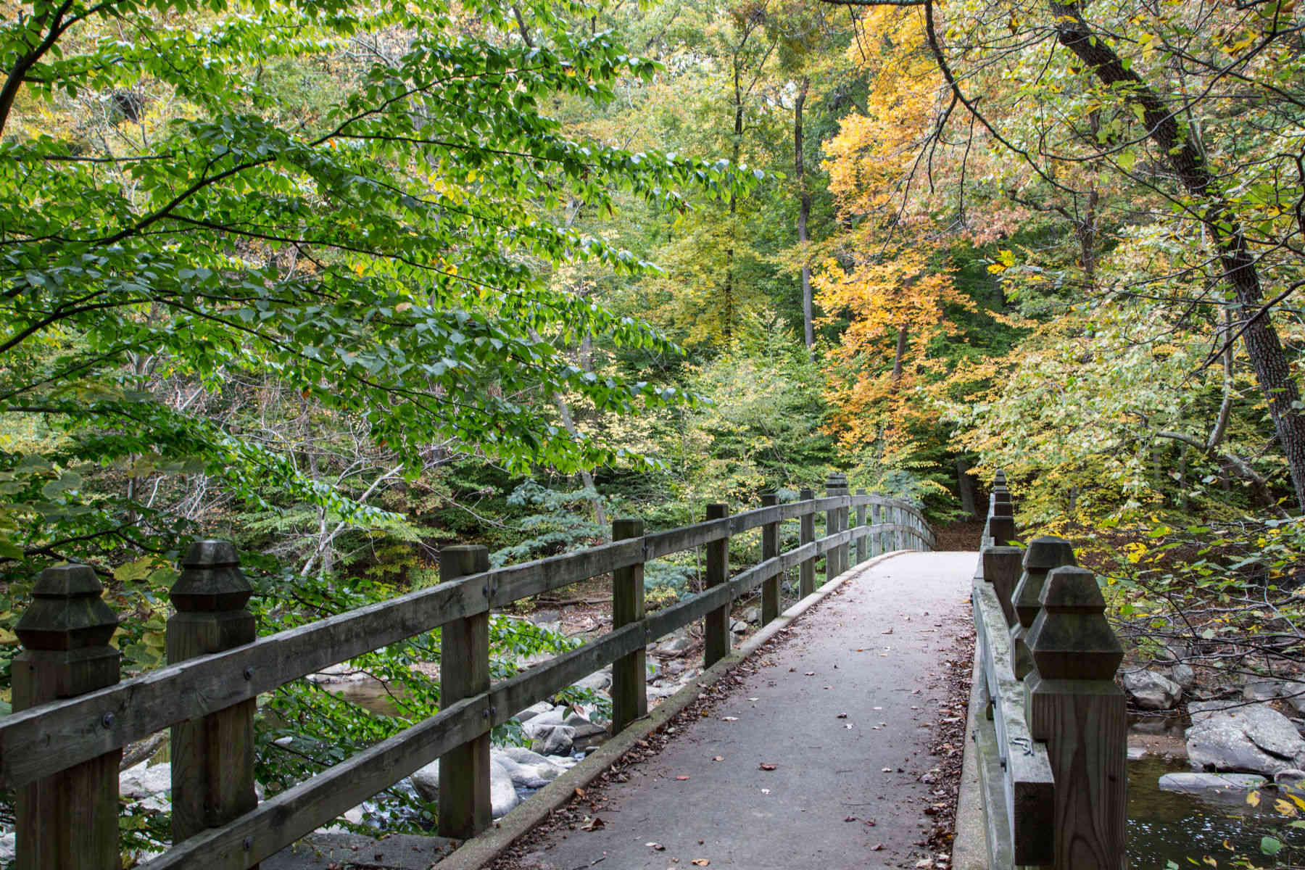
Welcome to The Practice of Biophilia in DC May 22, 2017

Slide 2
AGENDA
University of the District of Columbia
May 22, 2017, Agenda, 4 – 6:30pm
4:00 - 5:00
Biophilic Collaborative: Biophilic DC, DOEE and UDC
Welcome
Dr. Sabine O’Hara, CAUSES, UDC
Director Tommy Wells, Department of Energy and Environment
Background and NonProfit Sector
Stella Tarnay, Biophilic DC
Government Sector Sector
Chris Shaheen, Office of Planning – OP’s Small Park Strategy Plan
Damien Ossi, DOEE – DOEE Wildlife Action Plan

Slide 3
University Sector
Dr. Sabine O’Hara, CAUSES, UDC
5:00 – 6:00
Six Break Out Groups: Healthcare, Architectural Design, Wildlife Biodiversity, DC Residents,
Scientists, Urban Parks
Moderators:
Dwane Jones, UDC
Mary Lynn Wilhere, DOEE
6:00-6:30
Report Out
Conveners give short summary of the group’s ideas, recommendations

