Slide 1
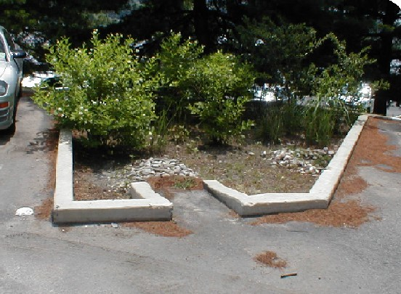
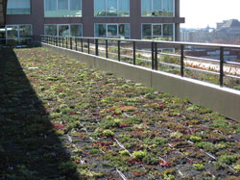
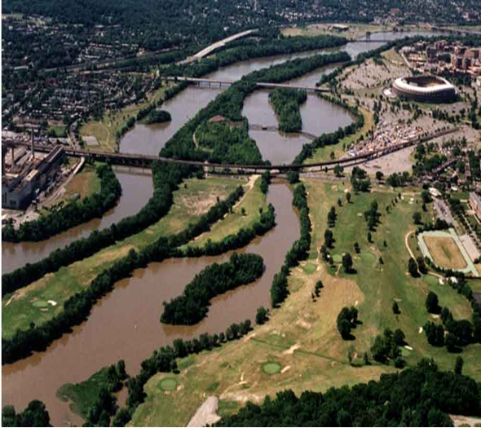
DC Draft Phase II Watershed Implementation Plan Federal Stakeholder Meeting
February 23, 2012
Metropolitan Washington Council Of Governments
Hamid Karimi
Deputy Director Office of Natural Resources
District Department of the Environment

Slide 2
Overview of Draft Phase II WIP
Information submitted by 10 federal agencies!
Partnering approach works to improve water quality and control stormwater runoff
Updated boundary information was provided by agencies
Agencies accepted/acknowledged DDOE assigned target load allocations for N, P, TSS
All deliverable deadlines were met by each agency
Information submitted includes:
Narrative about the agencies
Narratives about proposed actions and goals

Slide 3
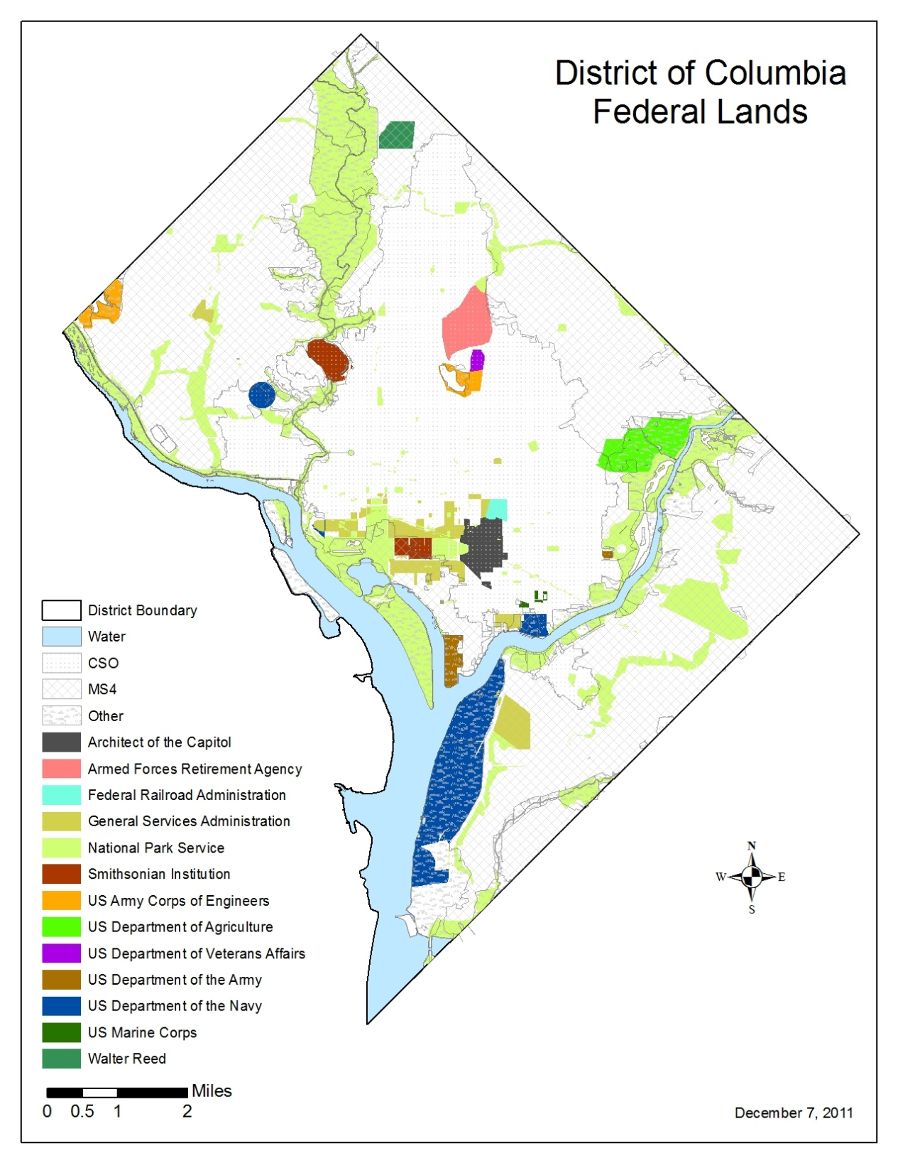

Slide 4
2012-13 Two Year Milestones
Agencies catalogued existing installed BMPs to receive credit towards their load allocation
Practices to be installed through 2013 were submitted by agencies
Long term (programmatic) practices were submitted by agencies
Such as: managing areas as fields, allowing reforestation, removing permeable areas, developing sustainability, pollution prevention and LID policies

Slide 5
Tracking and Reporting
Open communication
Strict observance of reporting periods
Short term goal = Development of a spreadsheet which could be used by all agencies for reporting
Long term goal = Central interactive reporting tool (to be developed by EPA per 7/6/11 two year milestone guidance)

Slide 6
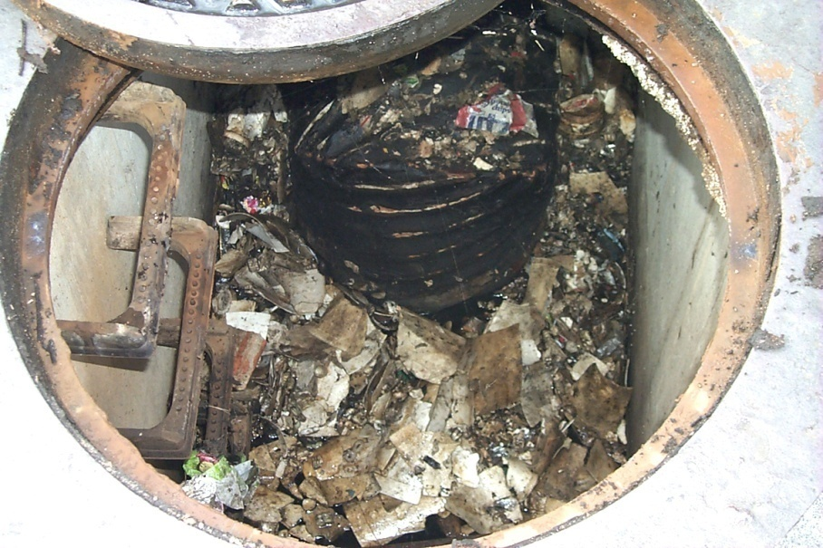
BMP Inspection and Maintenance
All BMPs need to
be inspected and
maintained in order to:
Protect monetary
investment
Ensure performance
DDOE inspects BMPs
submitted through soil
and erosion regulations for installation, completion, and maintenance
Practices that have gone through the DDOE process are on a inspection and maintenance schedule
Action Needed: A main contact from each agency to schedule these ongoing inspections
Notes:
Clogged manhole sand filter

Slide 7
Federal Agency Concerns
Why are the Federal Agencies in a separate input deck than the rest of DC?
This decision was made in order to ensure that the federal agencies are held accountable for their loadings
Federal agencies constitute a large and distinct category
Can federal agencies continue the process of cataloging all of their BMPs and receive credit when the model calibration is redone in 2017?
BMPs installed after 2006 can potentially be included into the Phase 2 WIP and milestones process. It is likely that BMPs dating back to 1985 will be included in the WIP 3 process (2017). BMPs need to be inspected for maintenance and ensure working order
DC Land Area in Acres
DC Total | Federal Agencies Total
39,202 | 9,742

Slide 8
Federal Agency Concerns, cont’d
Why were loads calculated for the CSO area when the stormwater from the area is treated at Blue Plains?
The CSO loading was developed because there are some agencies in the District located wholly in the CSO area, which would give them an unfair advantage of not having to participate in the E.O. 13508, Bay TMDL and DC WIP because their loadings are treated at Blue Plains.
For those agencies with loadings in the MS4 and Other drainage areas we very much encourage all of the resources being used for BMP implementation to be used in the MS4 and Other areas, however any BMPs installed in the CSO area would be considered “leading by example” b/c you are going above and beyond your loading allocation.

Slide 9
Federal Agency Concerns, cont’d
Was land use taken into account when target loads were calculated?
Yes. EPA provided federal loadings calculated by the Bay Model to jurisdictions broken down into land river segments
DDOE then distributed the loading to individual federal facilities in each land river segment based on the facilities’ acreage
In each land river segment, the load for each land use is multiplied by the number of acres of that land use in the land-river-segment

Slide 10
What’s Next?
Final WIP due to EPA March 30th
remaining comments/fixes/additions on Phase II Draft needed by March 14th from all federal agencies
Continue cataloging all existing BMPs
Tracking and Reporting on implementation……
Inspecting and Maintaining existing BMPs
Explore utilizing new and emerging practices and technologies
Two Year Milestones – reporting by partners and the District must be done annually and as requested
Report progress to EPA on December 31st
Thank you for ‘partnering’ to help us all achieve a clean Chesapeake Bay!

Slide 11
Important Links/Contacts
DDOE Chesapeake Bay WIP Page:
http://ddoe.dc.gov/service/total-maximum-daily-load-tmdl-chesapeake-bay
DC Draft Phase II WIP:
http://ddoe.dc.gov/sites/default/files/dc/sites/ddoe/publication/attachments/DC_Chesapeake_Bay_Draft_Phase_2_WIP.pdf
EPA Chesapeake Bay TMDL Page:
http://www.epa.gov/reg3wapd/tmdl/ChesapeakeBay/index.html
DC Contacts:
Diane Davis: diane.davis2@dc.gov
Sarah Sand: sarah.sand@dc.gov

