Slide 1
Developing Final Phase II WIPs and Milestones
Jim Edward
EPA Deputy Director
Chesapeake Bay Program Office
DDOE Meeting with Federal Partners
February 23, 2012

Slide 2
Objectives
TMDL and WIP Process Background
DC Draft Phase II WIPs and Milestones
  Highlights and where we are in the process
  Great cooperation among DC and federal agencies
  EPA’s overall evaluation
Working Toward the Final Phase II WIP
EPA Support
Timeline
Agency and DDOE concerns

Slide 3
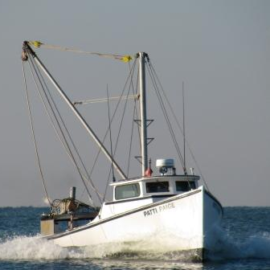
Chesapeake Bay TMDL
A rigorous and historic “pollution diet” to restore clean water to Bay and the region’s streams, creeks and rivers.
Bay TMDL is the most comprehensive roadmap for restoration we have ever had for Chesapeake Bay. Addresses all sectors and major sources of nutrient and sediment pollution.
Why a Chesapeake Bay TMDL?
        Clean water is our obligation to the watershed’s 17 million residents and countless communities.
        Insufficient restoration progress through current voluntary and regulatory measures.
        Required under the Clean Water Act and responds to court orders and legal settlements. Cornerstone of Executive Order Strategy.

Slide 4

TMDL and WIP Development Schedule: 2009 - Ph. II WIP
Major basin
jurisdiction
loading
targets
Final WIP I
November-December 2010
Oct 2009
Final
TMDL
Established
November-December 2009
Bay TMDL Public Meetings
December 2010
Phase II Watershed Implementation Plans: Starting 2011
Provide Local Planning Targets for smaller Watersheds,
Counties,
Federal
Agencies
Draft Phase I Watershed Implementation Plans: November 2009 – Sept.1 2010
Local Program Capacity/Gap Evaluation
2-year
milestones, reporting, modeling, monitoring
July 1 and August 13 Allocations
January 2012: 2012/2013
milestones
Draft TMDL
Sept. 24, 2010
(45 days)
Public
Review
And
Comment
Final Phase II WIP & Milestones -March 30th 2012

Slide 5
Federal Agency Involvement in Phase II WIPs and Milestones
  Overall, significant improvement across the jurisdictions
  Great progress in connecting federal agency coordinators with jurisdiction lead agencies
  DC met the full expectations:
    engaging federal agencies
    providing planning targets
    working directly with the agencies to help them assemble the information needed for WIP and milestone input deck
  EPA and the Federal Facility Team working together with the jurisdictions to collectively fill gaps
  Extensive programmatic federal milestones developed by EPA and other agencies will support jurisdiction WIPs

Slide 6
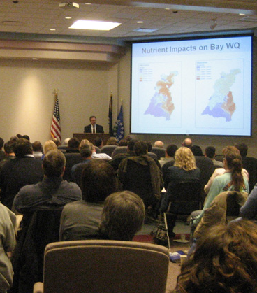
Federal Facilities in DC WIP II and Milestones
In July 2011, DDOE provided federal agencies with proposed planning targets.
Targets based upon updated GIS data layers.
Draft Phase II WIP includes federal agency strategies to meet targets.
Federal agencies submitted two year milestones for 2012-2013 – programmatic and BMPs to DDOE.
Milestones include practices in the ground from 2006 -2012 and upcoming practices through 2013.
Approximately 25 pages of details on federal facilities owned by over a dozen departments or agencies.

Slide 7
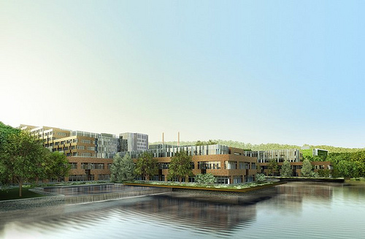
Sample DC Federal Agency Milestone Submissions
General Services Administration
  Install bio-retention at St Elizabeth site to treat stormwater runoff from over 352,000 sq ft (8 acres) of land area.
  Install green roofs at St Elizabeth site to manage over 550,000 sq ft of roof area.
National Park Service
  Install forest buffers as part of reforestation of over 15 acres of park land.
  Install approximately 8 miles of riparian buffer.

Slide 8
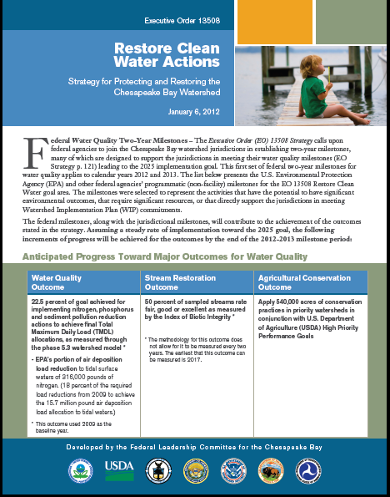
Federal Programmatic Milestones
EPA and other federal agencies’ programmatic (non-facility) milestones for the Restore Clean Water goal area
Final issued 1/6/2012
Quantitative outcomes
  22.5 percent of pollution reduction actions
  50 percent of sampled streams rate fair, good or excellent
  540,000 acres of conservation practices in priority watersheds

Slide 9
EPA Evaluation of DC Draft Phase II WIP
Draft Phase II WIP – Strengths
  On track to meet 2017 and 2025 targets.
  Excellent job engaging federal agencies - specific targets.
  Separate input deck developed thru CAST for federal agencies.
  Strengthens reasonable assurance for stormwater.
  Reflects MS4 permit provisions (e.g. 1.2. retention standard).
  Proposes offsets program through retention credits.
Draft Phase II WIP – Areas for Improvement
  Resolve inconsistencies between input decks for WIPs and milestones.
  Mention the Stormwater MOU among EPA and other federal agencies to implement EISA and address retrofits on existing developed land.

Slide 10
EPA Evaluation of DC 2012-2013 Milestones
2012-2013 Milestones - Strengths
  Federal agency input decks included specific BMPs to be implemented in 2012-2013 period.
  Input decks include practices previously not reported to Bay Program.
2012-2013 Milestones – Areas for Improvement
  Add milestones to finalize stormwater regulations and stormwater guidebook.
  Consider adding milestones to reflect specific MS4 permit and draft Phase WIP commitments (e.g. retrofit).
  Add milestone to have fully effective offsets program in place by December 2013 for growth sectors.

Slide 11
Priorities for Completing Final Phase II WIPs
Federal Agency Review of DC Phase II WIP
  Are your agency’s properties reflected?
  Do you have an understanding of expected pollution reduction targets?
  Have you provided data to the jurisdiction about previously unreported BMPs (post 1/1/2006)?
  Have you provided data to the jurisdiction regarding planned additional BMPs during 2012/2013, or provided a description of steps that will be taken leading to future additional BMPs?
DDOE
  Input decks - resolve any outstanding issues.
  Tracking /Reporting – identify steps that will be taken to develop tracking system in close coordination with EPA and other federal agencies.
  Include plan for developing an Offset Program by 2013.

Slide 12
Status of Key Stormwater Milestones
DC MS4 permit is being contested by 2 different groups – alternative dispute resolution including DDOE-EPA-appellants.
DC will continue to move forward implementing provisions of the permit.
EPA-DOD making progress on developing MOU to implement EISA Section 438.
Initial discussion included EPA-DOD –being expanded to include all federal agencies.
On February 14th, several agencies participated in a technical session to discuss current agency efforts related to the EISA 438 retention standard.

Slide 13
Future Federal Milestones
EPA understands the difficulty projecting future practices given budgets, etc.
Federal and state partners (including Governors/DC Mayor) agreed to 2 year milestones.
Expect continual progress and full accounting of planned BMPs in 2014/2015 milestones for all Bay jurisdictions; DC and its federal partners got this done for 2012/2013.
Through adaptive management agencies can make adjustments to 2 year milestones as conditions change.

Slide 14
EPA Phase II Support for Federal Facilities
EPA will work with all jurisdictions and the Federal Facility Team to address:
  Information gaps in WIP II
  Training needs (stormwater, reporting)
  EISA 438 workshop for Federal agencies
  Design of reporting and tracking system
  Identification of cost effective BMPs and sharing information on success stories
  BMP maintenance and ongoing verification

Slide 15
Timeline for Finalizing Phase II WIP
Final DC WIP due by March 30, 2012.
Late February DC and EPA working to resolve inconsistencies between input decks, WIP and milestones.
Changes/modifications to DC and federal agency input decks should be submitted to EPA by 1st week in March to assure timely results from model evaluations.
Federal-focused meetings as needed; Federal Facilities Team meets biweekly.

Slide 16
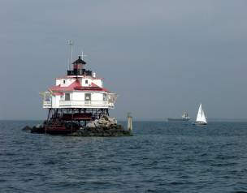
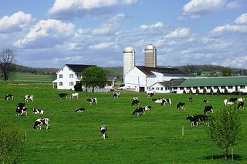

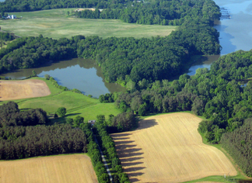
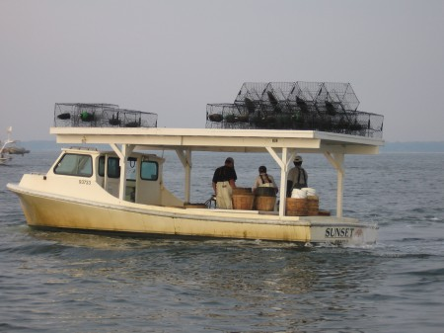
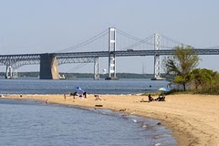
QUESTIONS
edward.james@epa.gov, (410) 267-5705
antos.katherine@epa.gov, (410) 295-1358
allen.greg@epa.gov, (410) 267-5746
www.epa.gov/chesapeakebaytmdl

