Slide 1
Department of Energy and Environment Green Zone Environmental Program (GZEP) 2016
http://doee.dc.gov/summer https://www.facebook.com/DOEE.GZEP

Slide 2
Larissa Etwaroo, Acting Program Coordinator
Program Assistant to the Coordinator
Payroll/Office Assistant
(Site 1, 2, 3, 4)
Payroll/Office Assistant
(Site 5, 6, 7)
Senior Field Manager
Ward Managers (Site 1, 2, and 3)
Site Managers
Team Leaders
Ward Manager (Sites 1, 2 & 3)
Ward Manager (Sites 4 & 5)
DOEE-GZEP Management Team:
Talisha Pitt, Michelle Dee, & Ben Stutz
Site Managers
Team Leaders
Ward Manager (Sites 6 and 7)
Site Managers
Team Leaders
Team Leaders
Site Managers
Warehouse Manager

Slide 3
GZEP 2016 Overview
Program Details
Space
Six weeks – June 27 to Aug 5
9:00 a.m. to 3:30 p.m.
2 days inside – 3 days outdoors
Sites 1-6, 14 to 21 year olds, 50 participants and 6 staff per site
14-15 9am-1:30pm
16-21 9am-2:30pm
Site 7, 22 to 24 year olds, 25-30 participants and 4 staff
22-24 9am-3:30pm
DCPS High and Middle Schools
One large classroom (with no desktop computers on-site)
Access to restroom facilities.
Cafeteria space for eligible GZEP participants.
In-room A/V, or access to A/V for PowerPoint presentations.
Storage room or adjacent classroom to store outdoor work equipment.
Additional on-site security provided by DCPS.
Separate entrance/exit door located in or near the classroom (if possible).

Slide 4
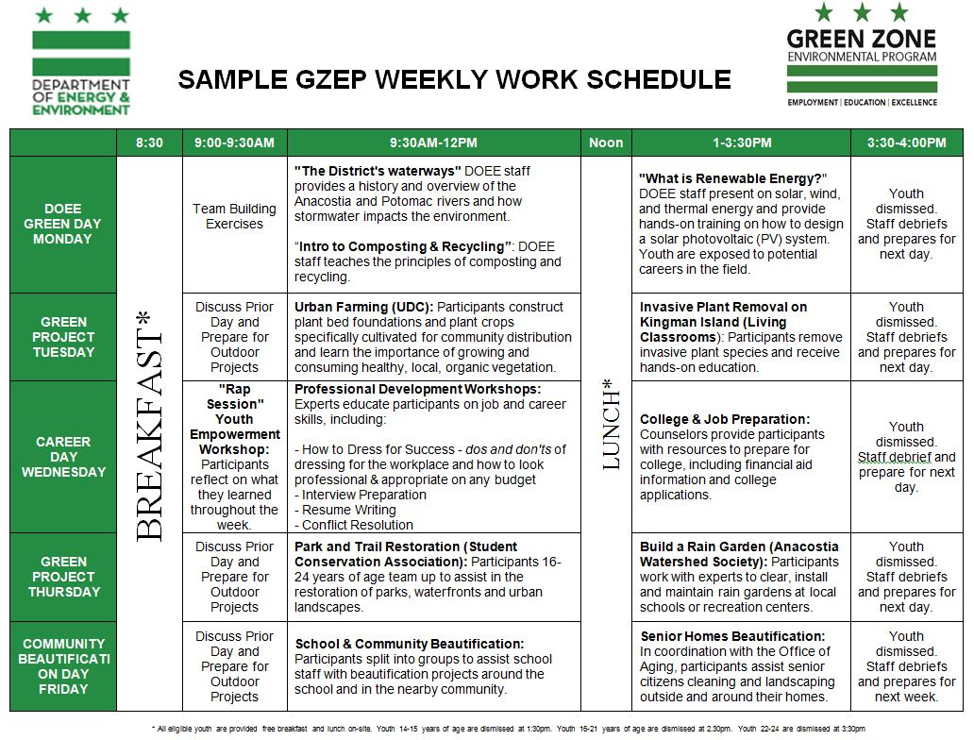
***2015***

Slide 5
In 2015, DOEE staff taught and evaluated courses each week to GZEP participants…
# | Courses Taught
1 | Introduction to District Wildlife and Habitat
2 | LID, Construction and Stormwater
3 | Watershed Trailer and Storm Drain Markers
4 | Introduction Watershed and Clean Up
5 | Water Quality Pollutants
6 | Introduction to Conservation
7 | DC Energy Systems
8 | Building Energy Benchmarking
9 | Solar & Renewables
10 | Introduction to Air Quality
11 | Recycling, Hazards, Waste, Composting
12 | Pesticides
13 | Lead Education and Enforcement
14 | Healthy Homes Program and Public Health
15 | Sustainability101
QUESTION | RESPONSE
This course was beneficial to my education | 1 | 5 |  | 10
This course helped me learn about jobs in the fields of energy and the environment | 1 | 5 |  | 10
The course activities were interesting | 1 | 5 |  | 10
This course helped increase my understanding of environmental issues | 1 | 5 |  | 10
This course should be taught next year | YES |  |  |  | NO
This course was… | Exciting |  | Boring |  | Just OK
The one thing I remember most from this course was…

Slide 6
Based on the courses we conducted an educational review…

Slide 7
GZEP 2016 – Draft Summer Schedule (22-24 years old site – 9am to 3:30pm Daily)
Monday | Tuesday | Wednesday | Thursday | Friday
27 Orientation | 28 DOEE Classes | 29 | 30 | 1
4 HOLIDAY | 5 Career Day | 6 | 7 | 8
11 Career Day | 12 DOEE Classes | 13 | 14 | 15
18 Career Day | 19 DOEE Classes | 20 Tour DC Water | 21 | 22
25 Career Day | 26 DOEE Classes | 27 | 28 | 29
1 Career Day | 2 DOEE Classes | 3 | 4 School Clean Up | 5 Closing Event
15 open dates for outdoor training and installation
5 days of DOEE classes that can be replaced with indoor solar education and training
Proposals can mix and match these days based on their schedule and project logistics

