Slide 1
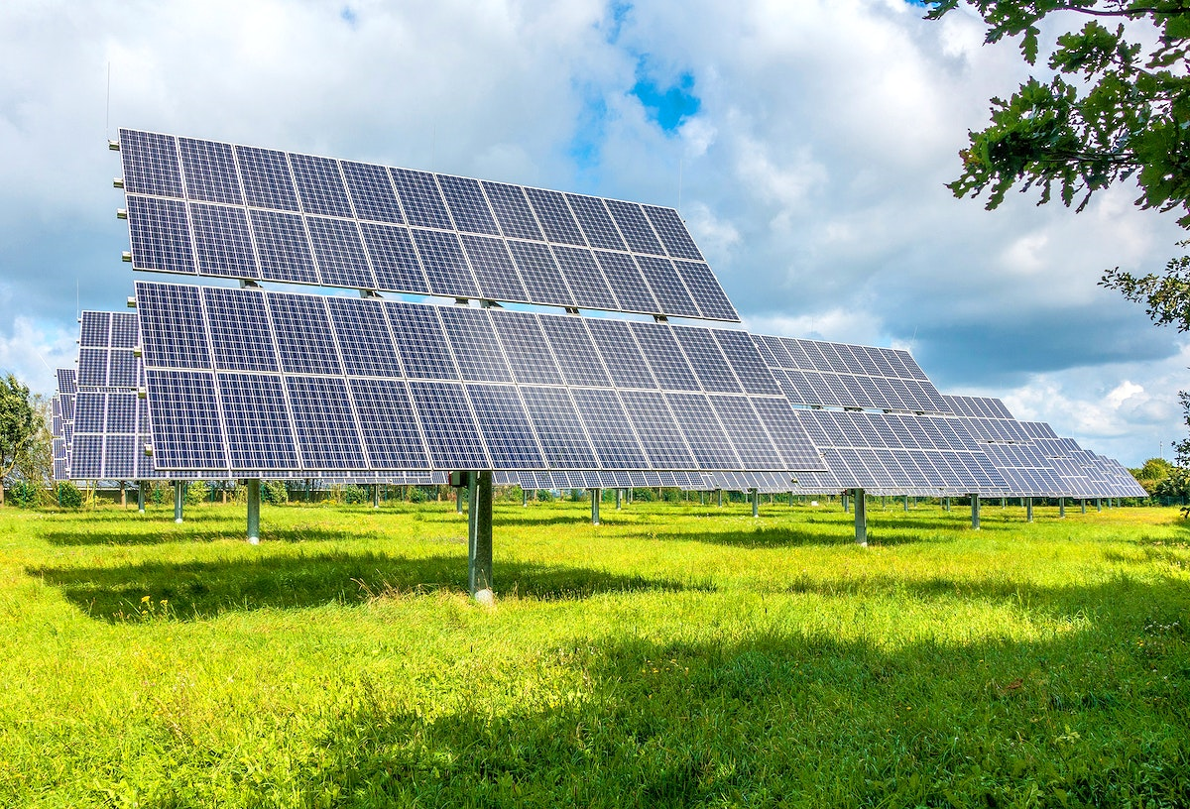


Greenhouse Gas Reduction Fund
DOEE Request for Partners
Information Session
TAG THIS PRESENTATION @DOEE_DC

Slide 2

Goals
Address the needs of current and future Solar for All participants and increase the number of low-income and disadvantaged residents receiving Solar for All benefits.
Increase solar capacity in the District, particularly through increased partnerships with real estate investors/developers and large, existing commercial properties and by performing the upgrades, including roof repair/replacement and energy efficiency upgrades, to enable the installation of solar systems.
Develop solutions to program challenges and identify solutions that DOEE can employ to establish the most effective, predictable and stable program.
@DOEE_DC

Slide 3
Use of Funds
GGRF funds can be used for both residential rooftop and community solar projects, associated storage technologies, and enabling upgrades (like energy efficiency, roof and structural repairs, updated electrical panels, etc.) provided they are directly connected to a solar and/or storage system.
DOEE request to the GGRF Solar for All Competition:
$270 Million
Partners: $100K - $100M
Performance Period: 5 years
Include letters of support in application
@DOEE_DC

Slide 4
Project Areas
Management of Community Renewable Energy Facility (CREF), rooftop solar and battery storage projects, including the request for proposal process from solar developers; contract negotiation with solar developers; contract management; permitting and inspections; and project design, implementation, and evaluation.
Provision of enabling upgrades for solar and/or storage including roof repair, electrical panel upgrades, and energy efficiency improvements and upgrades.
Community solar subscriber and CREF data management
Community outreach and education and consumer protection
Financial models and programs to mobilize distributed solar projects
Technical assistance (research, market analysis and monitoring, project siting, interconnection coordination)
Utility coordination and utility-side infrastructure to support public-facing installations
Green workforce training and development
Site hosts for solar and storage projects
@DOEE_DC

Slide 5
Federal Requirements/Preferences
Environmental justice and equity must be addressed. DOEE's application will be in alignment with the Biden-Harris Administration’s Justice40 Initiative. Meaningful benefits should be provided to LMI households.
Grantees expending US EPA funds must adhere to the requirements of law for those expenditures, such as the Buy America Sourcing requirements under the Build America, Buy America (BABA) provisions of the Infrastructure Investment and Jobs Act (IIJA) (P.L. 117-58 §§ 70911-70917) that apply when using federal funds for the purchase of goods, products, and materials on any form of construction, alteration, maintenance, or repair of infrastructure in the United States. The Buy America preference requirement applies to all the iron and steel, manufactured products, and construction materials used for the infrastructure project under an award for identified EPA financial assistance funding programs.
@DOEE_DC

Slide 6
Federal Requirements/Preferences
EPA’s Notice of Funding Opportunity (NOFO) speaks to the need to train residents from underserved communities for local, green jobs that are in line with the U.S. Department of Labor and U.S. Department of Commerce’s Good Jobs Principles, with prevailing wages, strong benefits, and safe working conditions.
The EPA will give preference to applications that include community ownership models of solar systems.
@DOEE_DC

Slide 7
Questions?
RFP DUE August 29 by 11:59pm
Email: 2023GGRFpartners.grants@dc.gov
@DOEE_DC

